Slide 1
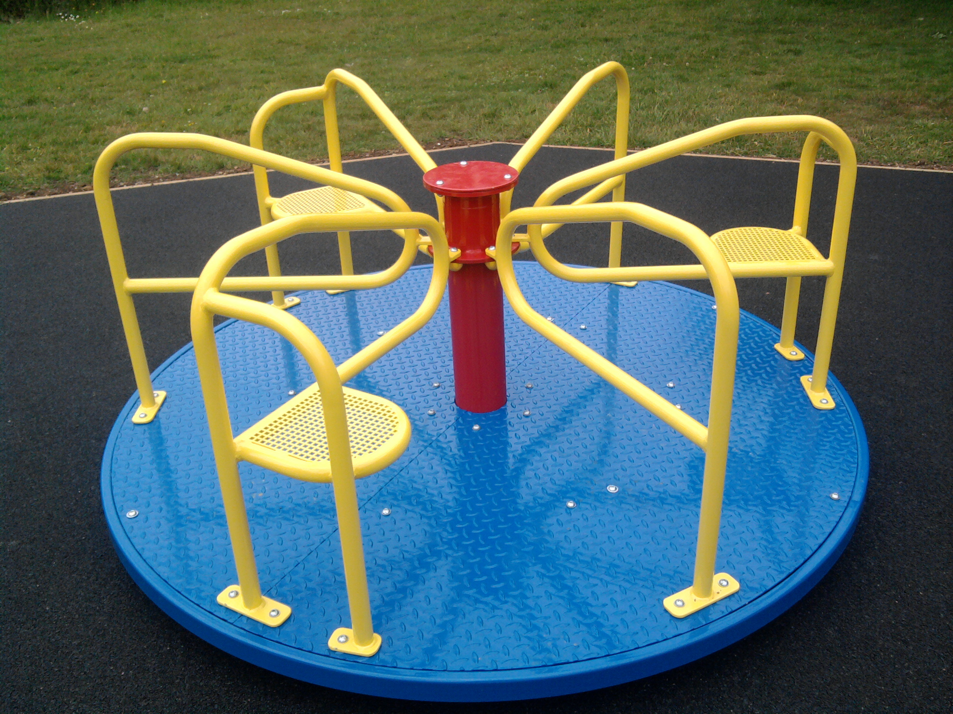
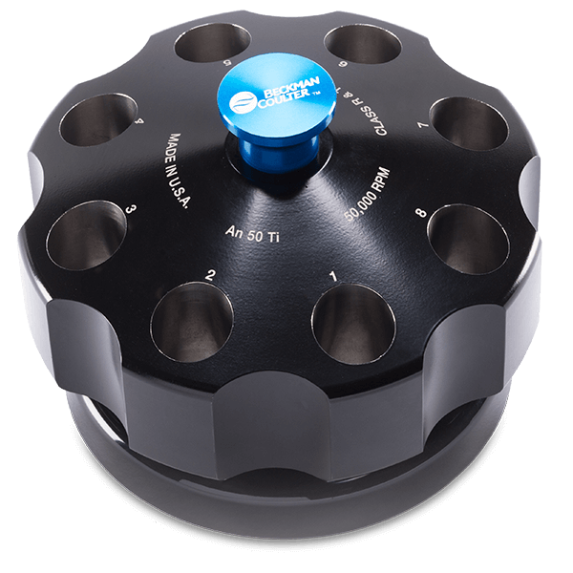
Sedimentation Velocity- Analytical Ultracentrifugation
Dana Kennedy
Al-Sady Lab Workshop
August 18, 2022
Notes:
go over what the technique is, basic principles, and how to analyze the data

Slide 2
Sedimentation Velocity-Analytical Ultracentrifugation: Background
Quantitative technique looking at how macromolecules behave in solution: gain insight on protein mass, shape, and conformational changes of protein complexes
36K RPM- high rotor speed (can go up to 60K) under vaccum
Watch how protein in moving in solution in real time: throwing the protein outward through centripetal force and measuring the rate of sedimentation
Informative by the terms Sedimentation coefficient (s), frictional ratio (shape), and estimate of MW
Notes:
An advantage of Analytical Ultracentrifugation experiments is that you gain quantitative information about the molecule or protein of interest in solution. For example, using structural analysis of cryo-EM, gives structural snap shots of flash frozen proteins or macromolecules. But this is in real time, in solution
An example I found helpful to visualize what’s happening Is Lets say we are standing in a swimming pool. If you take your fist and you move it through the pool, it’s going to travel relatively easily. If I do the same thing with my hand extended, and apply the same force, it’s going to move more slowly because of drag or friction. And it’s no different for when we spin a protein or macromolecule in a centrifuge if you have a protein that is spherical, like a fist, or a protein that is much more elongated, and non-globular which is affected by drag, and therefore affects its sedimentation behavior.
Gives robust structural information in solution in real time. (Andrew Herr example).
Note SE-AUC: can determine MW, oligomeric state, equilibrium assembly constants (such as association constants). But for today we will just focus on SV-AUC

Slide 3
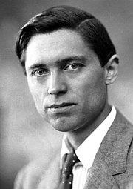
The foundation of Analytical Ultracentrifugation
Svedberg and associates built the first ultracentrifuge in 1924
Won the 1926 Nobel Prize in Chemistry for work on disperse (“colloidal”) systems which supported Brown and Einstein’s theory of Brownian Motion
Experiments included in the prize were the first ultracentrifuge “sedimentation- diffusion” experiments that suggested concepts of
Tertiary structure- Purified egg albumin is homogenous with MW of 34000 g/mol.
Quaternary structure- Hemoglobin data was consistent with multi-subunit complexes
Laid the groundwork for AUC, and for studying macromolecular transport techniques that we use today to resolve protein size, shape, weight, density and charge effect
Theodor Svedberg, PhD
August 30, 1884- February 25, 1971
Notes:
So a more current example of the power sv-auc is a paper that helped lay the foundation of my project..

Slide 4
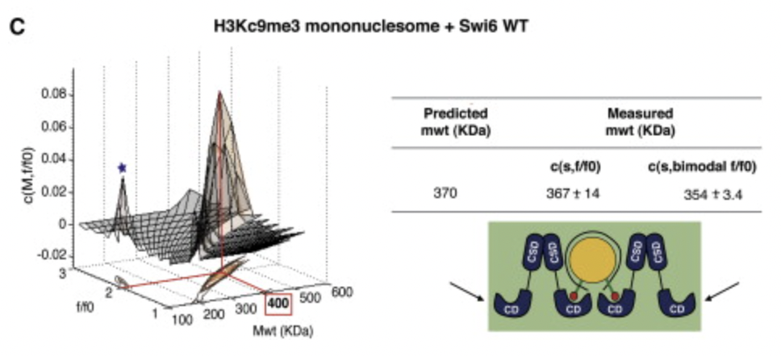
SV-AUC is powerful for defining the masses of single to multiprotein complexes, as well as shape differences
2011: A major gap in our field was identifying how many molecules of Swi6 (HP1) interact with the nucleosome.
“sticky ends” to bind
neighboring nucleosome
stoichiometry of four WT Swi6 proteins to one core nucleosome
Canzio et al. 2011 Mol. Cell.
Notes:
And then in 2013…

Slide 5
SV-AUC is powerful for defining the masses of single to multiprotein complexes, as well as shape differences
2013: How does Swi6 self associate?
2022: How does phosphorylation of Swi6 regulate the protein’s ability to form higher order oligomers?
Does phosphorylation break or further promote oligomerization?
Canzio et al. 2013 Nature
Notes:
And then in 2013 Daniele also used SV-AUC among other techniques to probe how does Swi6 Self associate? And that is through three binding modes.

Slide 6
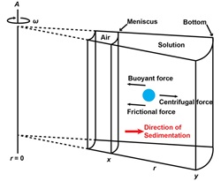
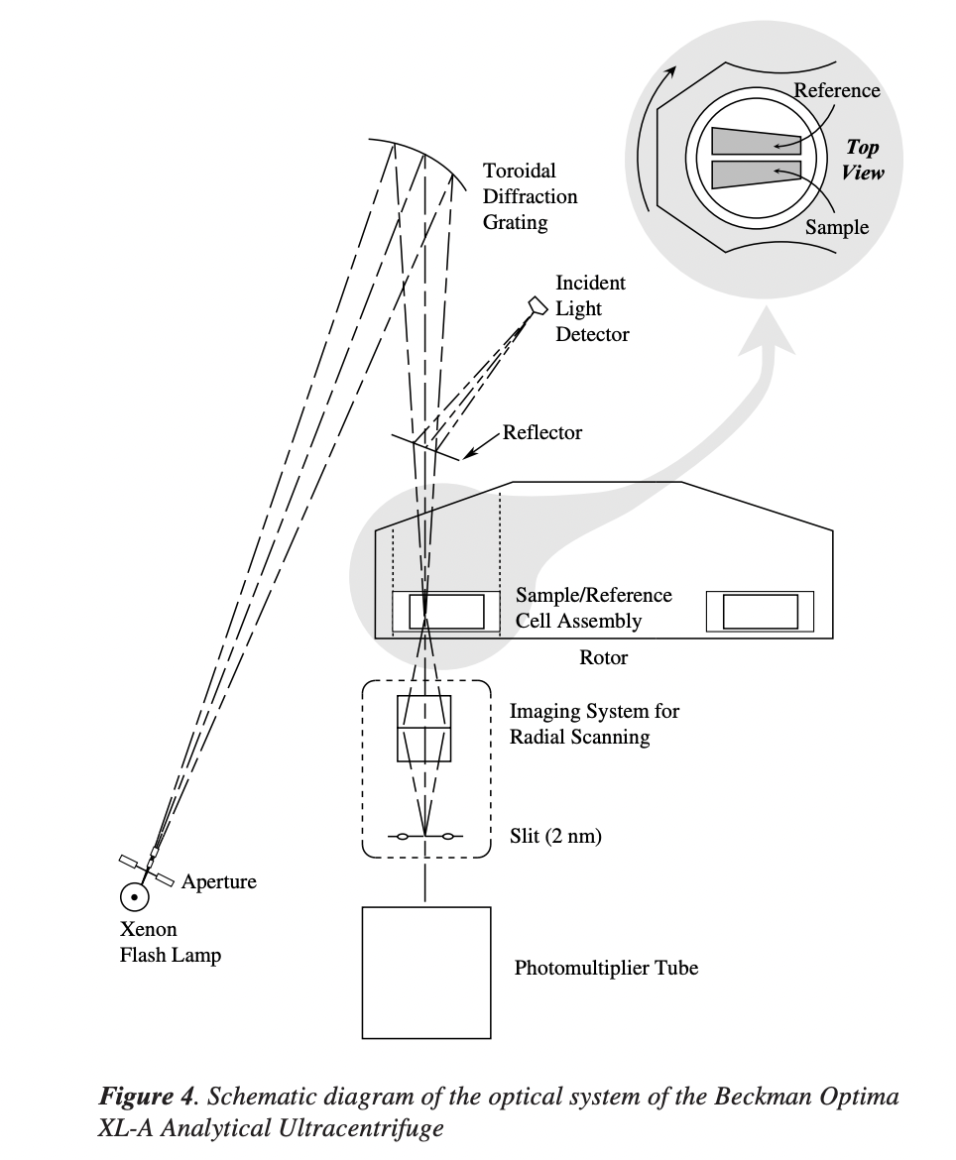
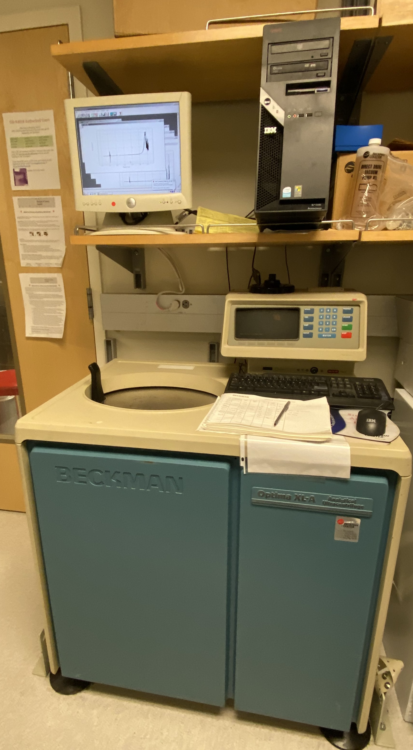
Instrumentation: Ingredients for collecting data
Beer’s law:
A = εcl
Beckman
Notes:
Xenon flash lamp light source and the set up is out typical UV-vis spectrophotometer.
The light bounces off the Diffraction grating, which selects the wavelength, the light shines through the sample to the imaging system, and finally hits the photomultiplier tube which amplifies the detected signal.
We use beer’s law to make sure we are using a protein concentration that is between about OD .1 and 1
Can detect up to three wavelengths so usually 280, 250, and 230 for proteins

Slide 7
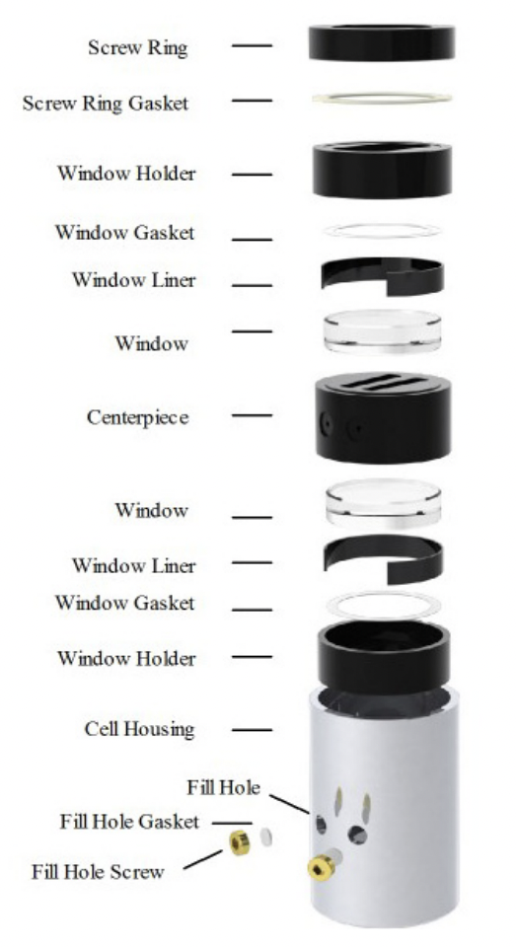
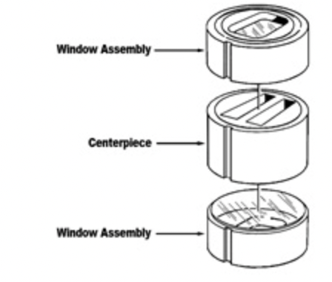
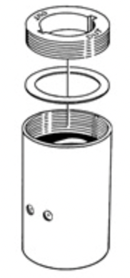
Instrumentation: Ingredients for collecting data
Beckman, Spin Analytical
Notes:
So here on the left I am showing you all of the sample cell components. They comprise 3 key parts. The top and bottom window and the centerpiece that are placed in the cell housing. After all of these components are placed in the cell housing, you apply a force called torque to tighten and seal these pieces together. And you actually load the protein and buffer blank into the centerpiece in these two holes, which are sealed with screws.

Slide 8
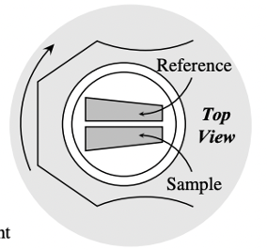
Instrumentation: Ingredients for collecting data
❌
✅
Beckman, Spin Analytical
Notes:
I want to note that the sample cells are not rectangular like we may be used to seeing. Instead, they are sector shaped.
In an SV-AUC experiment, we’re looking at the rate of the molecule moving in solution.
The centripetal force is acting on the protein radially. Meaning from the center of the rotor outward. So, the sector shape is actually aligned with the centripetal field.
It also prevents convection. If molecules were pushed by the centripetal force toward the lateral walls of the cell, they could concentrate there to such a degree that they would form a solution whose density exceeded that of the surrounding.
Lastly I want to note that there are three forces acting on the molecules. Centripetal force in the same direction of sedimentation, which are counteracted by the Buoyant force and frictional force. And these will come up again in equations we will discuss in a bit.
Now that we’ve gone over instrumentation, lets go over example data
For people’s future reference:
If molecules were pushed by this force toward the lateral walls of the cell, they could concentrate there to such a degree that they would form a solution whose density exceeded that of the surrounding medium. In this case the molecules that accumulated near the lateral walls could then move to the bottom of the cell (by convection) at rates much faster than would a single, isolated molecule in the bulk solution. We would then not be observing the sedimentation of individual molecules in the bulk solution, which is what we want to study, and the s-values determined would be useless for molecular-weight determination.
https://www.mcgill.ca/biochemistry/files/biochemistry/404_silvius_15.pdf

Slide 9
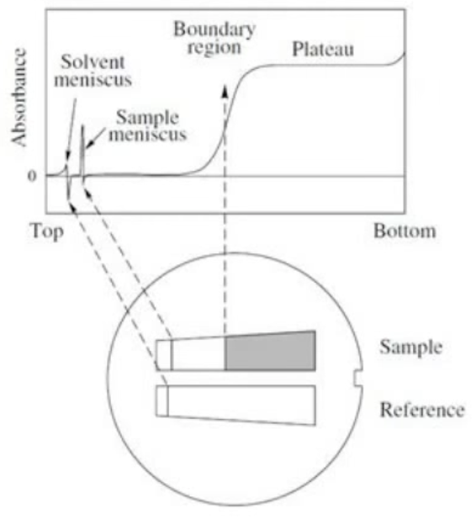
Example data
Each line on the graph represents a wavelength scan. As the protein reaches the bottom of the cell, the wavelength will flatten over time. This distribution over time allows us to calculate diffusion coefficient, Sed. Coefficient, shape, and MW
Centripetal force is counteracted by buoyant and diffusion forces
Notes:
Our axes for SV-AUC data are absorbance on the y axis and radius on the x axis.
What we observe on the curve are some artifacts
The first optical artifact are the Solvent Meniscus and sample meniscus from the top of the samples
The second optical artifact is the protein crashed into the back of the cell and that’s where you see this spike from the bottom of the cell, and it’s called “clearing the meniscus”
In the center of the wavelength scan we see a plateau, which over time will get lower and lower. As the protein moves outward, its going into a wider and wider region of the sector, so it appears like a dilution effect.
On the right I’ll play a video of what the data looks like as wavelength scans are generated over time.
Which now we are going to review a few important equations which encompasses these terms

Slide 10
The Lamm equation
Diffusion
Sedimentation
Notes:
The first is the Lamm equation. I am not going to go over the derivation of the equation, because it is quite complex. But the two values we quantify in an SV-AUC experiment are the diffusion coefficient and the sedimentation coefficient.
Numerous software for analyzing AUC data have the Lamm equation built in.
Diffusion coefficient defines the ”spread of the boundary”. The boundary region is the transition of cleared buffer and protein. It describes the randomness or Brownian motion of the particle or protein.
Sedimentation coefficient describing the rate of movement of the protein.
I just want to note the importance for the equation relating both diffusion and sedimentation of the protein of interest. And once we define S and D we can further define Molecular weight..

Slide 11
The Svedberg equation relates Sedimentation coefficient and the Molar Mass (and diffusion)
The Svedberg Equation
s = $\frac{M(1−\overline{v}p)}{f}$
s= sedimentation coefficient in Svedbergs (10⁻¹³ seconds)
M= molar mass
f= frictional ratio (shape)
p= buffer density
= partial specific volume of protein
Notes:
The second equation to note is the Svedberg equation which relates the sedimentation coefficient and the Molar Mass.
The terms of the svedberg equation are…
The svedberg equation shows us that the sedimentation coefficient (s), is proportional to the mass. This makes sense, because a particle that’s very large is going to sediment at a faster rate.
The larger the protein, the larger the sedimentation coefficient will be.
It is also important to note that the frictional coefficient (f) is inversely proportional to the sedimentation coefficient.
The frictional coefficient is highly dependent of mass. It is the term we relate to the shape of the protein, and encompasses the drag the protein or macromolecule experiences in solution.
Further we can relate Stoke’s law and even stoke’s radius into the Svedberg equation to pull out our diffusion coefficient (D).

Slide 12
The Svedberg equation relates Sedimentation coefficient and the Molar Mass (and diffusion)
The Svedberg Equation
Stoke’s Law
s = $\frac{M(1−\overline{v}p)}{f}$
f= $\frac{RT}{D}$
s= sedimentation coefficient in Svedbergs (10⁻¹³ seconds)
M= molar mass
f= frictional ratio (shape)
p= buffer density
= partial specific volume of protein
Notes:
Further we can relate Stoke’s law and even stoke’s radius into the Svedberg equation to pull out our diffusion coefficient (D).
Those are the few key equations I want to note. So, Now we are going to switch gears and walk through a brief data analysis tutorial.

Slide 13
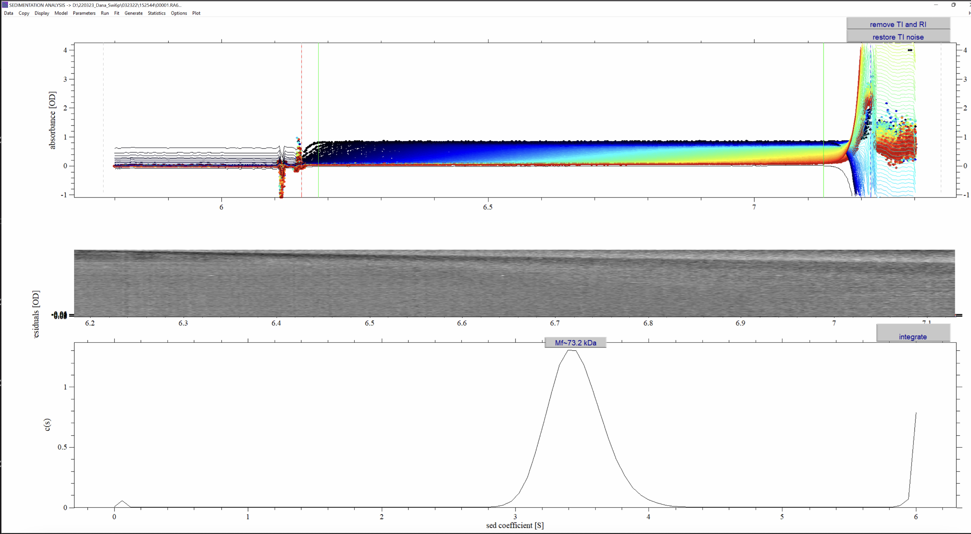
Using WayBack Machine & SEDFIT to analyze SV-AUC Data
Today’s Example: 10 µM wtSwi6
Notes:
When you analyze the data you use two things, 1. "Way Back Machine" which just an archive of lost websites, this one being the SV-AUC data analysis tutorial. And 2. SEDFIT which is the software with the built-in equations to solve for our sedimentation coefficient and molecular weight

Slide 14
Using WayBack Machine & SEDFIT to analyze SV-AUC Data
Types of analysis:
c(s) analysis: (SEDFIT) variant of the Lamm distribution, characterizes homogeneity
Van Holde-Wescht: useful for multiple species
systems
dc/dt: Don’t know what is in your system, will
tell you if have a single species of multiple species
Today’s Example: 10 µM wtSwi6
Notes:
I want to note there are many types of analyses, all of which have limitations and advantages. The one I use is the c(s) distribution in the SEDFIT program developed by Peter Schuck at the NIH. It is a variant of the Lamm distribution equation and is used to characterize homogeneity. So in today's example we are going to look at previous data I collected on 10 uM wtSwi6. First we load the data...
(used data from 3/23/2022Note SE-AUC: can determine MW, oligomeric state, equilibrium assembly constants (such as association constants). It is slower, rotor speed and typically days.

Slide 15
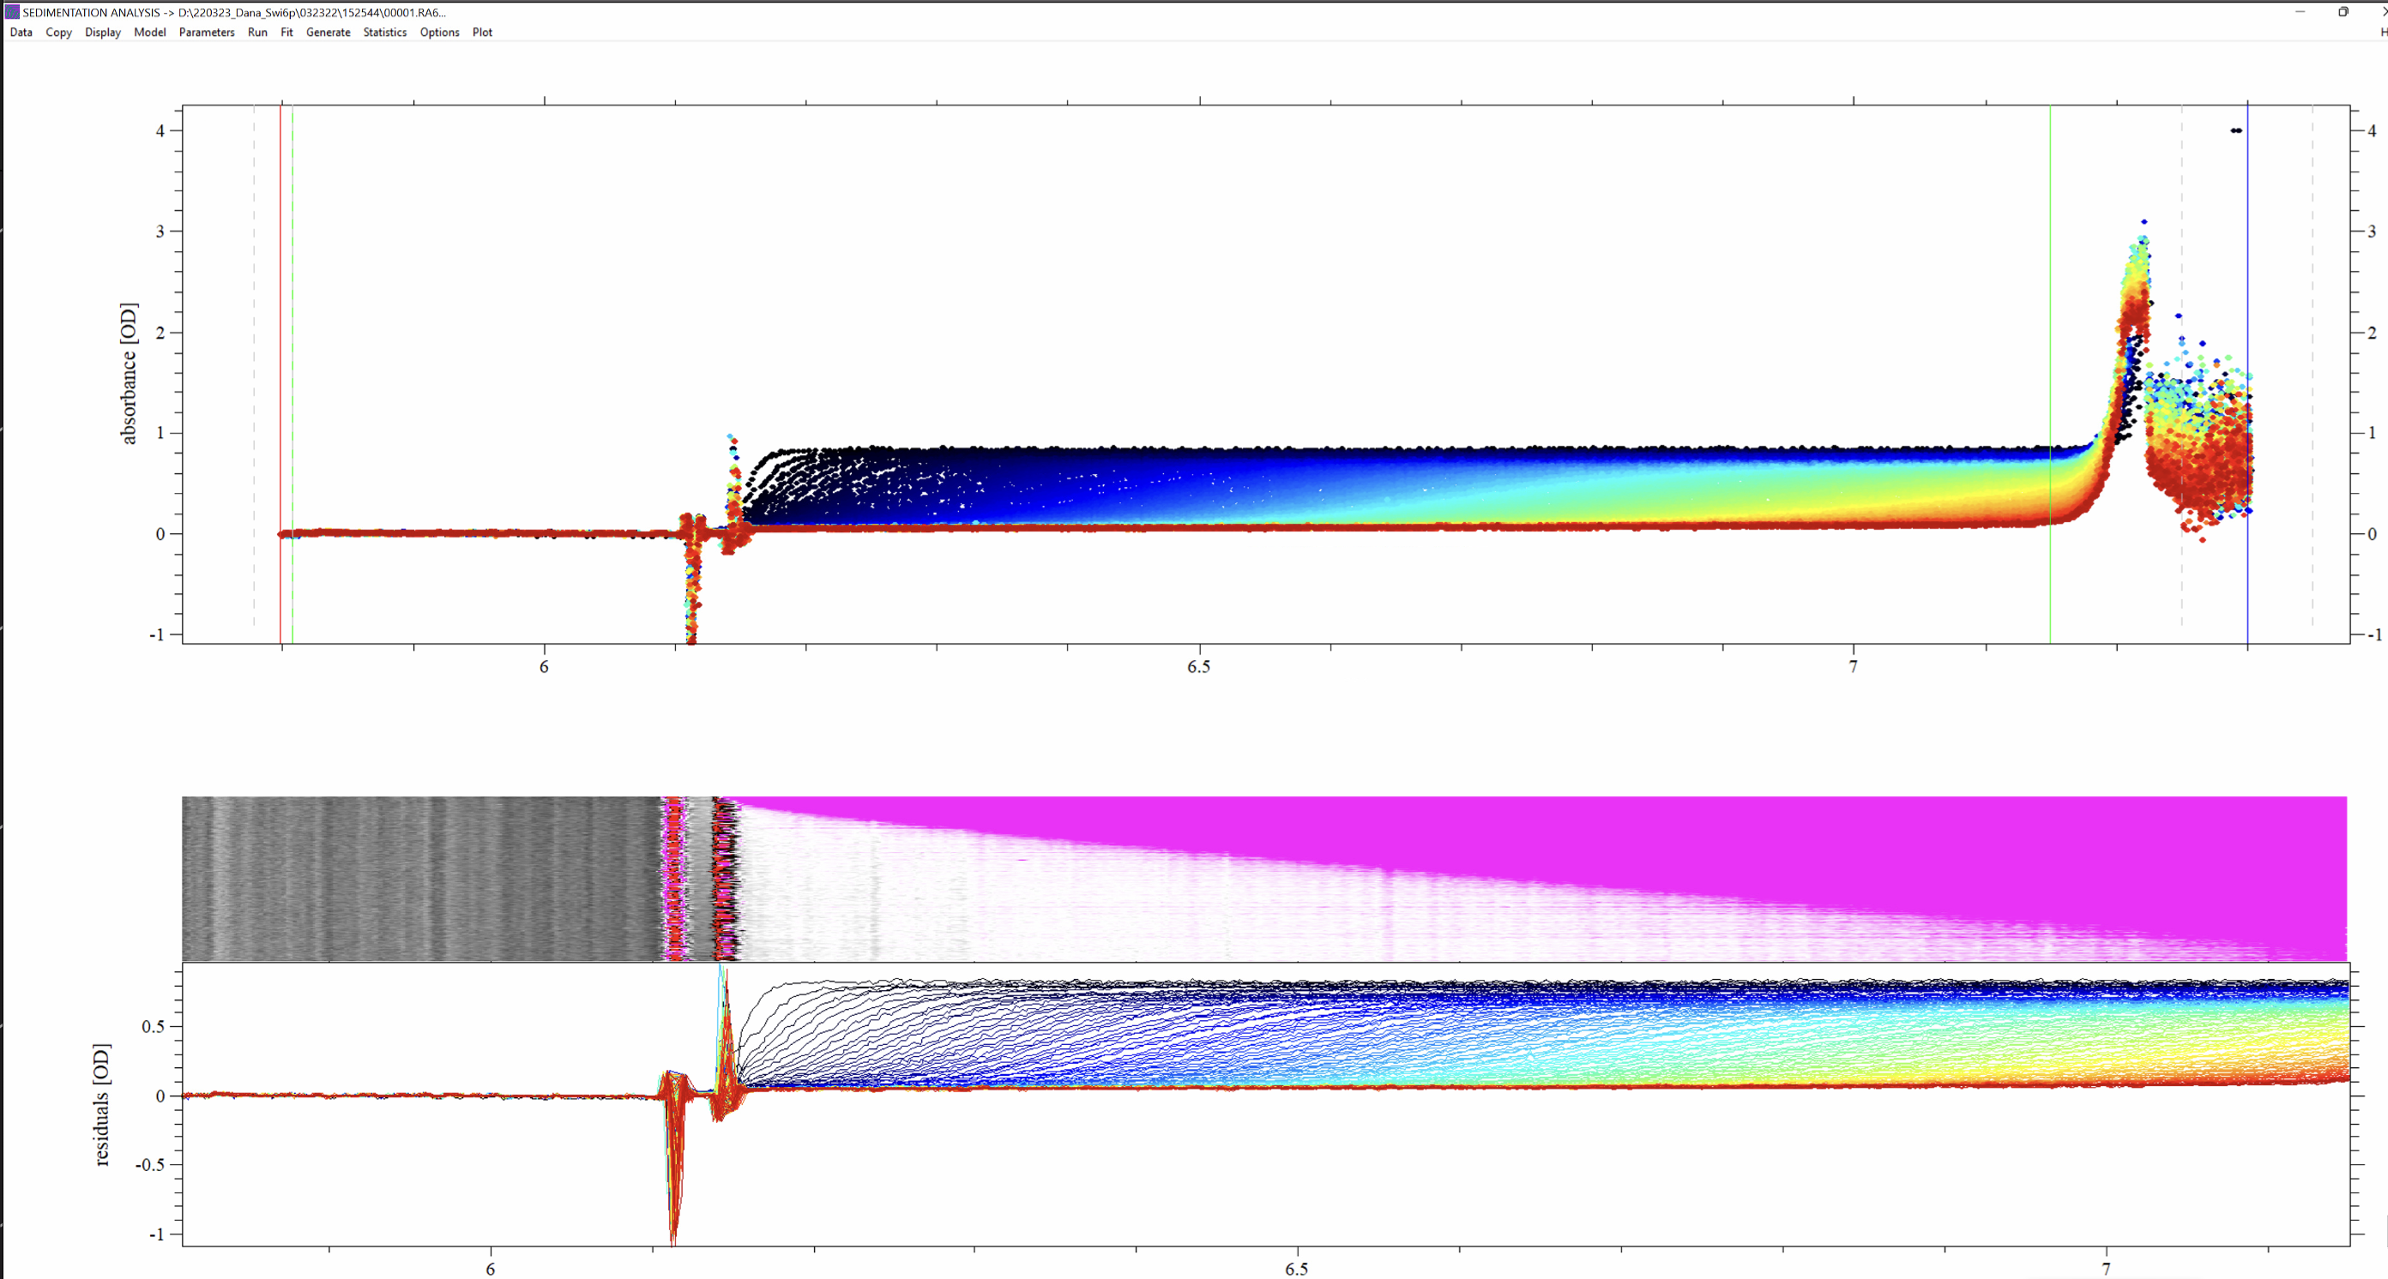
Loading the Data and preparing for analysis
Notes:
This is the loaded data files in SEDFIT. On the Y axis we have absorbance, on the X axis we have the radius in centimeters.
On the bottom we have residuals. Residuals show deviations between data and model we are fitting the data to. As we can see here without fitting the data to any equation or modifying the parameters, the residuals are poor. You want to see this box turn grey in color. Which we will start to work on..

Slide 16
Loading the Data and preparing for analysis
Notes:
What we need to do first is define the bottom, meniscus, and the outer and inner fitting limits.
meniscus, the red line, the bottom is the black line, and the outer and inner fitting limits are the green lines, so this is the region we are going to fit .

Slide 17
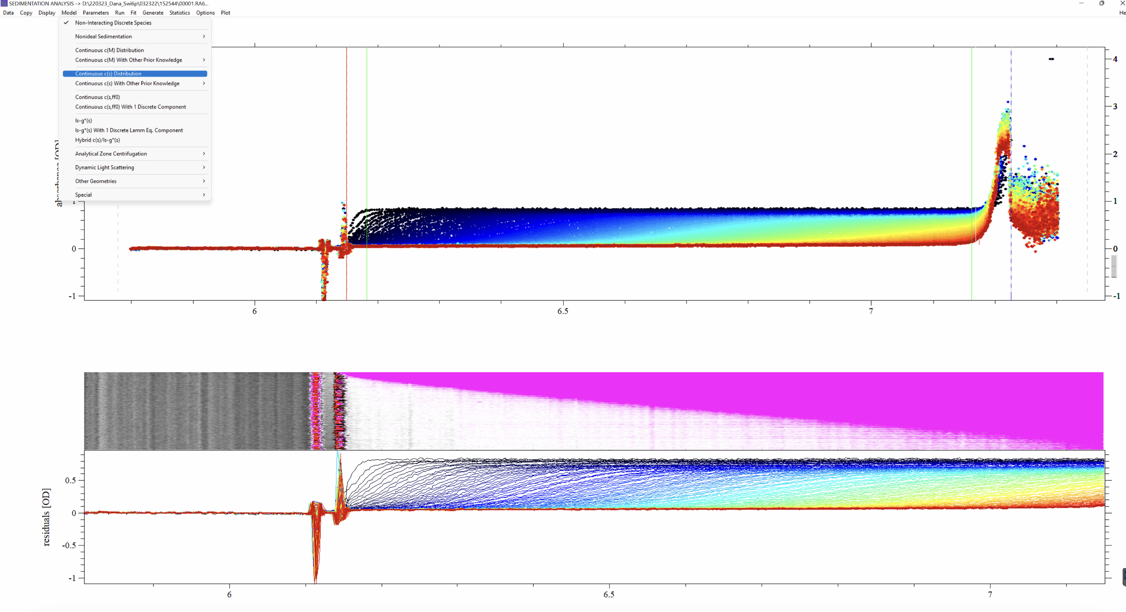
Selecting the model and setting initial values for the parameters
Notes:
Next, we select our model, which is the Continuous c(s) Distribution

Slide 18
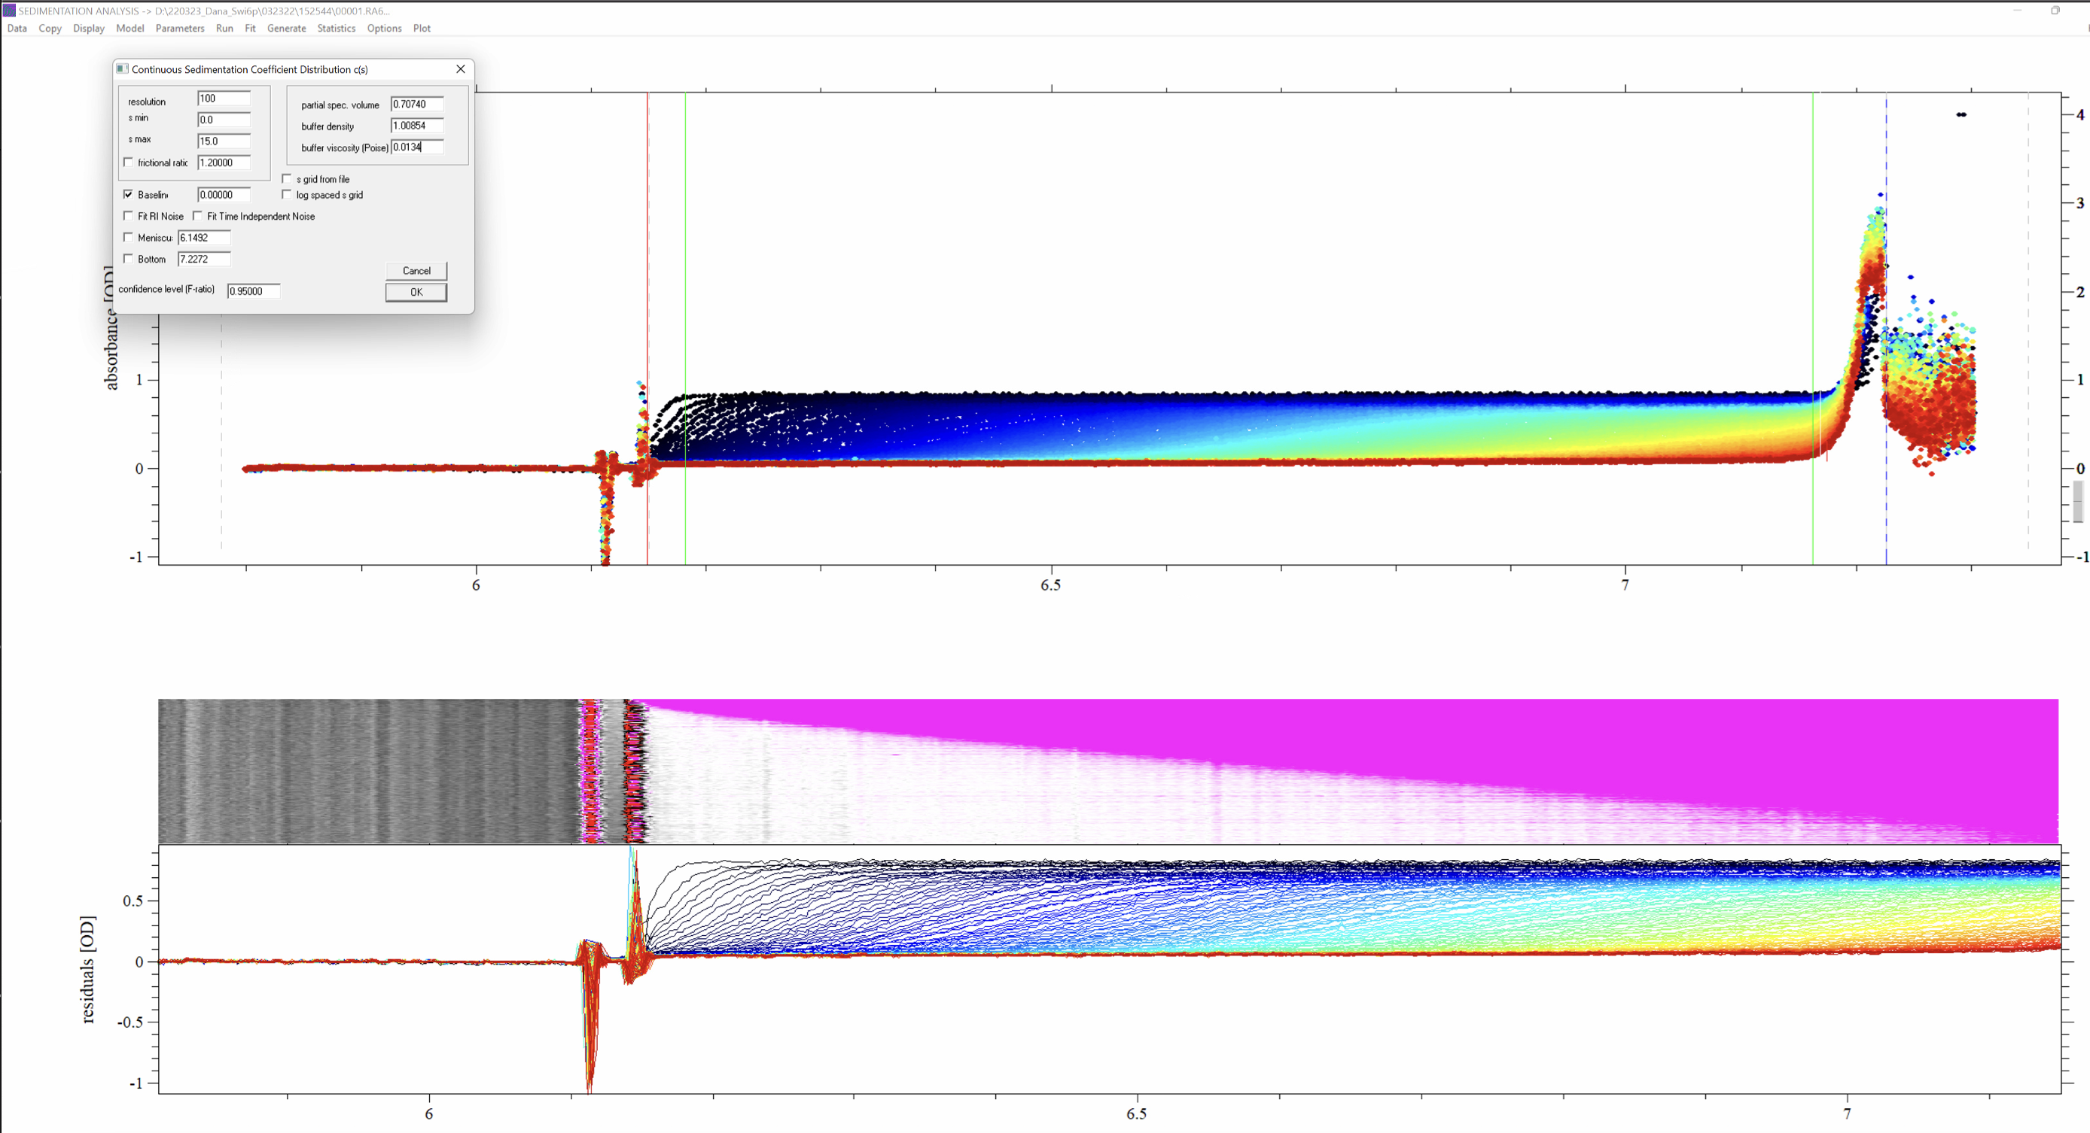
Selecting the model and setting initial values for the parameters
p
Notes:
Now we need to define some parameters. The sedimentation coefficient minimum is 0 and s max I usually start off setting to 15 or so to encompass higher order oligomers. We also need to set the v-bar, the partial specific volume of protein and buffer density, which are fixed values for our protein, and I am using predefined values for wtSwi6.
After setting the parameters, we hit “run”

Slide 19
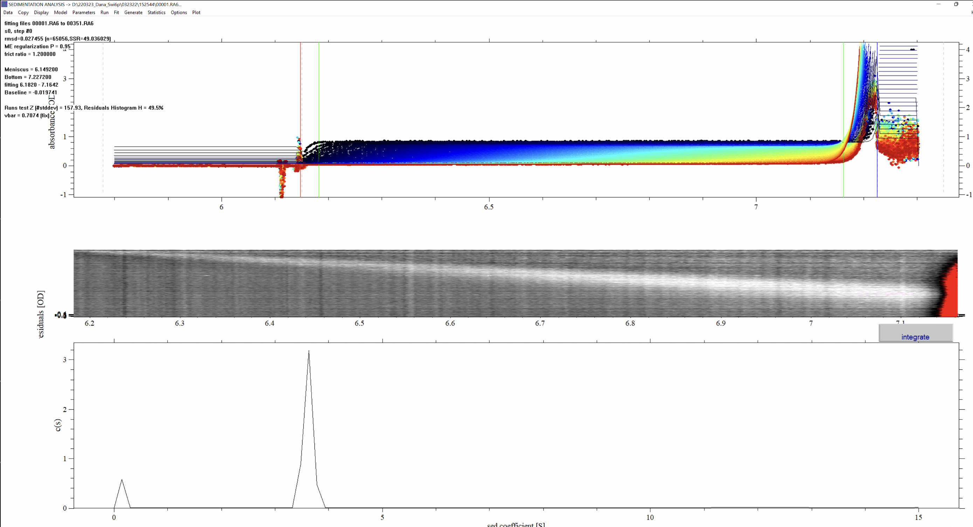
Selecting the model and setting initial values for the parameters
Notes:
If we execute the Run command we will calculate the first coarse or raw c(s) distribution. We can now see our first indication of a protein with a sedimentation coefficient of ~4. And we can see the residuals are a bit off, so I can modify the boundaries and hit run again..

Slide 20
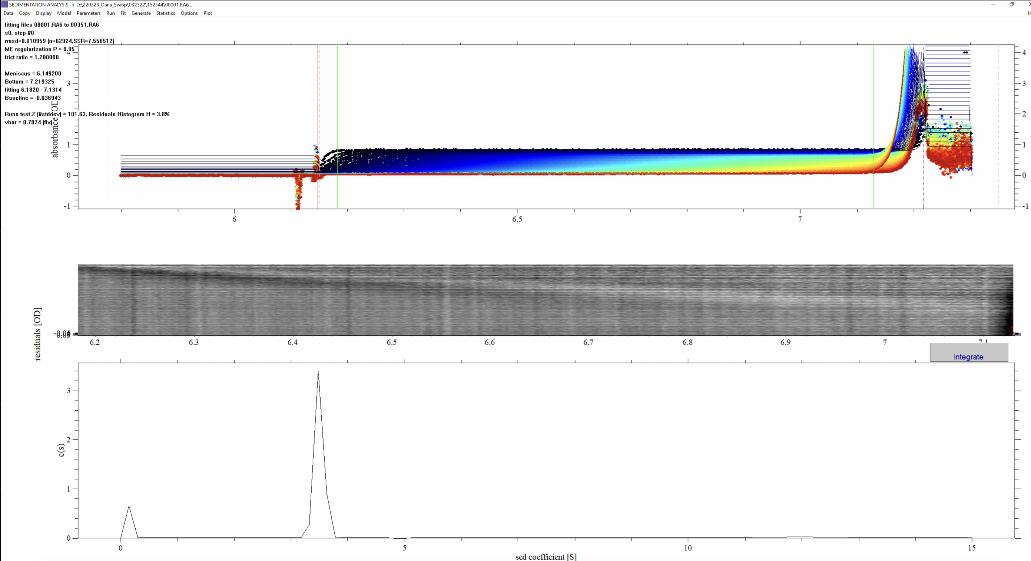
Selecting the model and setting initial values for the parameters
Notes:
And we can see the residuals got slightly better. Next..

Slide 21
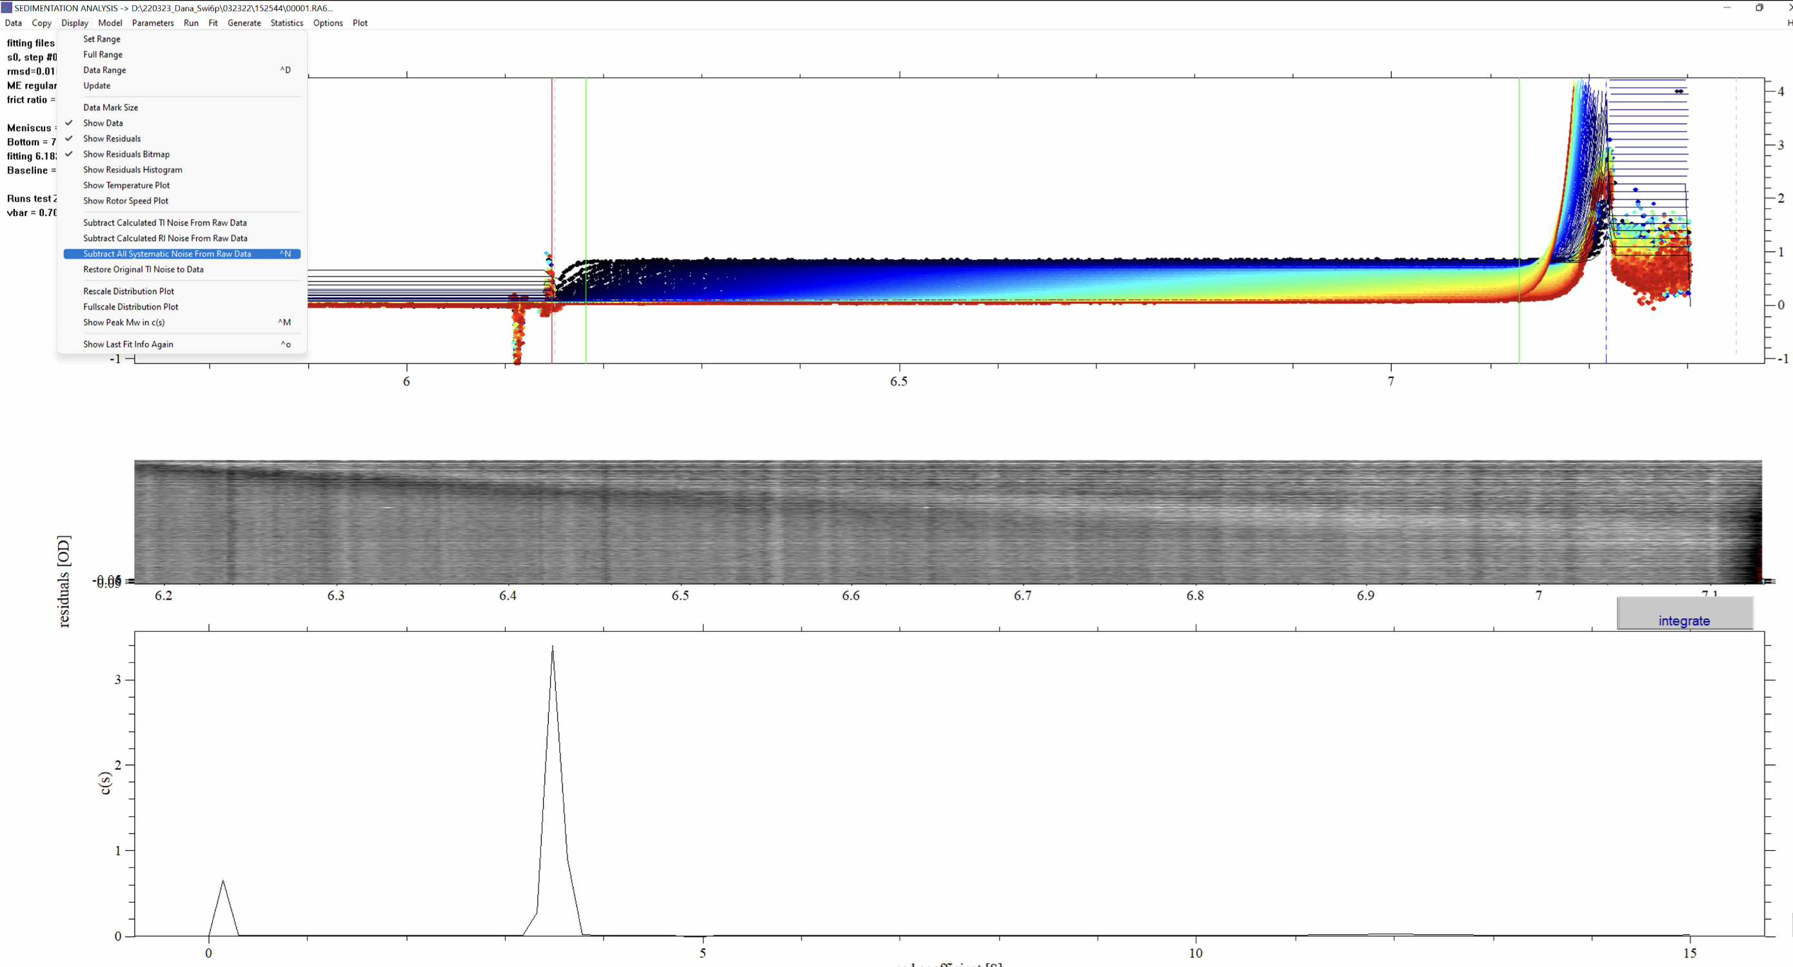
Selecting the model and setting initial values for the parameters
Notes:
Next we can remove systematic noise in an unbiased way but clicking this button

Slide 22
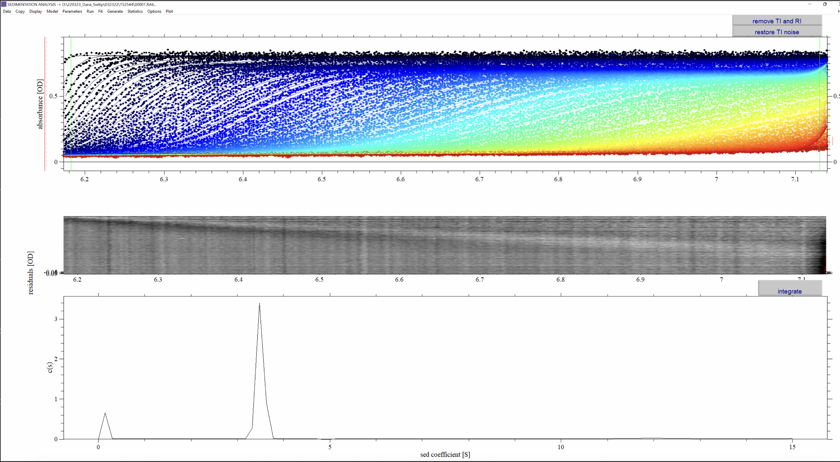
Selecting the model and setting initial values for the parameters
Notes:
Although this fit looks already promising, it is still very coarse and must be refined in order to allow a meaningful interpretation.

Slide 23
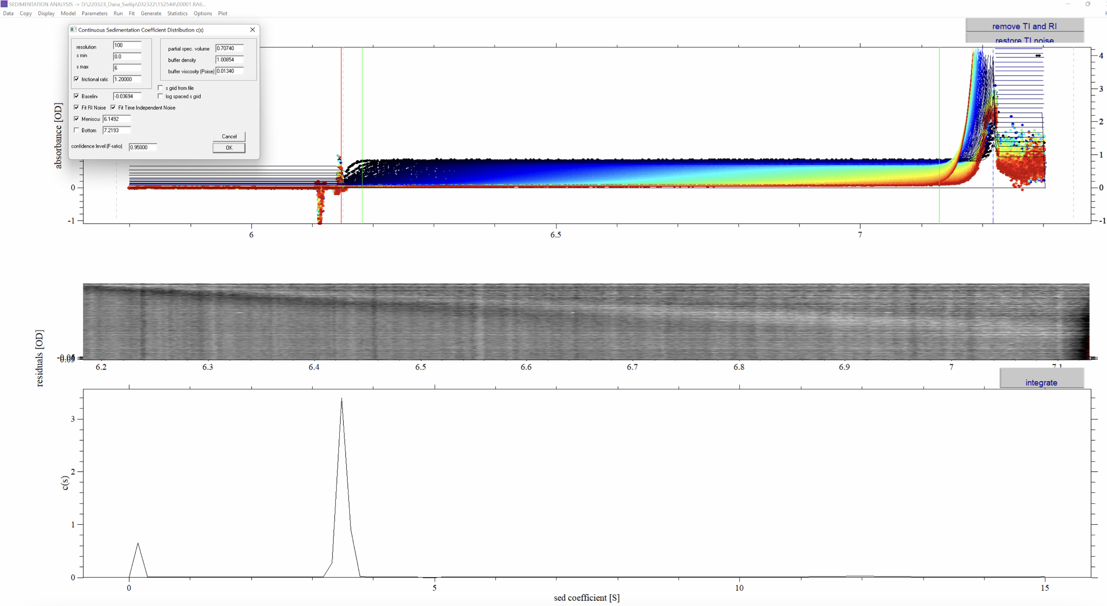
Interpreting and refining the results
Notes:
Before we fit the equation, we are going to modify the parameter box,
1) Improve the distribution range: we can change the s max to about 6
2) Because we want to use non-linear regression for the frictional ratio, check the box next to this parameter. Do the same thing with the meniscus in order to optimize this parameter.
Next, we hit “fit”. This will start a non-linear regression of the c(s) distribution.
onlinear regression is a form of regression analysis in which data is fit to a model and then expressed as a mathematical function.

Slide 24
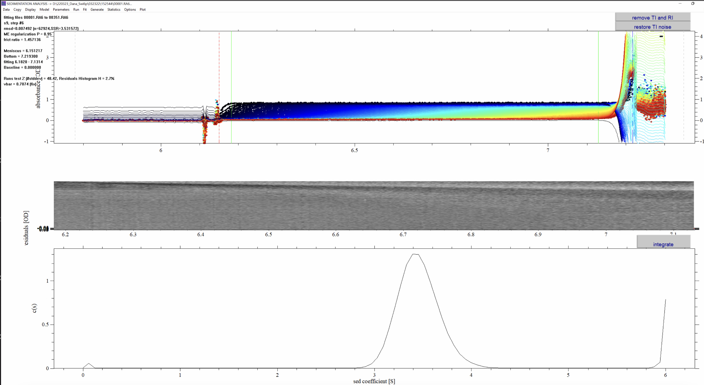
Interpreting and refining the results

Slide 25
Interpreting and refining the results
Notes:
And we see our first quantified value, a Molecular weight of ~73.2 kDa, which is representative of a wtSwi6 dimer. At this point, we can integrate the distribution…

Slide 26
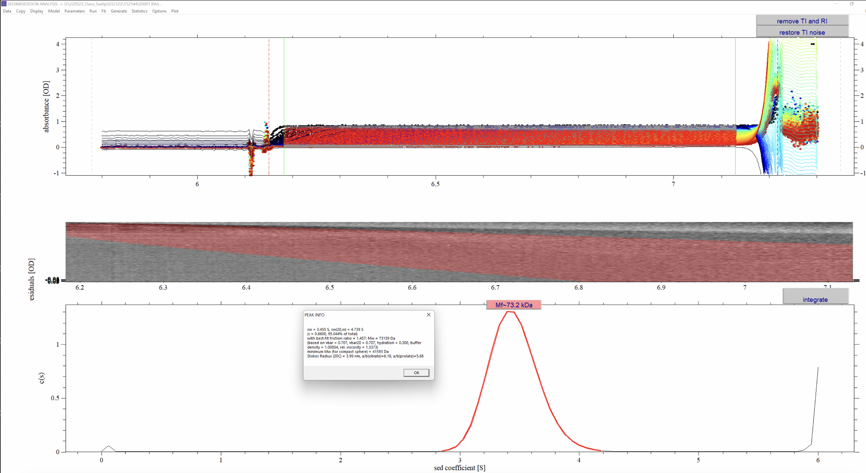
Interpreting and refining the results
Notes:
The highlighted red region is where the protein peak contributes to the raw data
Here, Mf means the molar mass taking into account the current best-fit frictional ratio f/f0. So our sedimentation coefficient for 10 uM wtSwi6 is 3.5S and the MW is 73.2 kDa. And this is the conclusion of the data analysis thus far. Where I am at with this technique is now running cleaved his tag wt Swi6 and phos Swi6 SV-AUC experiments to see if phosphorylation changes the way we know Swi6 sediments and forms higher order oligomers.

Slide 27
In conclusion…
SV-AUC is a quantitative technique looking at how macromolecules behave in solution
Watch how protein in moving in solution in real time: throwing the protein outward through centripetal force and measuring the rate of sedimentation
gain insight on protein mass, shape, and conformational changes of protein complexes
Notes:
The key take aways for today are

Slide 28
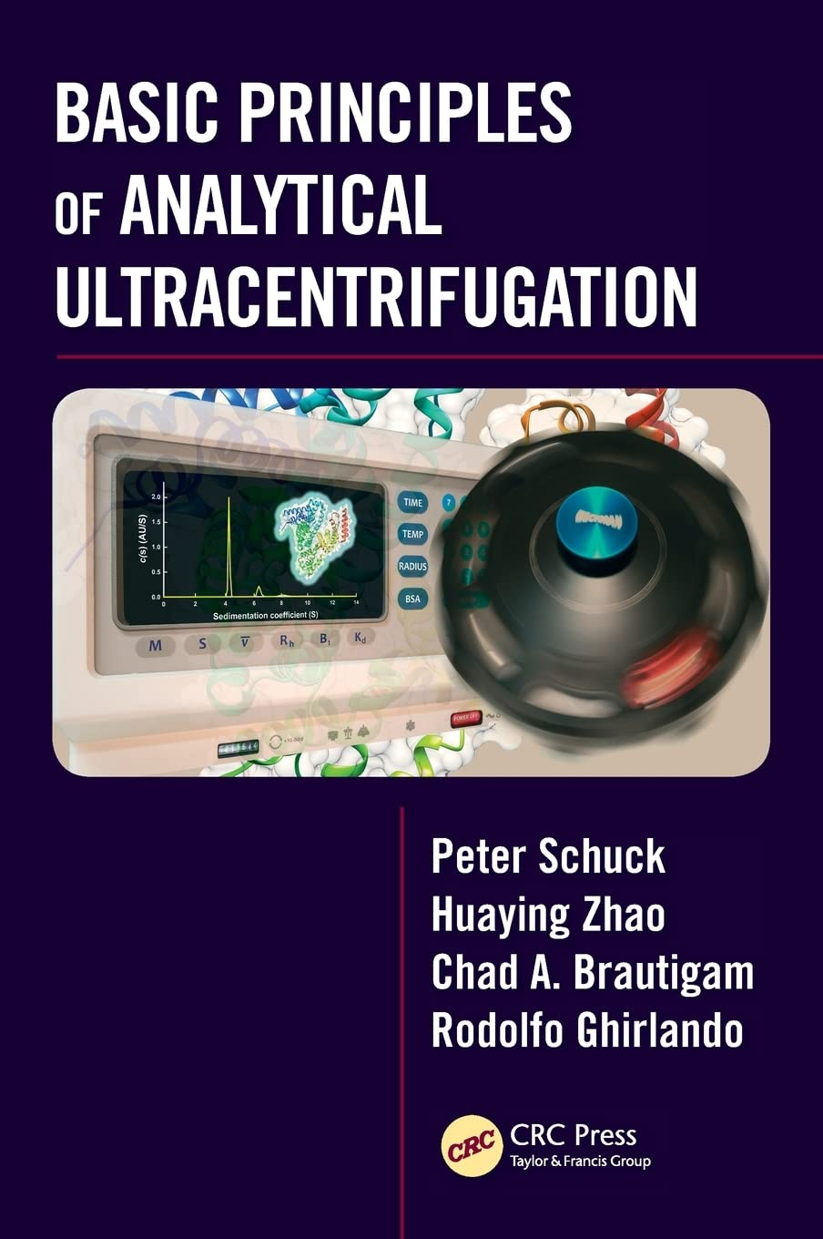
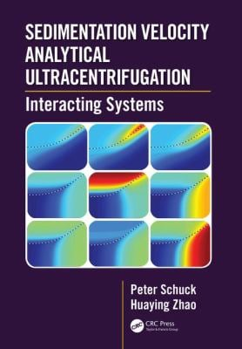
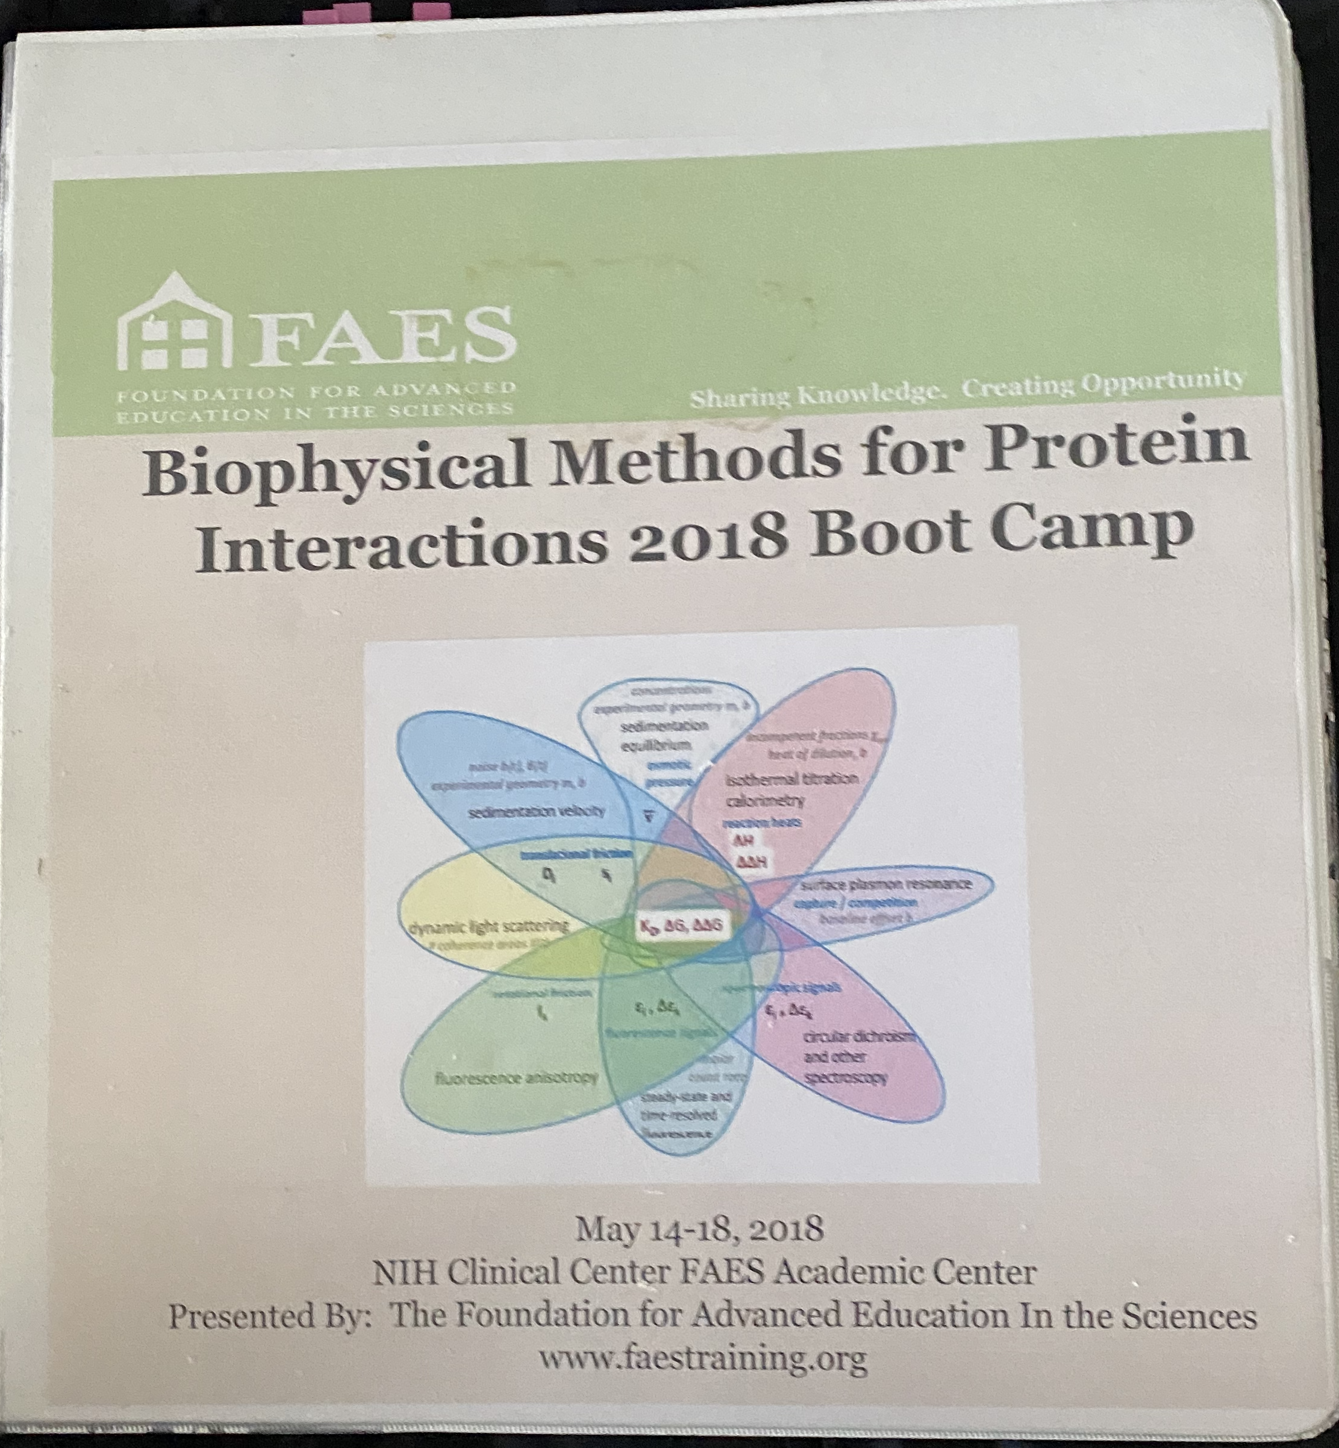
References
https://www.beckman.com/support/faq/product/major-components-analytical-sample-cell
https://www.bif.mit.edu/auc
https://d-nb.info/981712878/34
https://www.youtube.com/watch?v=A9wmCsMiy70
doi: 10.1016/S0091-679X(07)84006-4https://www.youtube.com/watch?v=8GiTLdSwl7M&t=2101s
https://www.youtube.com/watch?v=Kw72fyaiQsw&t=609s ** very helpful
https://en.wikipedia.org/wiki/Analytical_ultracentrifugation#History
https://www.mcgill.ca/biochemistry/files/biochemistry/404_silvius_15.pdf
doi: 10.1016/j.ymeth.2010.12.029
https://youtu.be/AA0w5Wc9r2o
doi: 10.1002/cpmb.131
https://www.beckman.com/resources/techniques-and-methods/spinsights/issue-4
doi: 10.1016/S0091-679X(07)84006-4
https://doi.org/10.4065/72.9.830
https://doi.org/10.1016/bs.mie.2015.04.004
https://en.wikipedia.org/wiki/Theodor_Svedberg
https://en.wikipedia.org/wiki/Sedimentation_coefficient
https://spinanalytical.com/pdf/AUC-Cell-Assembly-Instructions.pdf
https://d-nb.info/981712878/34

