Slide 1
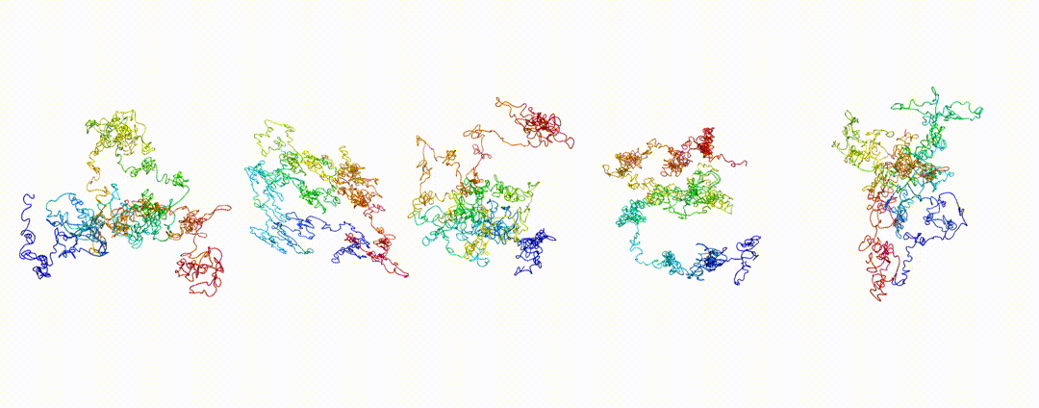
3D Structure Modelling
Al-Sady Lab workshop
Farzad Yousefi
03/27/2024

Slide 2
What I will talk about
Why we need protein structure ?
Why protein structure prediction is essential in modern biology?
Top 25 Latest Structural Bioinformatics Tools with Introduction to the Top 4
What is AlphaFold (AlphaFold 2)?
What does it do?
How does it work?
When does it not work?
How can it be used in structural biology?
What about complexes?
How can I try this out?
Run Colabfold in UCSF Wynton

Slide 3
Protein structure
The structure of a protein, that is the spatial disposition of all its atoms, determines its function, interaction with other molecules, regulation, stability, and all other kinds of relevant properties.
Knowing a protein’s structure is essential :
how it works,
how we can block or activate its activity with a drug,
how we can adjust its function or stability for a biotechnological application, etc.
Notes:
The structure of a protein, that is the spatial disposition of all its atoms, determines its function, interaction with other molecules, regulation, stability, and all other kinds of relevant properties. Knowing a protein’s structure is therefore essential to understand how it works, how we can block or activate its activity with a drug, how we can tune its function or stability for a biotechnological application, etc. That’s all relevant as fundamental knowledge and for applications in medicine and processes.

Slide 4
Protein structure Prediction
Protein structure modeling is the process of predicting the three-dimensional structure of a protein (the “target” protein) from its amino acid sequence.
Methods:
Homology modeling
similar proteins that can be used as templates.
In a procedure for homology modeling, one or more known structures are used as the core “structural information” from which models are built for the target protein.
Notes:
There are several methods available for protein structure modeling, that can be classified mainly depending on the availability of structures for (presumably) similar proteins that can be used as “templates”. When such similar structures are at hand, so-called “homology modeling” is the method to go. In a procedure for homology modeling, one or more known structures are used as the core “structural information” from which models are built for the target protein. The templates are typically derived from the Protein Data Bank (PDB), a database of experimentally determined protein structures; however, they could well be structures that you’ve solved but haven’t released, or even other models built previously. Homology modeling has been around for some decades already, and it works reasonably to very well when good templates are available -that is, structures are available for proteins that are quite similar to the target in terms of both sequence and structure.

Slide 5
Protein structure modeling methods
But what happens when no good templates are at hand?
If no suitable templates are available in the PDB, so-called ab initio modeling can be used.
This is not just one method but actually a broad range of computational techniques to predict protein structures from scratch, without the need for templates. Most methods for ab initio modeling are computationally intensive and typically produces less accurate results than homology modeling.
Notes:
But what happens when no good templates are at hand?
If no suitable templates are available in the PDB, so-called ab initio modeling can be used. This is not just one method but actually a broad range of computational techniques to predict protein structures from scratch, without the need for templates. Most methods for ab initio modeling are computationally intensive and typically produces less accurate results than homology modeling. Or that’s how it was until AlphaFold 2 (and newer methods that I’ve also discussed, such as ESMFold) showed up.

Slide 6
Why protein structure prediction is essential in modern biology?
some cannot be produced in stable forms in solution,
too small for some techniques, or too big for others, etc.
can be produced but they do not crystallize,
17% of the total residues in human protein sequences are covered by an experimentally determined structure Through an enormous experimental effort
many cases the structure covers only a fragment of the sequence
the structures of around 100,000 unique proteins have been determined, but this represents a small fraction of the billions of known protein sequences,
months to years effort required to determine a single protein structure.
Accurate computational approaches are needed to address this gap and to enable large-scale structural bioinformatics
Notes:
cryo-EM, larger molecules often yield better results compared to smaller molecules. There are several reasons for this:
Signal-to-Noise Ratio: In cryo-EM, the signal is generated by the electrons interacting with the sample, while noise comes from various sources including the electronic detector and sample drift. Larger molecules inherently scatter more electrons, providing a stronger signal compared to smaller molecules. This higher signal-to-noise ratio leads to better contrast and resolution in the final image.
Flexibility and Stability: Larger molecules often have more stable structures due to their increased number of interactions and domains. Smaller molecules may be more flexible or dynamic, making it challenging to capture their structures accurately. In cryo-EM, the technique relies on capturing multiple views of the molecule frozen in different orientations. Flexibility can lead to blurring or smearing of the image, making it difficult to reconstruct the molecule's structure accurately.
Statistical Averaging: Cryo-EM images are reconstructed from thousands to millions of individual particle images. Large molecules provide more data points per particle due to their size, allowing for more robust averaging during image processing. This statistical averaging helps to improve the signal-to-noise ratio and enhance the resolution of the final 3D structure.
Practical Considerations: Handling and imaging large molecules can be technically easier than smaller ones. Larger molecules are less susceptible to radiation damage during imaging, and they tend to produce stronger signals, requiring shorter exposure times. This reduces the risk of damaging the sample while still obtaining high-quality images.
Overall, while cryo-EM can provide valuable structural insights into molecules of various sizes, larger molecules tend to yield better results due to their inherent properties and the technical advantages they offer during imaging and analysis.
Intrinsic Properties: Some proteins inherently possess properties that hinder crystallization. These may include large size, high flexibility, aggregation propensity, or the presence of disordered regions.
Post-translational Modifications: Proteins with post-translational modifications (PTMs) such as phosphorylation, glycosylation, or lipidation may be more challenging to crystallize due to increased heterogeneity and complexity.
Hydrophobicity: Proteins with hydrophobic regions can aggregate in solution rather than forming stable crystal lattices. This is particularly problematic for membrane proteins, which have extensive hydrophobic surfaces.
Flexibility: Proteins that undergo conformational changes or have flexible regions may not adopt a stable conformation suitable for crystallization. Flexibility can prevent the formation of a well-defined crystal lattice.
Low Expression Levels: Proteins that are expressed at low levels may not yield enough material for crystallization experiments. Insufficient protein concentration can hinder nucleation and growth of crystals.
Non-native Conditions: Crystallization conditions often require specific pH, temperature, salt concentrations, and precipitants. If these conditions do not match the native environment of the protein, crystallization may fail.
Protein-Protein Interactions: Proteins that function as part of complexes or aggregates may not crystallize easily due to intermolecular interactions that prevent the formation of a regular crystal lattice.
Experimental Techniques: Despite efforts to optimize crystallization conditions, some proteins may remain refractory to crystallization using conventional methods. Advanced techniques such as lipidic cubic phase crystallization or microfluidics may be necessary for challenging cases.
Overall, the inability to crystallize certain proteins is often a result of a combination of factors related to the protein's intrinsic properties, expression, and the experimental conditions used for crystallization.
After decades of effort, 17% of the total residues in human protein sequences are covered by an experimentally determined structure Through an enormous experimental effort,
and in many cases the structure covers only a fragment of the sequence
the structures of around 100,000 unique proteins have been determined, but this represents a small fraction of the billions of known protein sequences, Structural coverage is bottlenecked by the months to years of painstaking effort required to determine a single protein structure.
Accurate computational approaches are needed to address this gap and to enable large-scale structural bioinformatics
Methods for protein structure prediction are essential in modern biology, because a huge number of proteins are not amenable to the kind of experimentation required to solve their structures:
some cannot be produced in stable forms in solution,
can be produced but they do not crystallize,
too small for some techniques, or too big for others, etc.

Slide 7
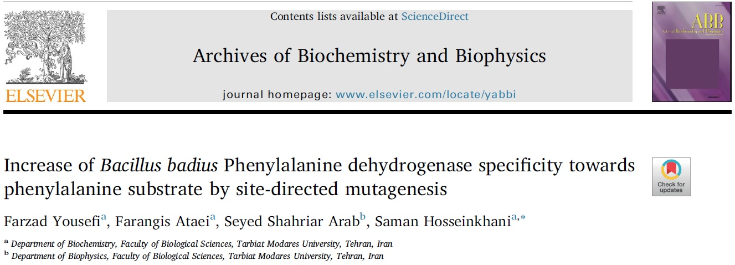

Slide 8
𝐓𝐨𝐩 25 𝐥𝐚𝐭𝐞𝐬𝐭 𝐬𝐭𝐫𝐮𝐜𝐭𝐮𝐫𝐚𝐥 𝐛𝐢𝐨𝐢𝐧𝐟𝐨𝐫𝐦𝐚𝐭𝐢𝐜𝐬 𝐭𝐨𝐨𝐥𝐬 :
1. AlphaFold2(-Multimer)
2. DMFold(-Multimer)
3. RosettaFold
4. ESMFold
5.RosettaFoldDiffusion-AA
6. Chroma
7.ProteinMPNN/LigandMPNN
8. NeuralPLexer2
9. Evo
10. DiffDock-L
11. DynamicBind
12. AlphaFlow/ESMFlow
13. PocketGen
14. DNA-Diffusion
15. PRESCOTT
16. CombFold
17. PreMode
18. AlphaFind
19. GrASP
20. LightDock
21. Tapioca
22. ALBATROSS
23. FragFold
24. AFCluster
25. AlphaFill

Slide 9
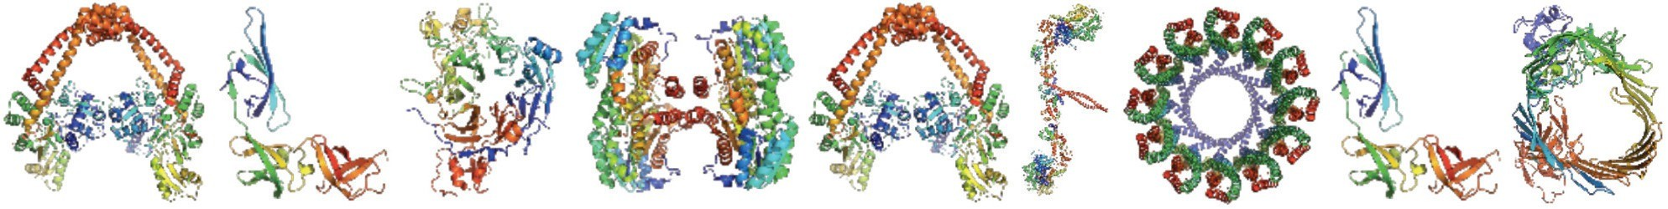
AlphaFold

Slide 10
What is AlphaFold?
A machine-learning-based model for predicting the 3D structure of proteins using only sequence as input
Trained on known sequences and structures from the Protein Data Bank, as well as large databases of protein sequences ,AlphaFold actually does use templates if available
Notes:
AlphaFold 2 is as of today the state-of-the-art deep learning system for protein structure prediction. It was unveiled in November 2020 as the first system that can accurately predict protein structures with near-atomic resolution even in the absence of templates. AlphaFold 2's architecture combines various kinds of neural networks trained on a huge representative dataset of the PDB. Given an input sequence for a target protein to be modeled, AlphaFold predicts its 3D structure and two different of quality metrics ,AlphaFold 2 actually does use templates if available; and besides, it uses alignments of protein sequences similar to the target. Both affect the quality of the results and also how you run the program

Slide 11
AlphaFold
outperform existing method for protein structure prediction.
solve several challenges related to the problem of protein structure prediction itself.
triggered a revolution in structural biology and structural bioinformatics.
Underpinning the latest version of AlphaFold is a novel machine learning
approach that incorporates physical and biological knowledge about protein structure,
leveraging multi-sequence alignments, into the design of the deep learning algorithm.
Notes:
AlphaFold 2 has been shown to outperform existing methods for protein structure prediction and has been used to solve several challenges related to the problem of protein structure prediction itself. Besides, it triggered a revolution in structural biology and structural bioinformatics. Underpinning the latest version of AlphaFold is a novel machine learning
approach that incorporates physical and biological knowledge about protein structure,
leveraging multi-sequence alignments, into the design of the deep learning algorithm.

Slide 12
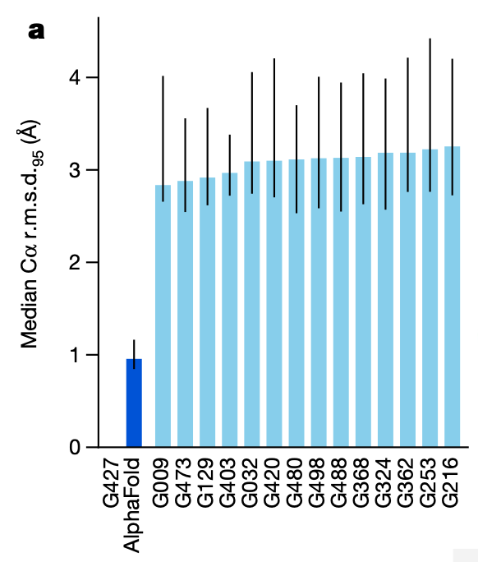
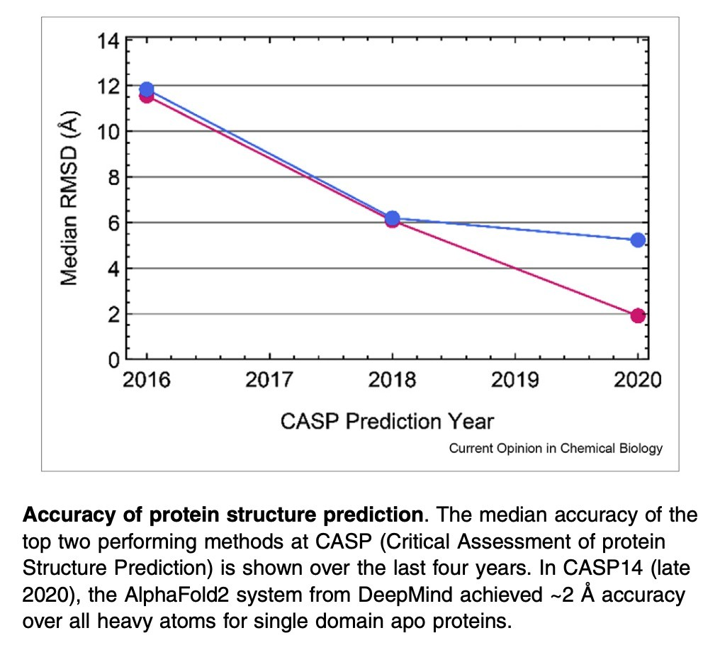
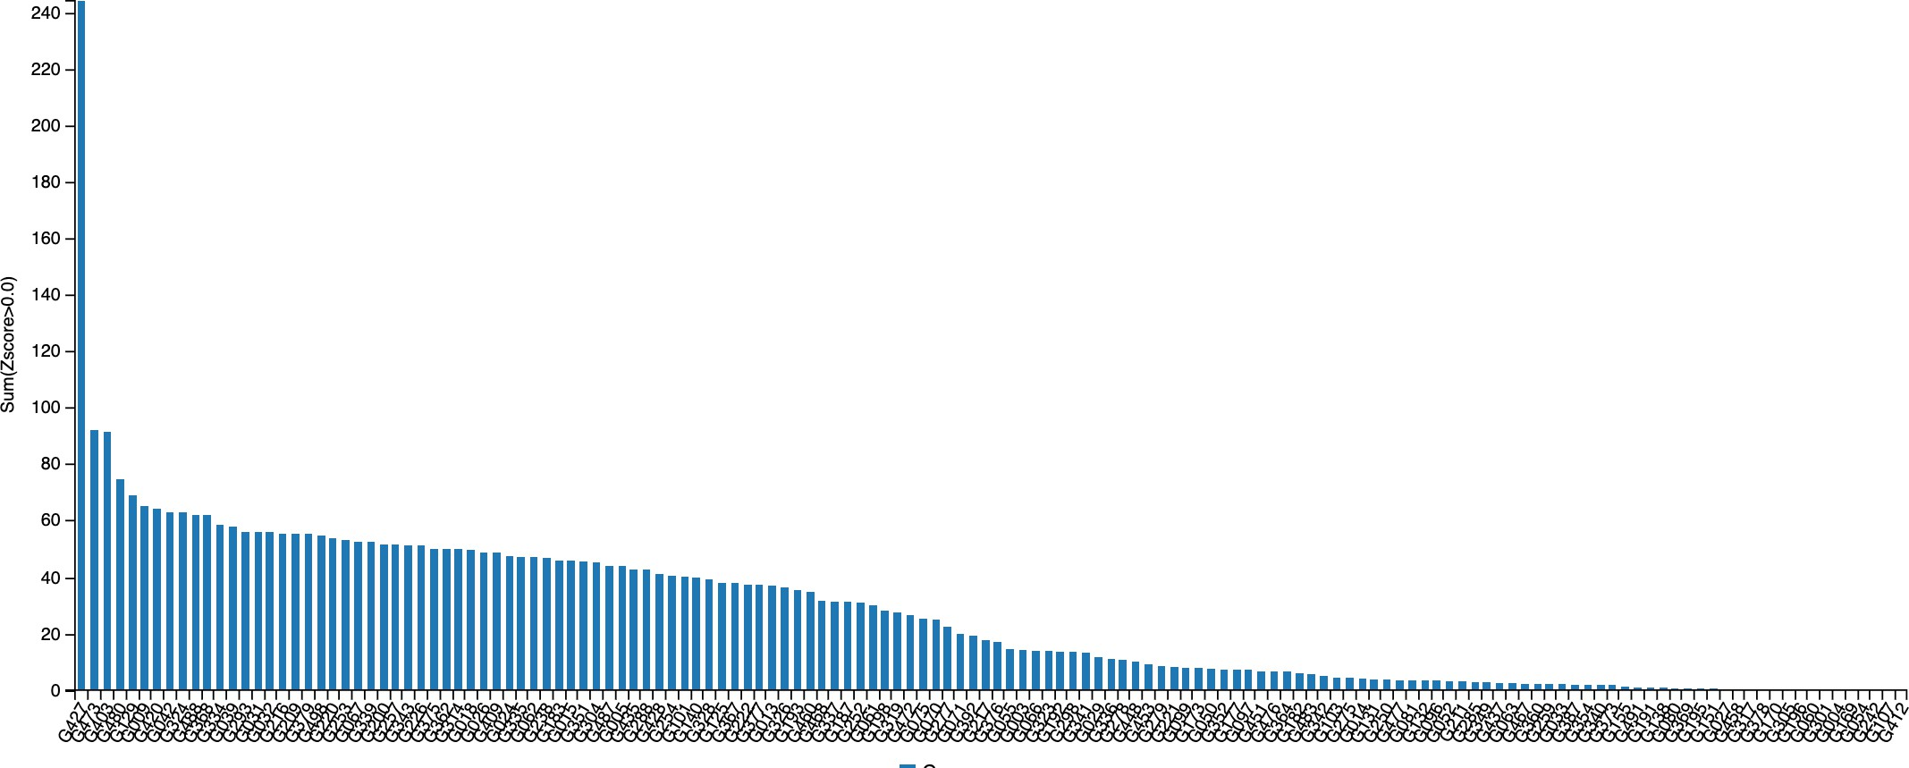
OK, but how well does it really do?
AlphaFold 2
Results from blind predictions (CASP14) “competition”
Jumper et al, Nature, 2021
AlQuraishi,
Curr Opin Chem Biol, 2021
Pereira et al, Proteins, 2021
Notes:
root-mean-square distance (RMSD) /CASP (Critical Assessment of Techniques for Protein Structure Prediction) is a biennial scientific experiment that evaluates the performance of protein structure prediction methods. The experiment aims to advance the field of protein structure prediction by providing a rigorous and fair evaluation of different methods, as well as to identify areas where further research is needed.
The performance
of AlphaFold on the CASP14 dataset (n = 87 protein domains) relative to the top15 entries (out of 146 entries), group numbers correspond to the numbers
assigned to entrants by CASP.
A Z-score of 0 means the data point is exactly at the mean, while positive values indicate data points above the mean and negative values indicate data points below the mean.

Slide 13
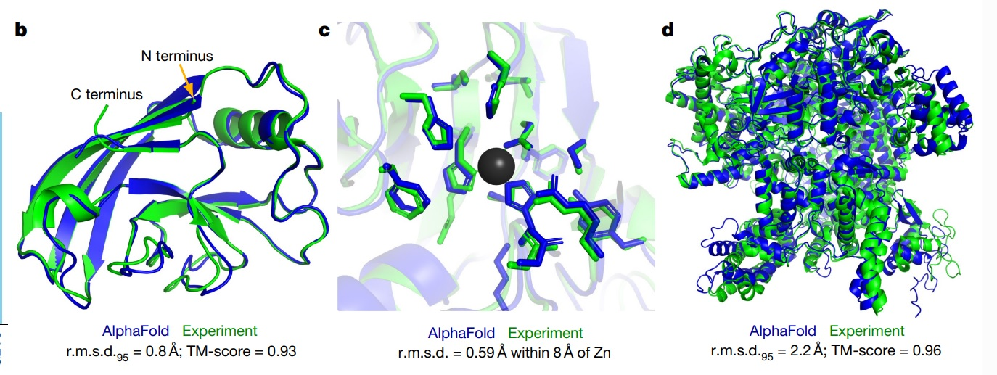
Jumper et al, Nature, 2021
Notes:
TM-score (Template modeling score) and RMSD (Root Mean Square Deviation) are known standards for measuring structural similarity between two structures which are
usually used to measure the accuracy of structure modeling when the native structure is known, Root Mean Square Deviation, Template modeling score TM-score has the value in (0,1], where 1 indicates a perfect match between two structures. Following strict statistics of structures in the PDB, scores below 0.17 correspond to randomly chosen unrelated proteins whereas structures with a score higher than 0.5 assume generally the same fold in SCOP/CATH.
b )CASP14 target T1049 (PDB 6Y4F, blue) compared with the true (experimental) structure (green). Four residues in the C terminus of the crystal structure are B-factor outliers and are not depicted ,
c) . c, CASP14 target T1056 (PDB 6YJ1). An example of a well-predicted zinc-binding site (AlphaFold has accurate side chains even though it does not explicitly predict the zinc ion)
d) CASP target T1044 (PDB 6VR4)—a 2,180-residue single chain—was predicted with correct domain packing (the prediction was made after CASP using AlphaFold without intervention)

Slide 14
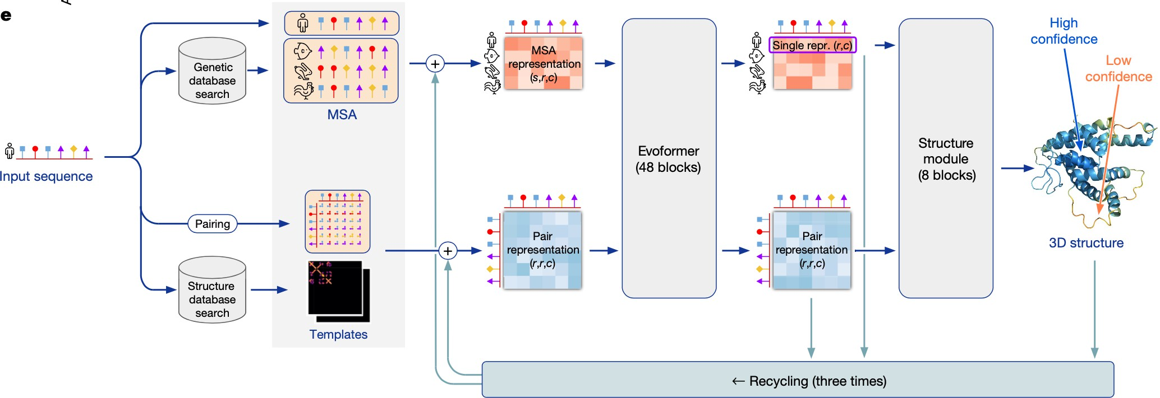
How does it work?
Jumper et al, Nature, 2021
Notes:
Model architecture. Arrows show the information flow among
the various components described in this paper. Array shapes are shown in
parentheses with s, number of sequences (Nseq in the main text); r, number of
residues (Nres in the main text); c, number of channels.

Slide 15
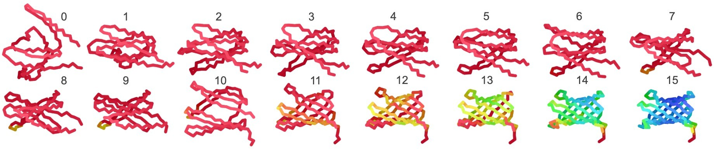
Anecdotal evidence for structure prediction of designed proteins with no known homologs
Mirdita et al, bioRxiv, 2021

Slide 16
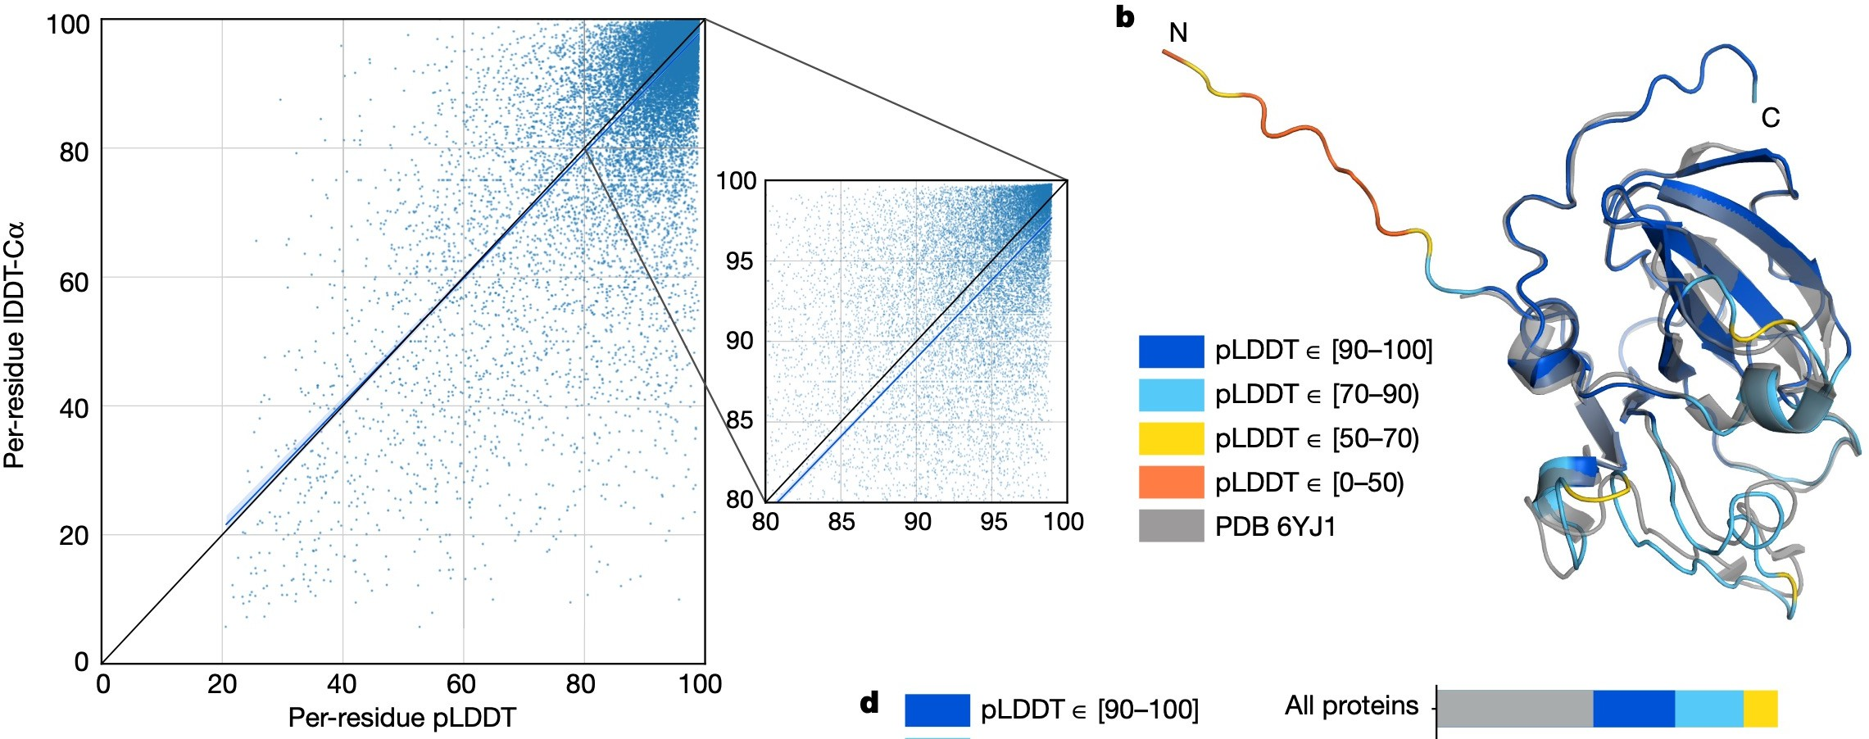
When can you trust the predictions?
Actual quality of predicted structure
Prediction of how good the predicted structure is
Jumper et al, Nature, 2021 Tunyasuvunakool et al, Nature, 2021
Notes:
, Confidence score compared to the true accuracy on
chains. Least-squares linear fit lDDT-Cα = 0.997 × pLDDT − 1.17 (Pearson’s
r = 0.76). n = 10,795 protein chains. The shaded region of the linear fit
represents a 95% confidence interval estimated from 10,000 bootstrap
samples. In the companion paper39, additional quantification of the reliability
of pLDDT as a confidence measure is provided

Slide 17
AlphaFold Tutorial: Getting Started
Notes:
Before you start, you need to set up a Google account in order to access and use these programs. If you have an account on Gmail, YouTube, etc. then you already have a Google account!
1Now connect to the right Google Colab notebook you need depending on how you want to run AlphaFold. By “depending on how you want to run AlphaFold”, I mean the following:

Slide 18
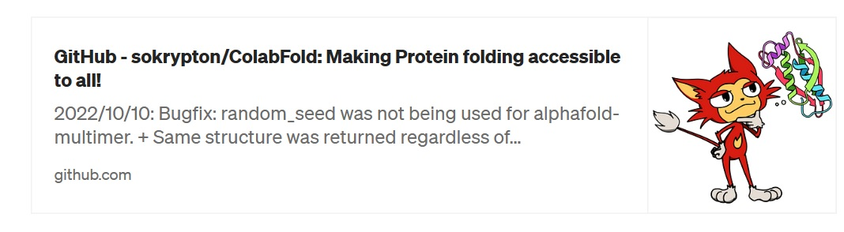
If you go to the official ColabFold page:
Notes:
If you go to the official ColabFold page:
Before you start, you need to set up a Google account in order to access and use these programs. If you have an account on Gmail, YouTube, etc. then you already have a Google account!
1Now connect to the right Google Colab notebook you need depending on how you want to run AlphaFold. By “depending on how you want to run AlphaFold”, I mean the following:

Slide 19
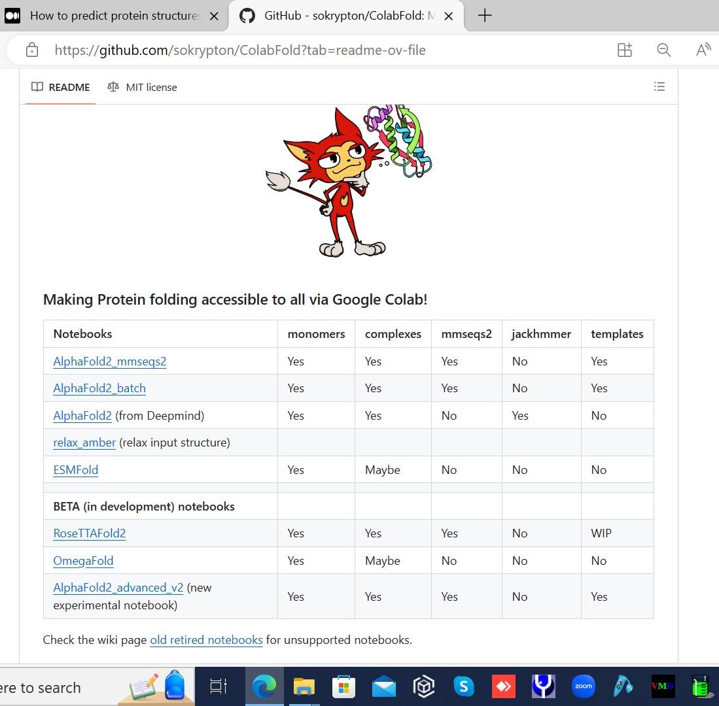
You will find a table of supported notebooks. These are the Release versions as of 03/25/2024
Notes:
You can see you have 3 flavors of AlphaFold, plus RoseTTAFold and ESMFold. RoseTTAFold was the immediate academic response to AlphaFold 2 right at the same time it came out, and ESMFold is the AI tool for protein structure prediction using deep protein language models, released recently by Meta.
Let’s look briefly at the three AlphaFold notebooks:
“from Deepmind” was the first-ever tool available to run AlphaFold, released by Deepmind together with AlphaFold’s source code and papers. Although you could perfectly use it to model structures, it is certainly superseded by the more powerful AlphaFold2_mmseqs2.
“AlphaFold2_mmseqs2” performs protein structure and complex prediction using AlphaFold or Alphafold2-multimer, respectively (AlphaFold-multimer being a tweaked version of AlphaFold that is slightly better than regular AlphaFold 2 at modeling complexes between multiple proteins). In this notebook, sequence alignments and template detection are carried out by the programs MMseqs2 and HHsearch.
“AlphaFold2_batch” is simply a batch implementation of the above notebook, useful to run predictions on several sequences in a single shot.
For most of your work in Colab Notebooks using Google’s resources, you will likely use AlphaFold2_mmseqs2. In particular, note that although AlphaFold2_batch allows you to run multiple predictions in a single session, Colab Notebooks running on Google’s resources are in practice halted after some time, so this won’t help you model large numbers of proteins in a single run -should suffice for a bunch, though. I found the batch mode actually useful if it is downloaded run locally. Here, I willl cover the use of AlphaFold2_mmseqs2.

Slide 20
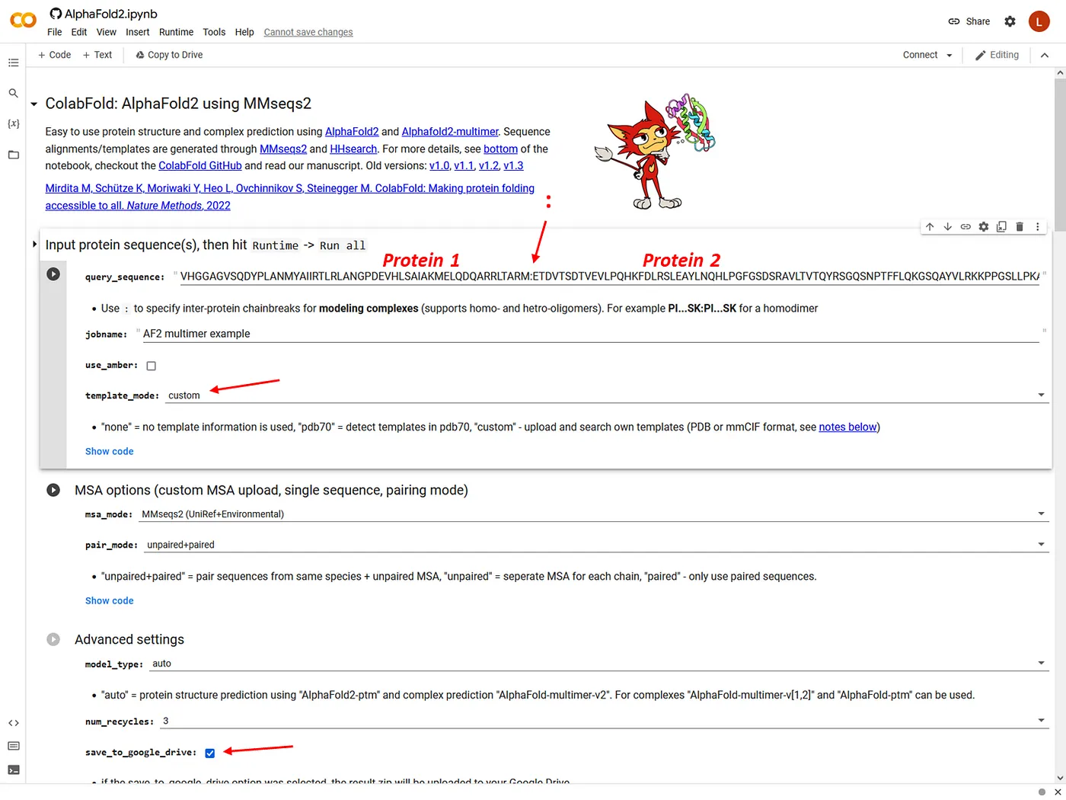
Notes:
To run AlphaFold2_mmseqs2 in Google Colab using Google-provided hardware consists in setting up the target sequence/s for modeling, and some choices regarding templates and other options.
See this example, where I’m setting up a run for G9a/GLP and a homodimer, i.e. folding two copies of a protein together into a binary complex (see the colon separating the first from the second sequence). This example is interesting because the actual experimental structure was just released, so AlphaFold doesn’t know about it, hence we can compare its predictions to the “true” structure. Besides, the structure has a quite peculiar topology, as you will see.
In this example I’m asking AlphaFold 2 to use a custom template (see arrow), contrary to just letting it find templates automatically at the PDB (option “PDB70”). Out of the 600+ residues of the target sequence, this template covers the last 300 -important for the analysis stage because we expect at least this part to be modeled correctly.
I also tell the program to save the files to my Google drive (arrow in “Advanced settings”):

Slide 21
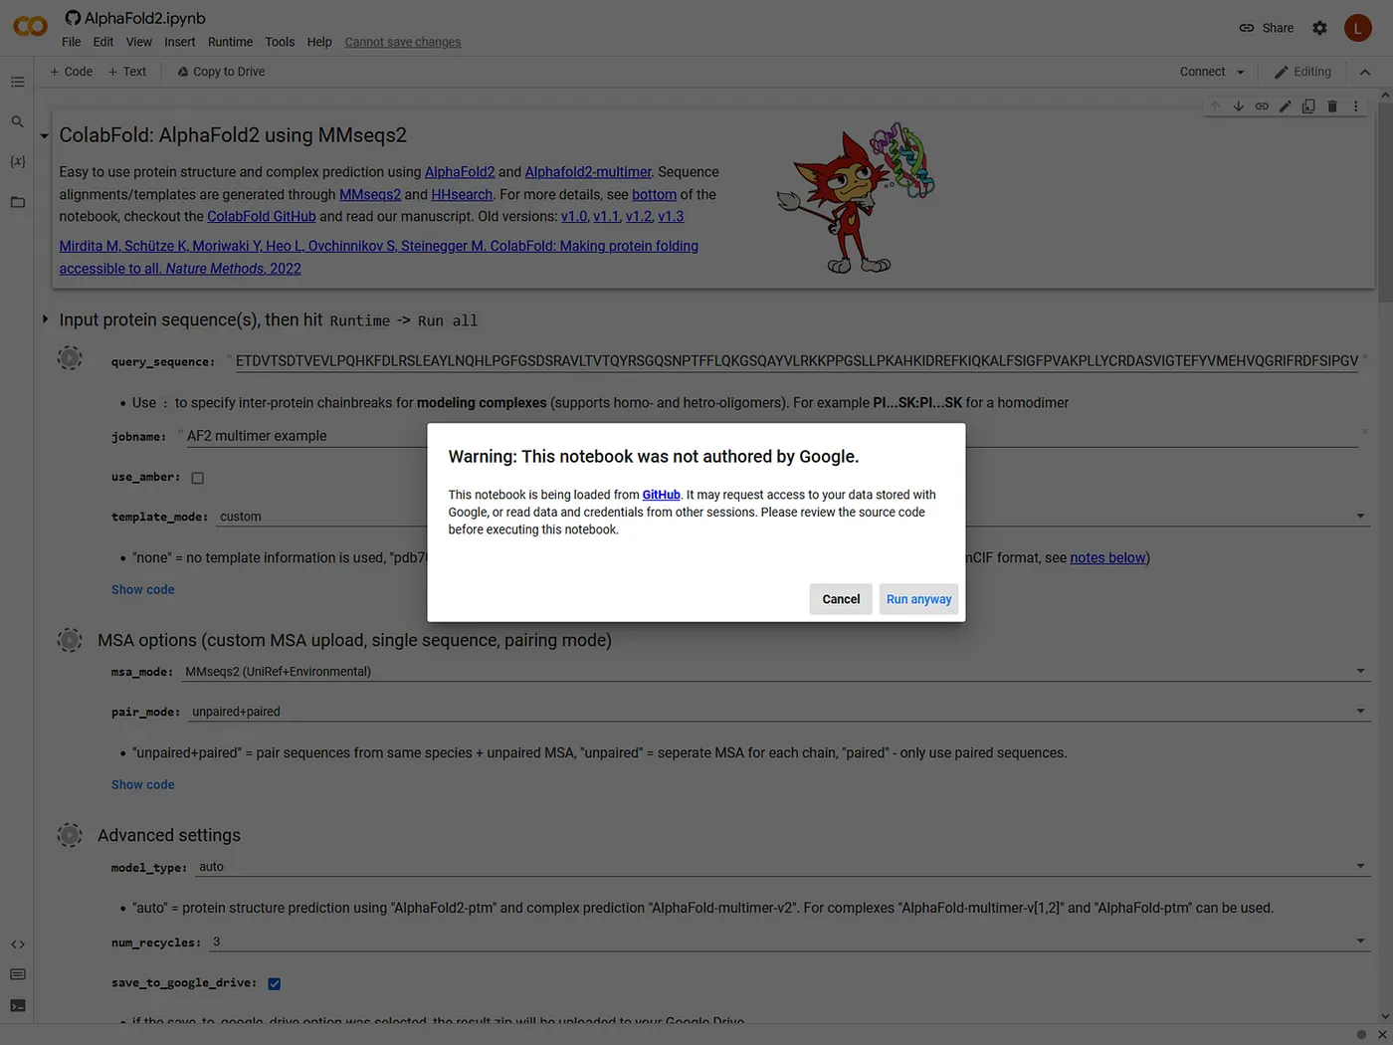
Notes:
Simply click “Run all” in the “Runtime” menu. You’ll immediately see this screen, on which you have to say “Run anyway”:

Slide 22
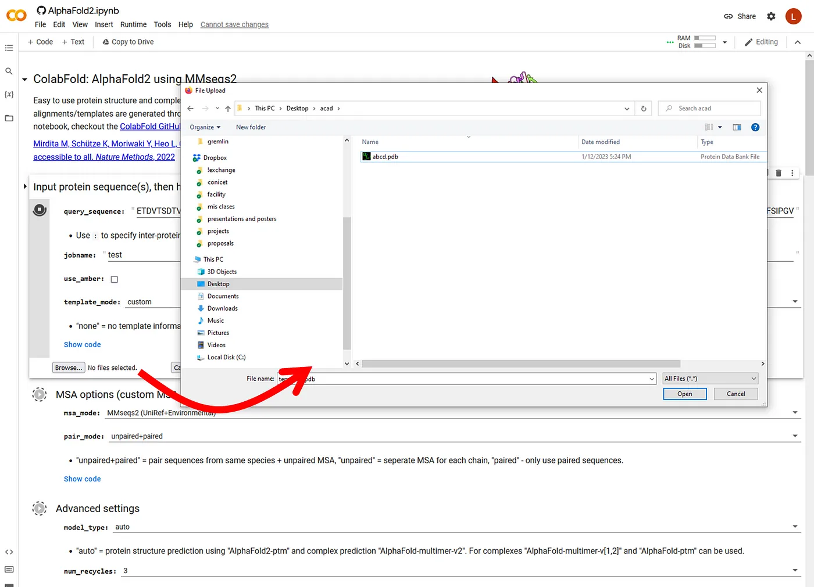
Notes:
If you chose to add your own templates as I did here, you must click a “Browse” button to upload the PDB of your custom template:

Slide 23
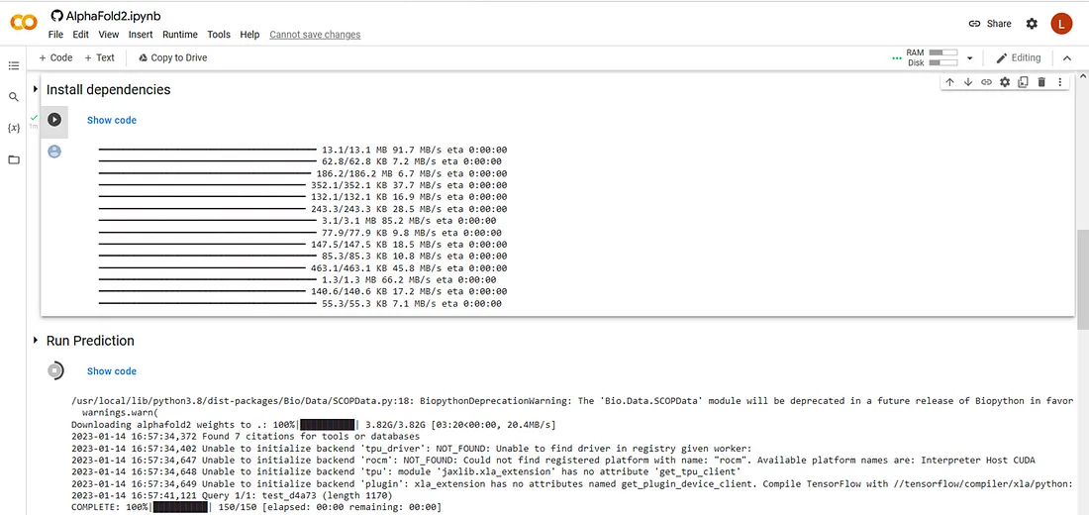
Notes:
Now, just let it run. You’ll see the progress as it goes, first installing dependencies (don’t worry, nothing actually goes to your disk, it’s all online!), downloading the weights of the network, getting sequences for the alignment (and grabbing templates from the PDB if you chose the PDB70 option):

Slide 24
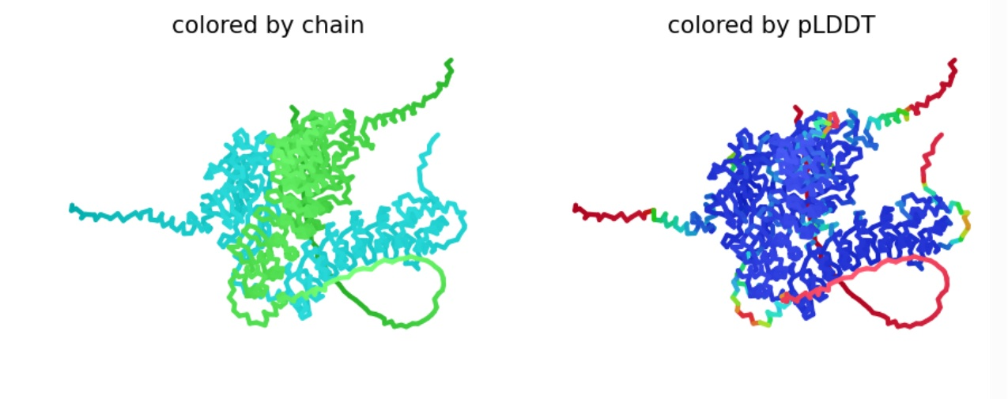
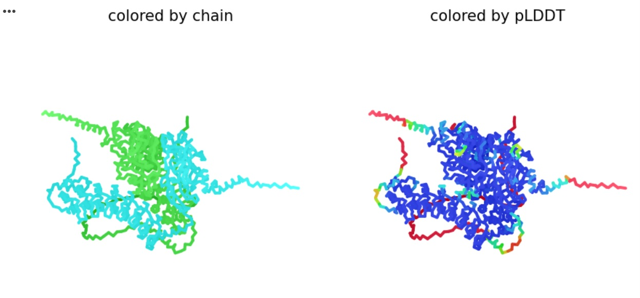
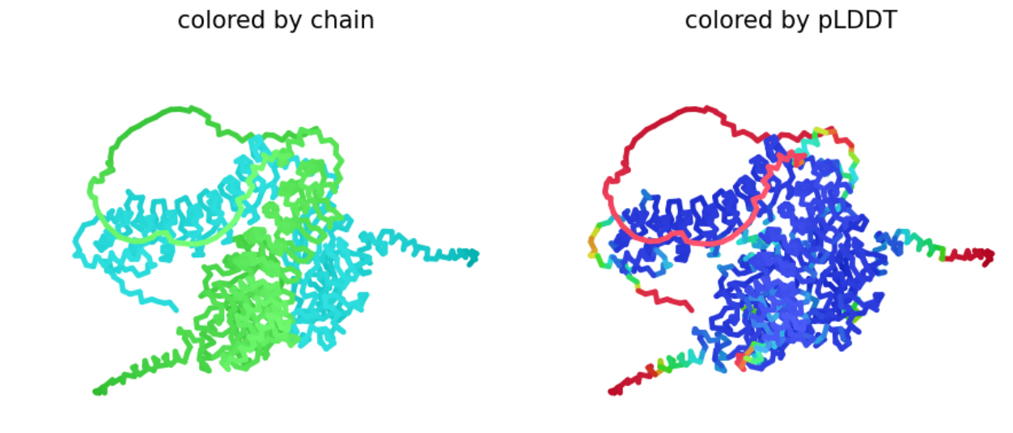
G9a/GLP
G9a/GLP
G9a/GLP
Notes:
Immediately after that, the program starts to craft the first model. After some minutes you’ll see two 2D views of this first model (left, colored by chain; right, colored by pLDDT which is a confidence metric per residue where blue is better) all quite blue which means quite high confidence ,together with some basic confidence metrics:
This first output already gives us some hints on how the modeling procedure will go.
What else can we say from this first model? Well there’s a lot or red, so there’s a big chunk that AlphaFold doesn’t know how to model -or it might actually be disordered, we don’t know. On the other hand, two regions are dominated by cyan and blue, so we can be quite sure these domains are probably modeled correctly -anyway we’ll know more about this at the end of the run. In-between, the green helicesare probably real but the program doesn’t know where to place them exactly; but again, we’ll know more about this at the end of the run.

Slide 25
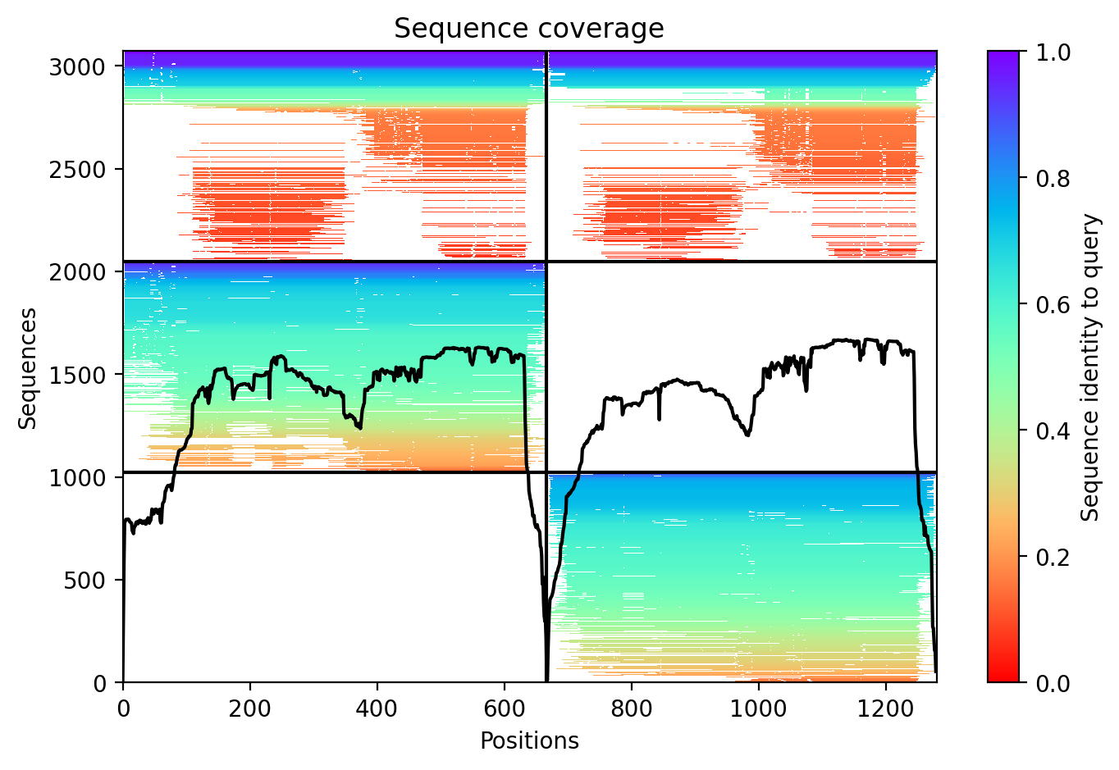
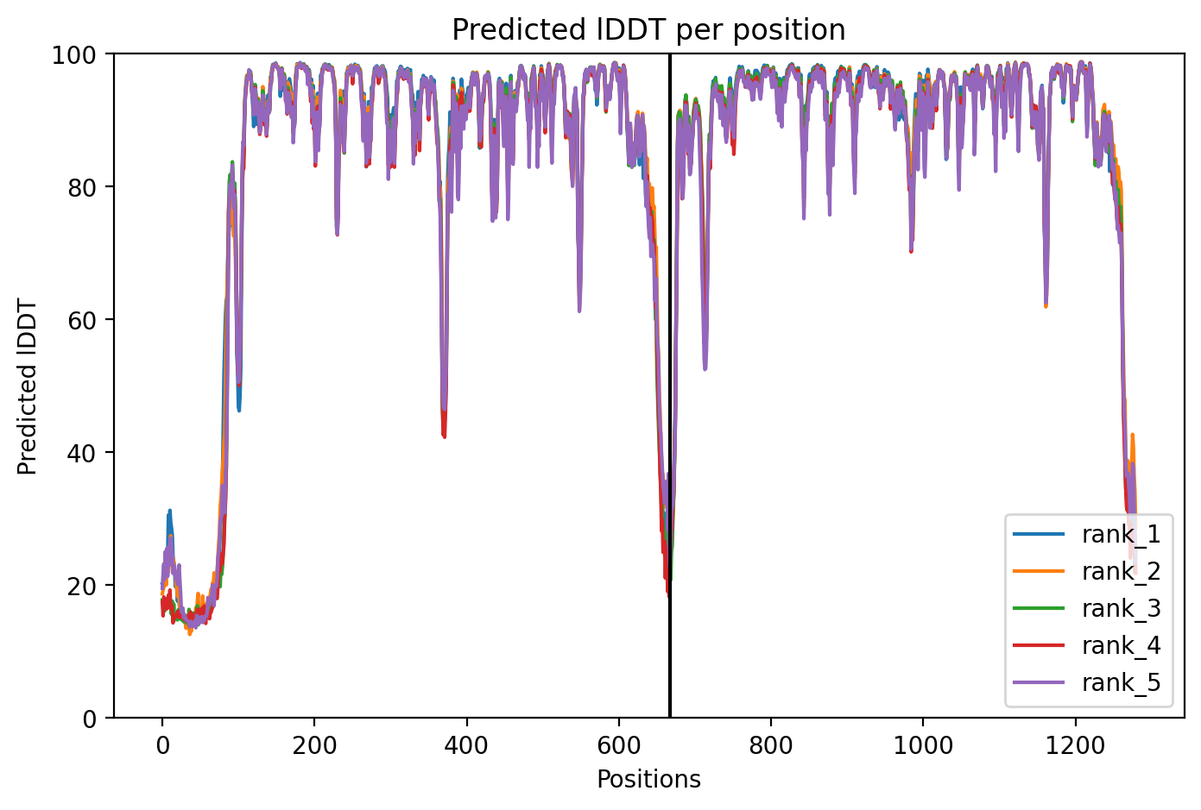
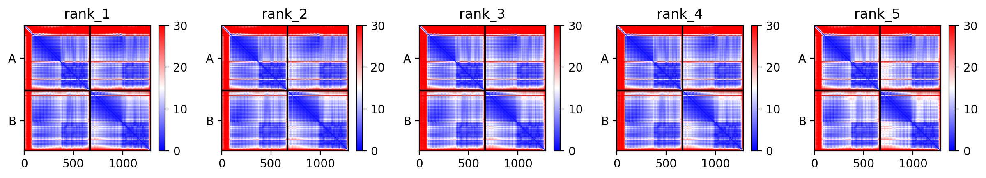
PAE plots
Notes:
As I understand the text I copied from the FAQ page in my previous answer, pLDDT mainly indicates the quality of prediction for individual domains (folding prediction for individual folding units), while PAE is governed by the prediction of the interaction between domains, that is, whether in a multi-domain structureYou can also see the pLDDTs in the plot on the bottom right of this screenshot from ColabFold. There are five traces, one per model and all very similar. On the x axis (residue) the pattern seems duplicated; this is because it corresponds to the two copies of the same protein, that we modeled together in an attempt to predict a homodimer:The other very important plot is the set of 2D matrices in the top, so-called PAE plots after “Predicted Alignment Error”. The PAE is the RMSD predicted for each possible pair of residues if it were to be aligned to the “true” structure. You want it all to be blue and nothing red. There’s one PAE plot for each of the 5 models produced, just like there are 5 traces in the pLDDT plots.
In this output, all PAE plots present some blue only around the diagonal, being all very red outside of it. This indicates that each domain of each protein is expected to be quite well modeled (mostly blue), but the relative arrangement of the domains is likely off (white and some red). Looking in more detail, you can see that the second domain of each protein is “more blue”; this is to expect because we provided a template for this domain.
The other important piece of information we can get from the PAE plots is that the relative arrangement of the two proteins lacks any support at all, and is likely just plain wrong, as it is all deep red.
The third plot, on the bottom left, indicates how deep the obtained alignments are at each residue of the proteins (that is, how many sequences include each residue). You want this to be as high as possible, ideally covering the whole proteins smoothly. In this case it’s not bad for the C-terminal domains, but it is a bit poor for the N-terminal ones

Slide 26
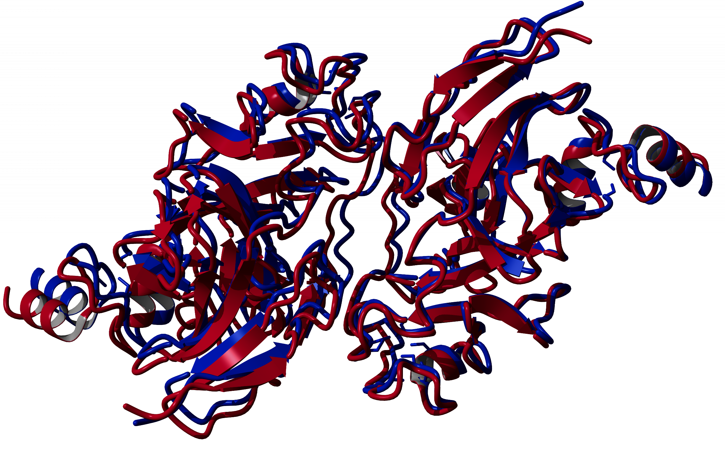
experimental structure
AlphaFold model
Notes:
Analyze the full results once the run is over. When AlphaFold has finished running, it will present you a 3D representation that you can view in-place or download as PDB file for inspection in your program of choice; plus a set of graphics with very relevant information

Slide 27
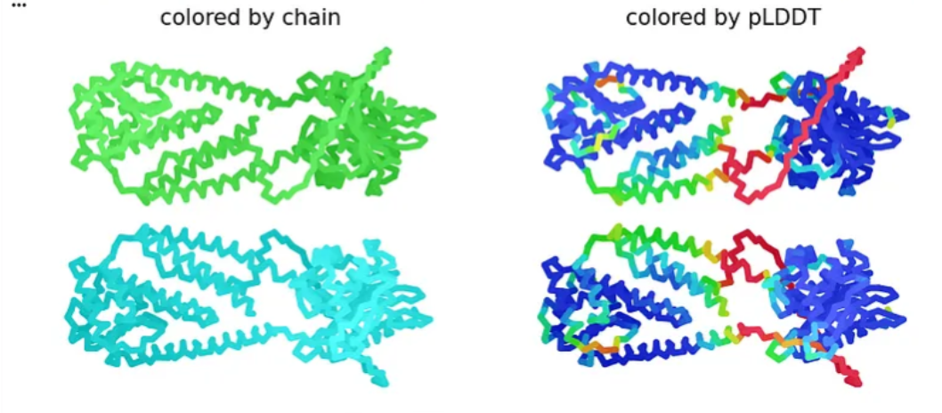
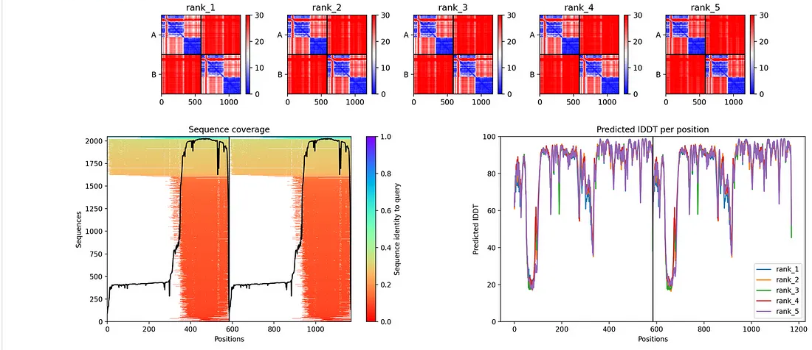
Alpha Fold Model of S. aureus BlaR1 with C2 symmetry
Notes:
In this output, all PAE plots present some blue only around the diagonal, being all very red outside of it. This indicates that each domain of each protein is expected to be quite well modeled (mostly blue), but the relative arrangement of the domains is likely off (white and some red). Looking in more detail, you can see that the second domain of each protein is “more blue”; this is to expect because we provided a template for this domain. The other important piece of information we can get from the PAE plots is that the relative arrangement of the two proteins lacks any support at all, and is likely just plain wrong, as it is all deep red.
The third plot, on the bottom left, indicates how deep the obtained alignments are at each residue of the proteins (that is, how many sequences include each residue). You want this to be as high as possible, ideally covering the whole proteins smoothly. In this case it’s not bad for the C-terminal domains, but it is a bit poor for the N-terminal ones.

Slide 28
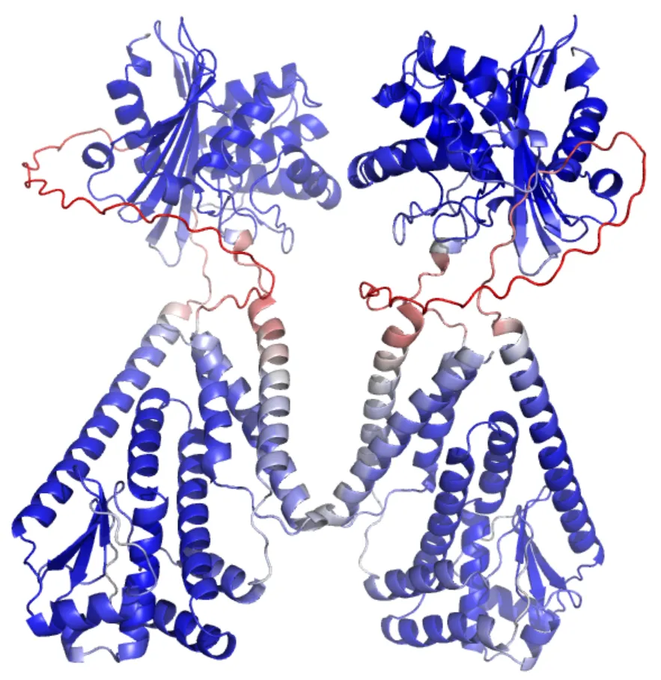
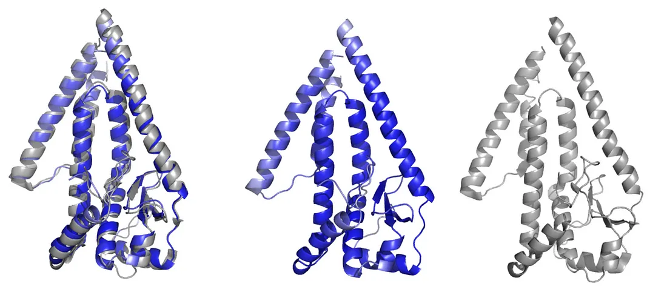
structure of S. aureus BlaR1 with C2 symmetry (PDB 8EXP)
AlphaFold model
experimental structure in grey

Slide 29
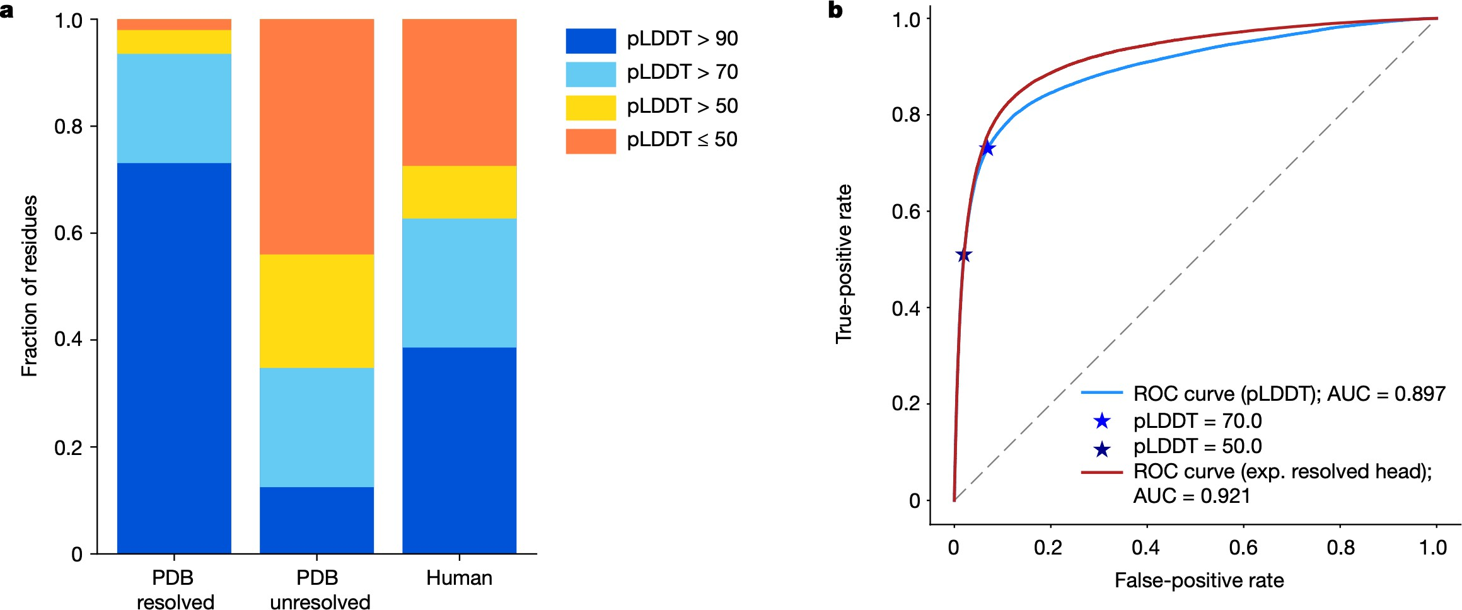
AF2 is a pretty good predictor of disorder
That is, when AlphaFold is unsure where the atoms should be, then Nature is too
Tunyasuvunakool et al, Nature, 2021 Akdel et al, bioRxiv, 2021

Slide 30
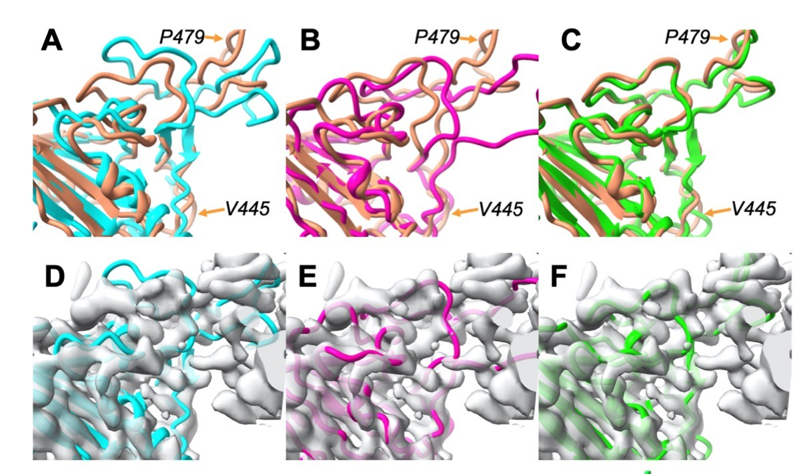
Useful for model building (here in Phenix)
AF2 vs EM struct AF2 refined against map Iterative rebuilding
Terwilliger et al, bioRxiv, 2022

Slide 31
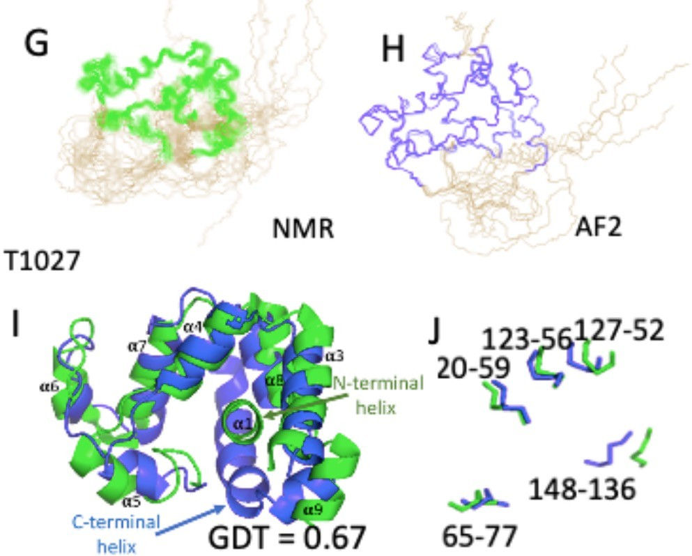
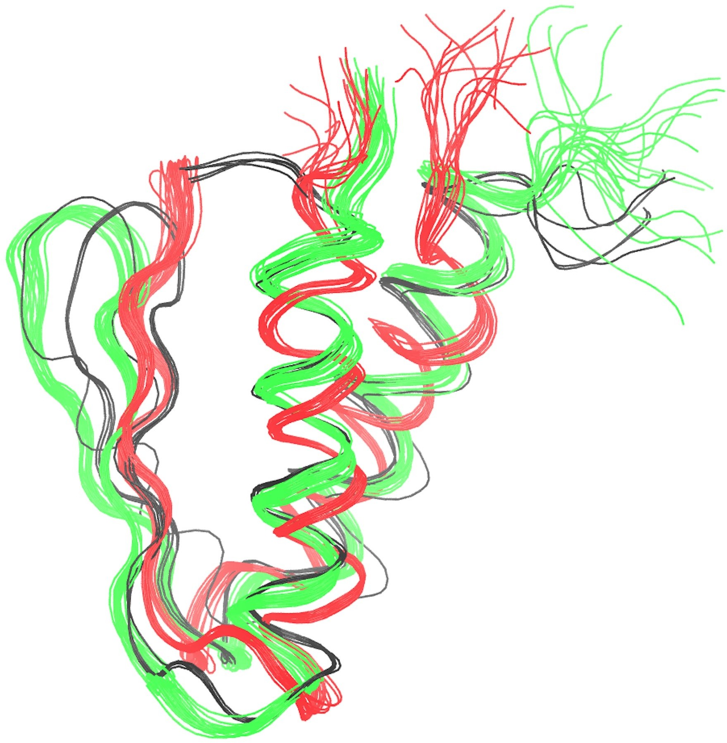
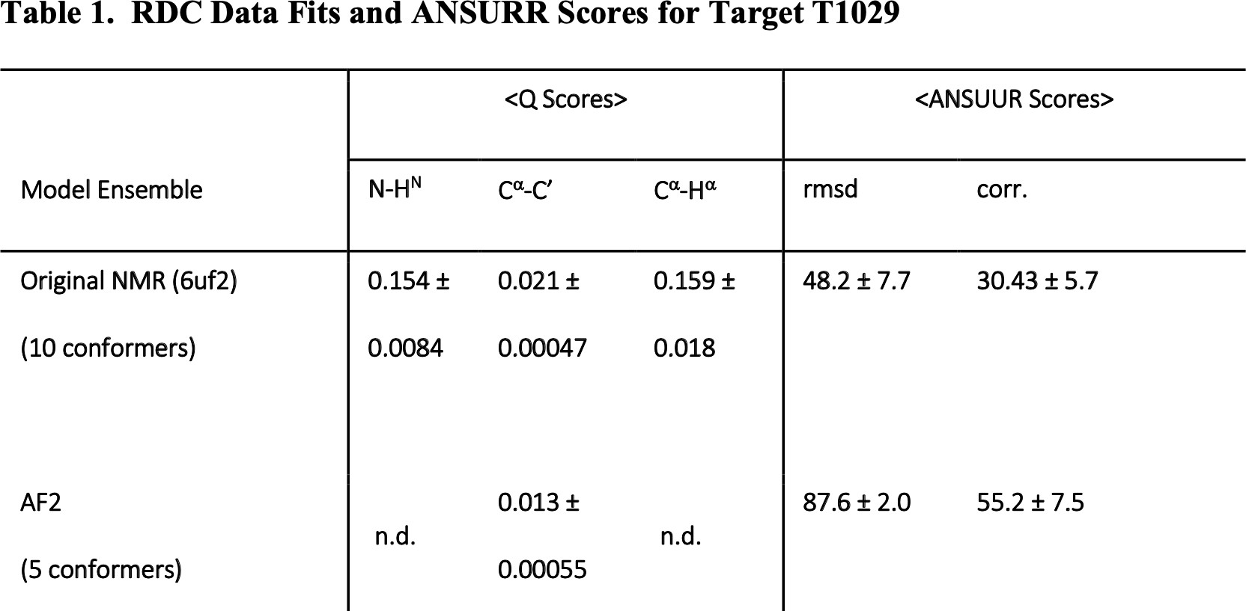
Useful for validation of NMR?
AlphaFold structure fits NMR data better than the NMR structure for CASP target T1029
gpW structures
Old NMR structure (1HYW)
Revised NMR structure (2L6Q)
AlphaFold structure (black)
Huang et al, Proteins, 2021

Slide 32
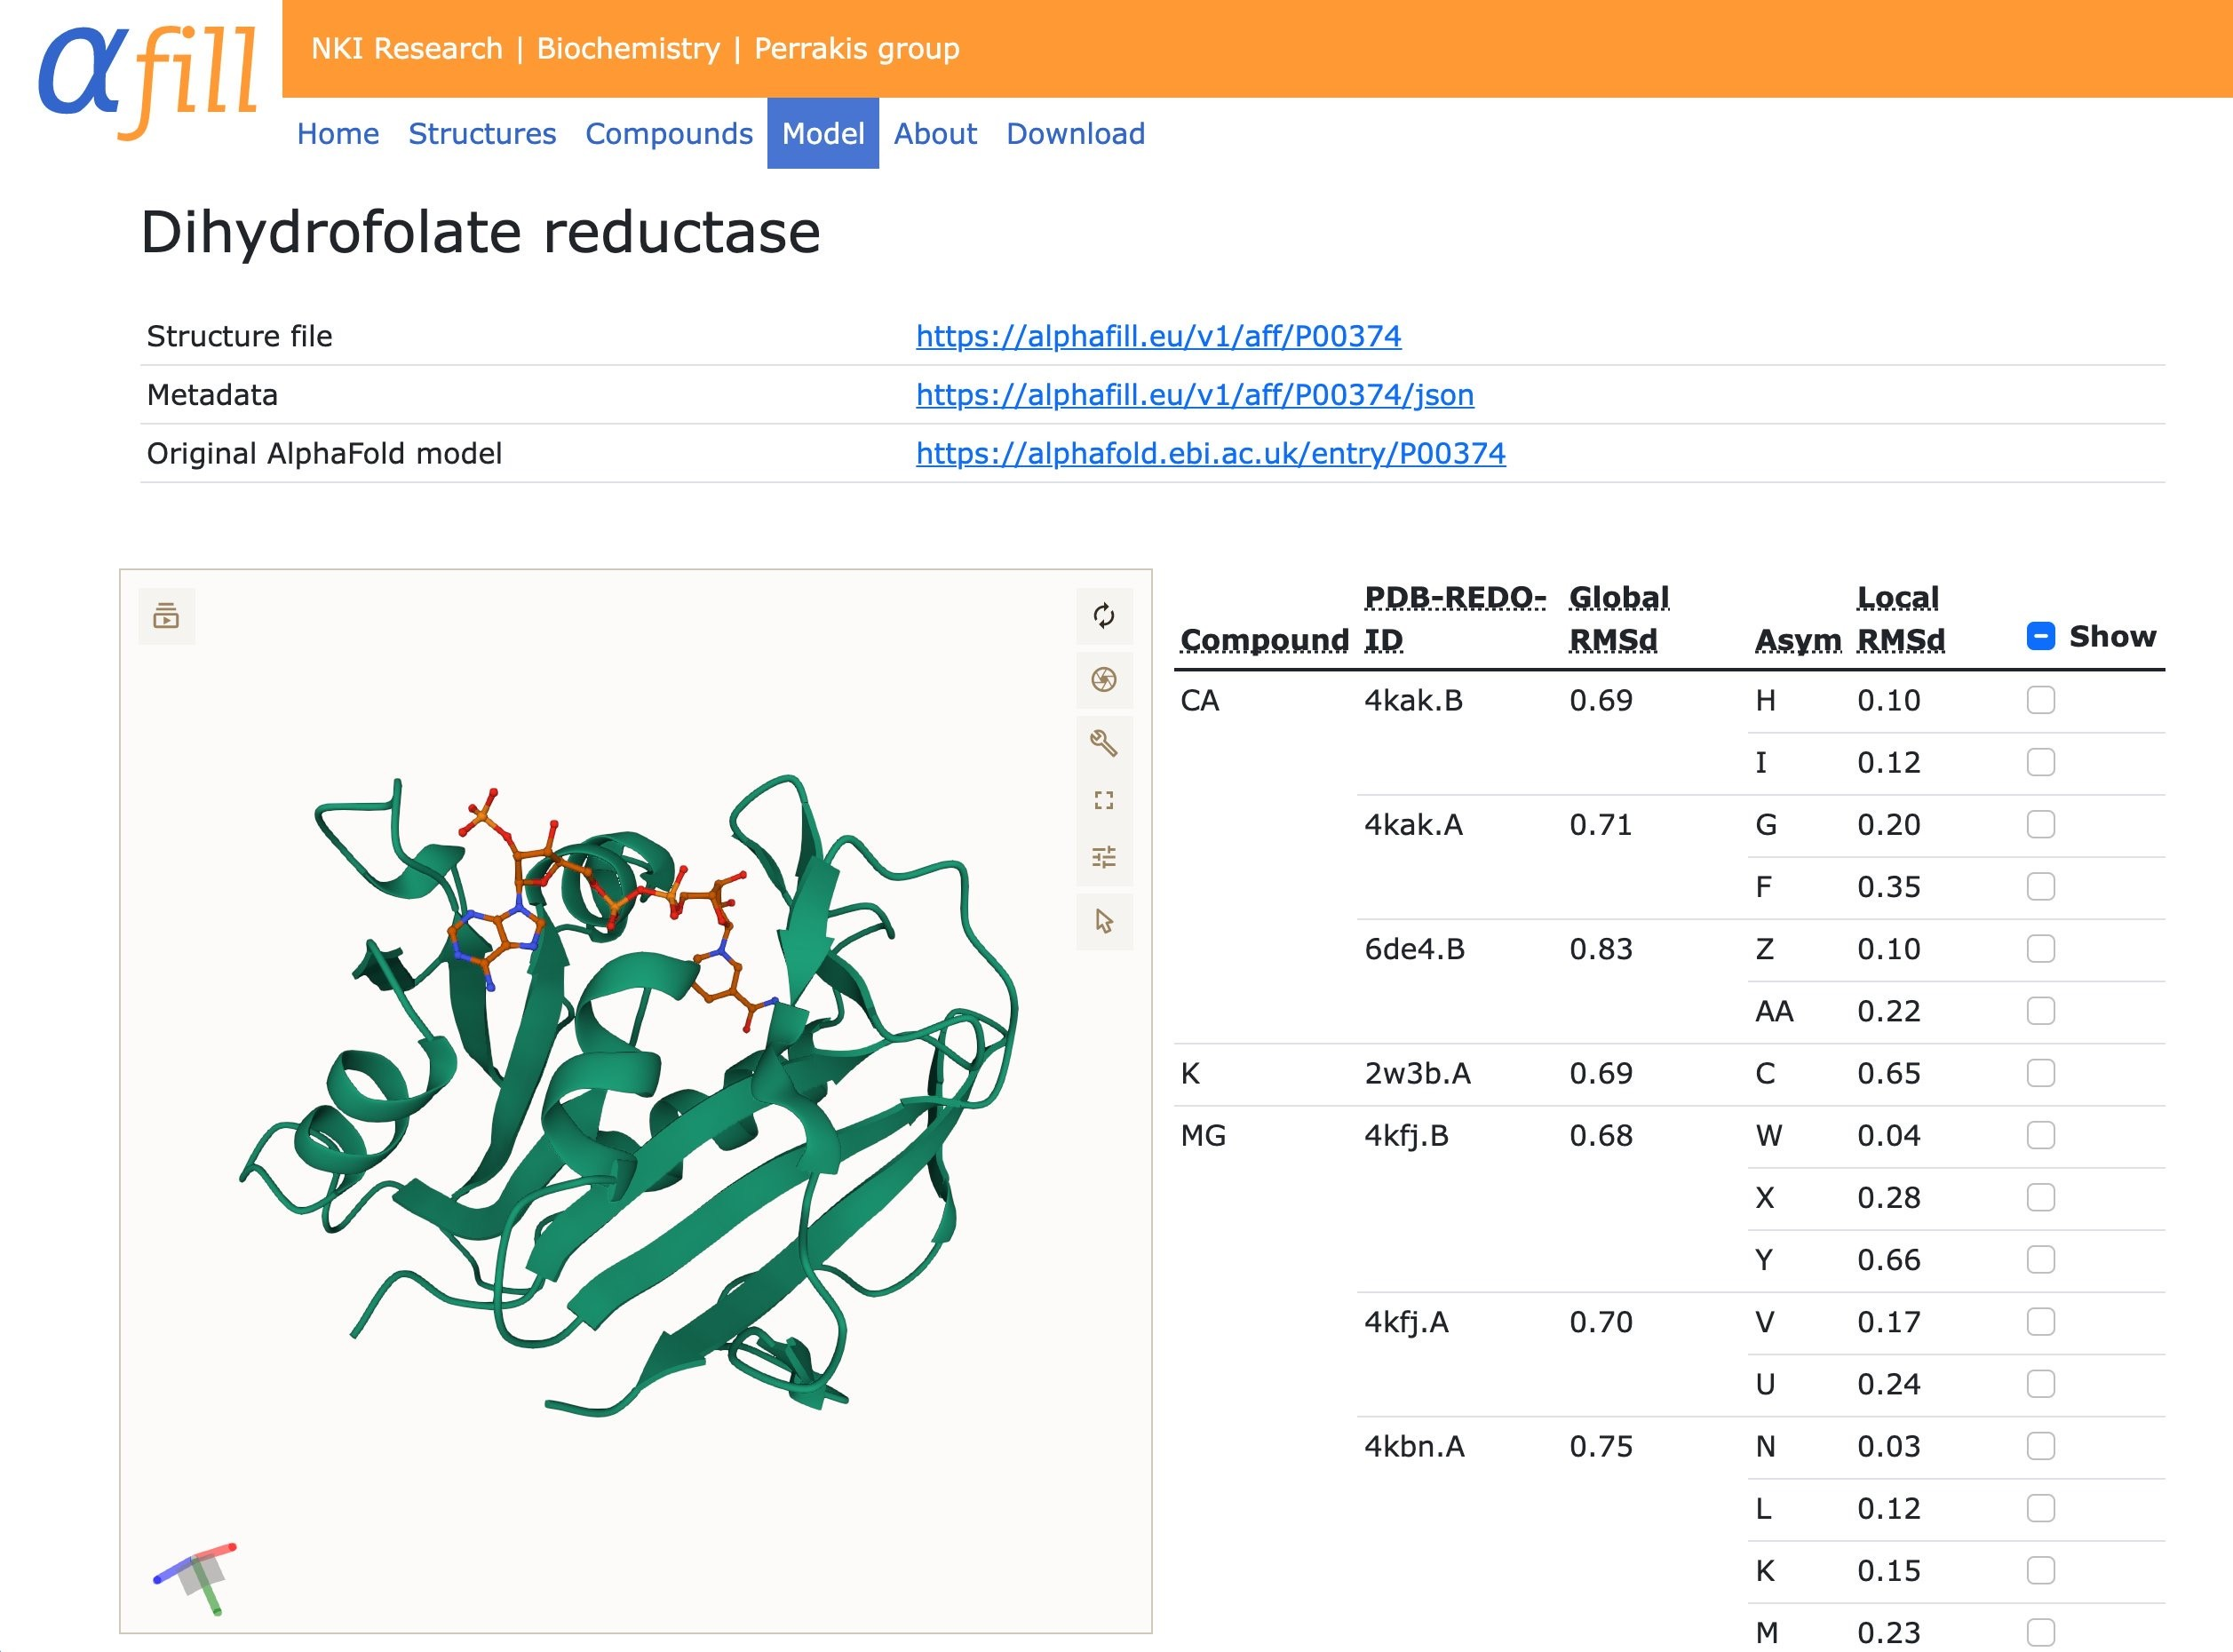
AF2 doesn’t give you ligands & cofactors, but you can sometimes copy/paste them
Hekkelman et al, bioRxiv, 2021
https://alphafill.eu/

Slide 33
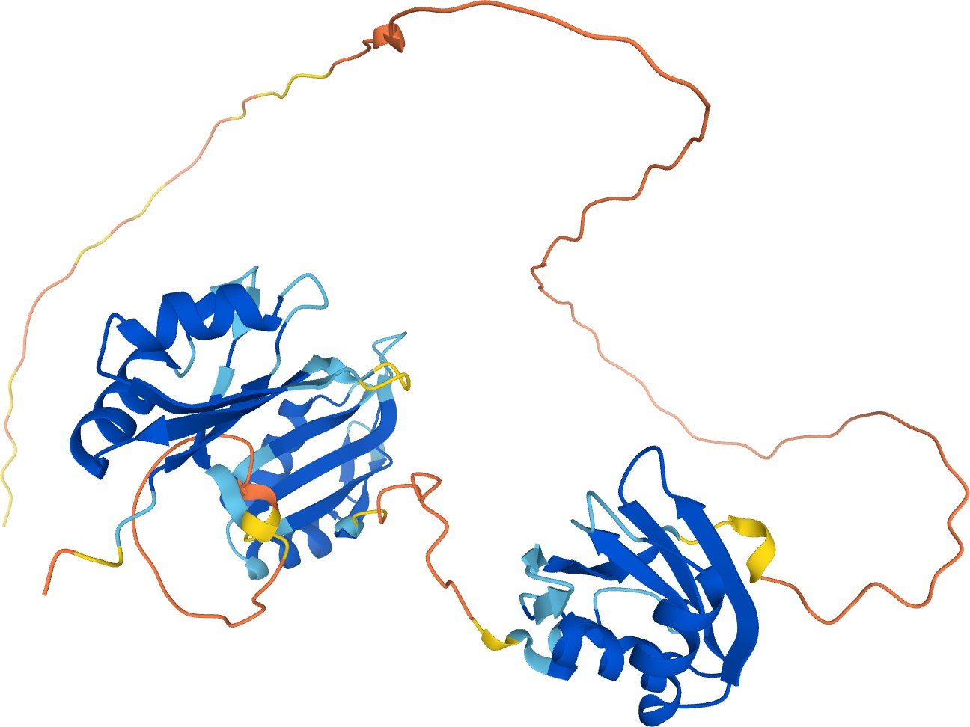
What is next?
Increased multimer accuracy
structure of nucleic acid and ligand interactions
Prediction of mutation effects : Changes in structure stability and binding affinity
It is not designed to predict flexibility or structures of flexible regionsAF2, however, is pretty good at telling us when we should not trust the predictions

Slide 34
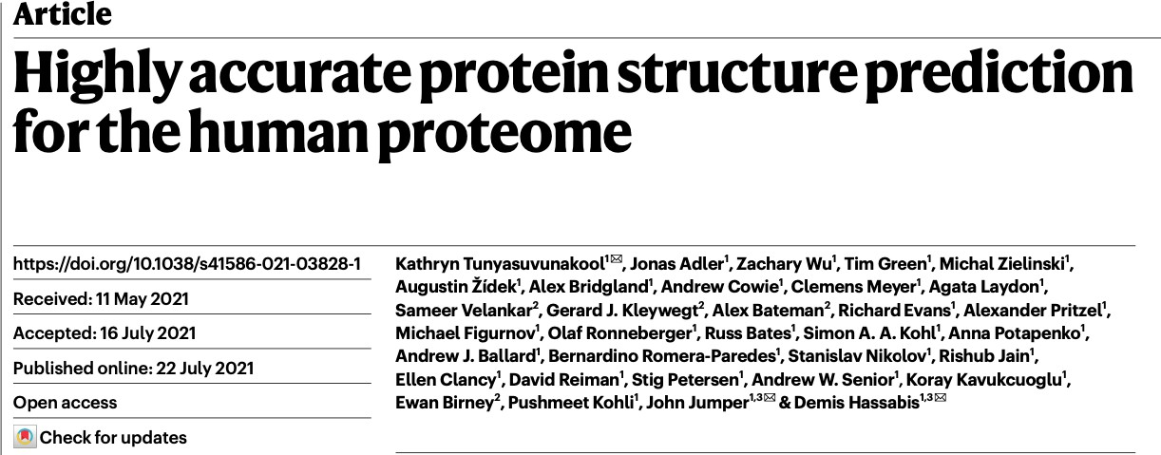
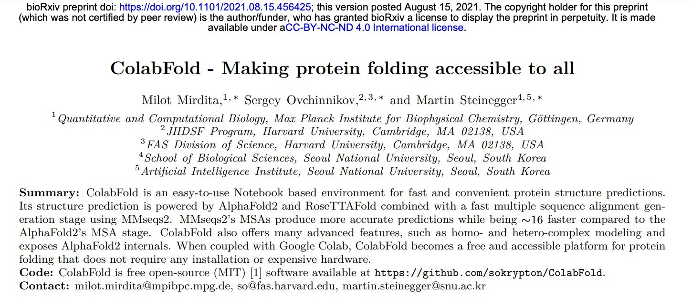
You too can use AlphaFold
https://alphafold.ebi.ac.uk/
https://github.com/sokrypton/ColabFold
Also: https://colab.research.google.com/github/deepmind/alphafold/blob/main/notebooks/AlphaFold.ipynb https://colab.research.google.com/github/phenix-project/Colabs/blob/main/alphafold2/AlphaFold2.ipynb https://github.com/deepmind/alphafold/

Slide 35
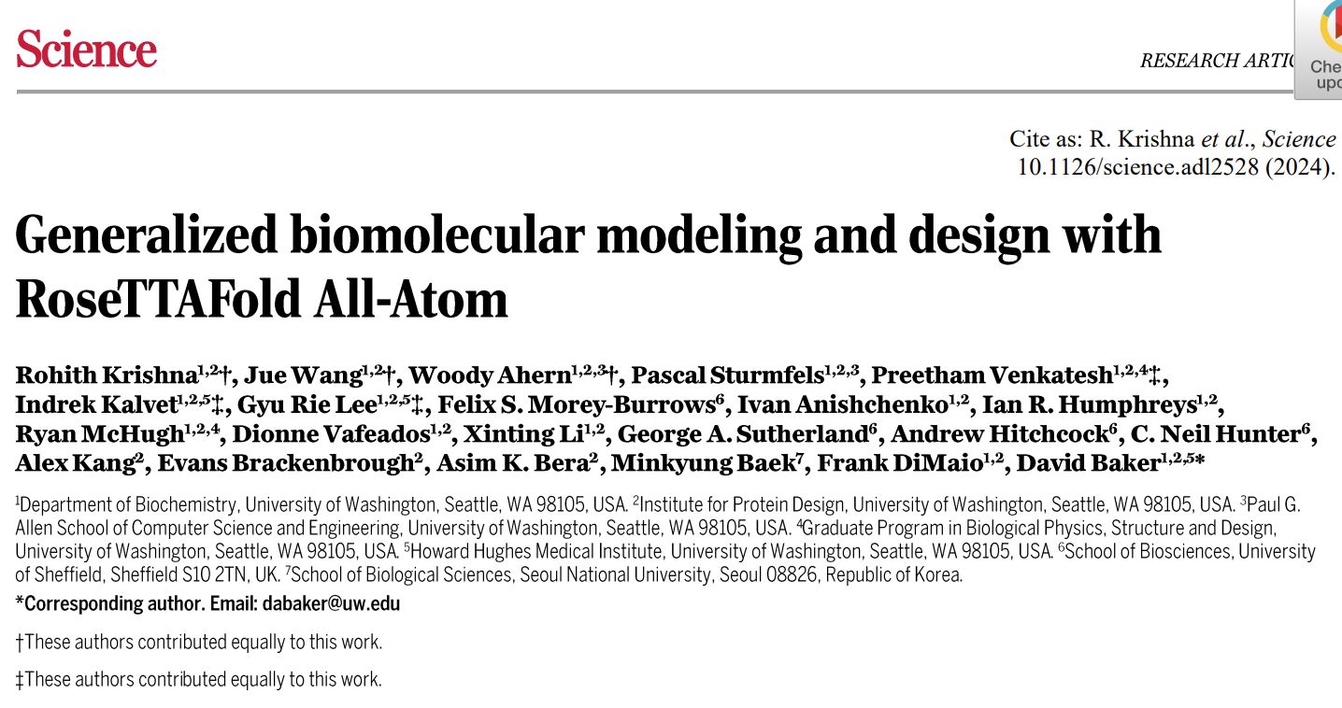
𝐑𝐨𝐬𝐞𝐓𝐓𝐀𝐅𝐨𝐥𝐝 𝐀𝐥𝐥-𝐀𝐭𝐨𝐦 (RF-AA),

Slide 36
𝐑𝐨𝐬𝐞𝐓𝐓𝐀𝐅𝐨𝐥𝐝 𝐀𝐥𝐥-𝐀𝐭𝐨𝐦 (RF-AA),
the long-awaited "𝐩𝐫𝐞𝐝𝐢𝐜𝐭-𝐞𝐯𝐞𝐫𝐲-(𝐛𝐢𝐨)𝐦𝐨𝐥𝐞𝐜𝐮𝐥𝐞" tool, is finally out in Science The preprint was earlier released last year Oct., 𝐑𝐨𝐬𝐞𝐓𝐓𝐀𝐅𝐨𝐥𝐝 𝐀𝐥𝐥-𝐀𝐭𝐨𝐦 is a network capable of predicting the structures of all atoms of a biological unit, including:
▪ proteins ▪ nucleic acids ▪ small molecules
▪ metals
▪ covalent modifications (covalently modified proteins)
In other words,
RF-AA can generate accurate models for complexes of 𝐩𝐫𝐨𝐭𝐞𝐢𝐧𝐬 𝐰𝐢𝐭𝐡 𝐭𝐰𝐨 𝐨𝐫 𝐦𝐨𝐫𝐞 𝐧𝐨𝐧-𝐩𝐫𝐨𝐭𝐞𝐢𝐧 𝐦𝐨𝐥𝐞𝐜𝐮𝐥𝐞𝐬 (small molecules, metals, nucleic acids, etc.)
RF-AA also provides error estimates of its predictions.

Slide 37
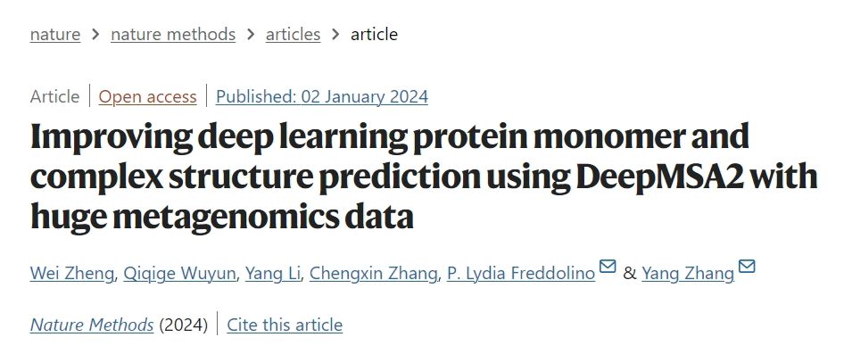
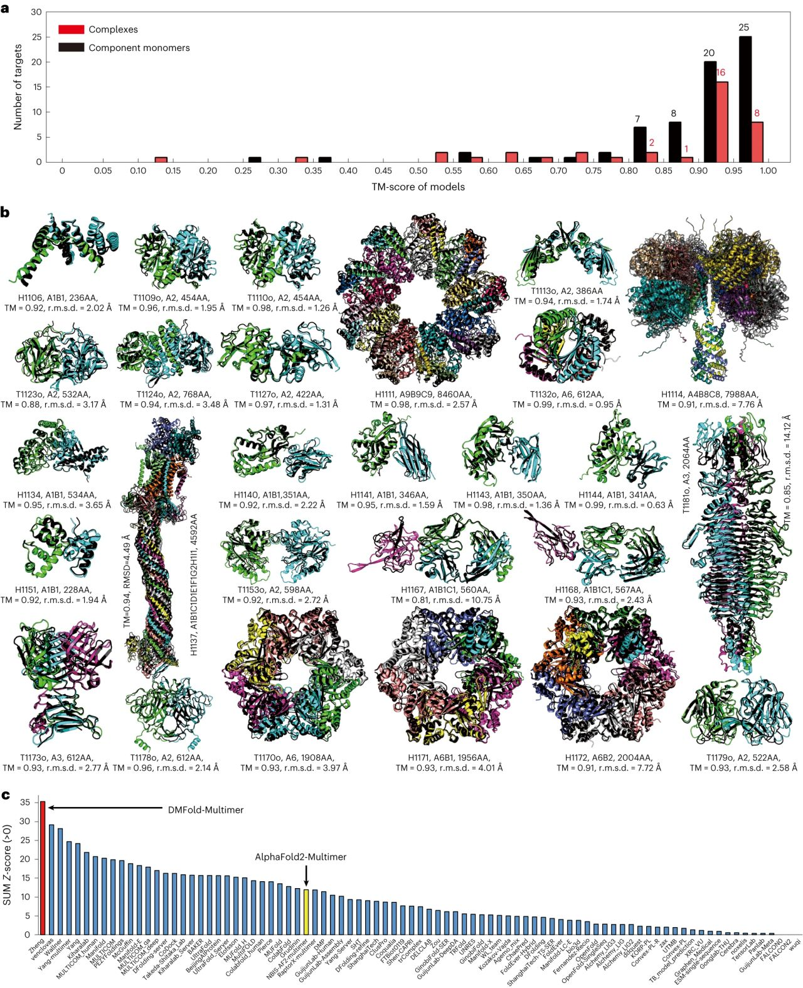
𝐃𝐌𝐅𝐨𝐥𝐝-𝐌𝐮𝐥𝐭𝐢𝐦𝐞𝐫
In the CASP15, DMFold-Multimer achieved a cumulative Z-score of 35.30.
Which was 3x higher than that of AF2-multimer (the version used in the competition),
And 21.1% higher than the 2nd-best performing tool.
𝐃𝐌𝐅𝐨𝐥𝐝 and 𝐃𝐌𝐅𝐨𝐥𝐝-𝐌𝐮𝐥𝐭𝐢𝐦𝐞𝐫 replace the default AF2 MSA with DeepMSA2 for significantly improved protein monomer and complex structure prediction.
The protein structure prediction tool that outperformed 86 𝐨𝐭𝐡𝐞𝐫 𝐦𝐞𝐭𝐡𝐨𝐝𝐬 in CASP15 complex modeling section is now published in Nature

Slide 38
𝐃𝐌𝐅𝐨𝐥𝐝-𝐌𝐮𝐥𝐭𝐢𝐦𝐞𝐫
5,042 difficult sequences for which AF2 produced
DMFold showed 11% higher pLDDT than AF2,
With 94% of the DMFold models having a higher pLDDT than the corresponding AF2 model.
up to 16.1% improvement over AF-Multimer in protein complex prediction of difficult targets and comparable performance on "simple" targets.

Slide 39
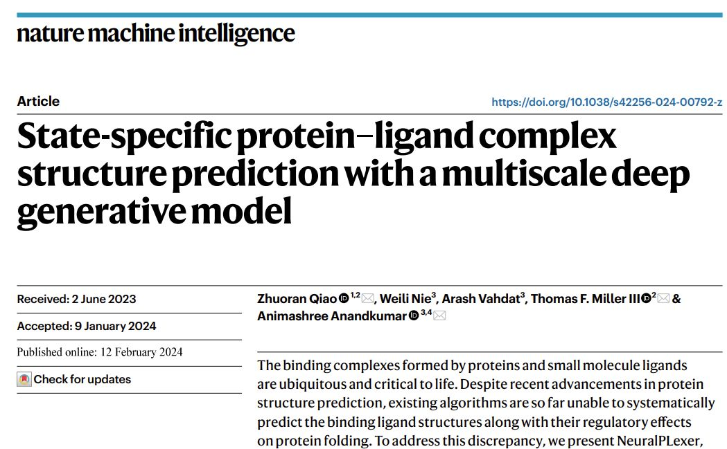
𝐍𝐞𝐮𝐫𝐚𝐥𝐏𝐋𝐞𝐱𝐞𝐫:
𝐍𝐞𝐮𝐫𝐚𝐥𝐏𝐋𝐞𝐱𝐞𝐫: A tool for predicting protein–ligand complex structures using protein sequence and ligand molecular graph inputs
"...on blind protein–ligand docking, NeuralPLexer improves the prediction success rate by up to 78% compared with the best-performing existing method on the PDBBind2020 benchmark.“
".

Slide 40
Thanks

