Slide 1
Chromatin Fiber Dynamics Workshop
Daniel Darling - November 2024 Al-Sady Lab

Slide 2
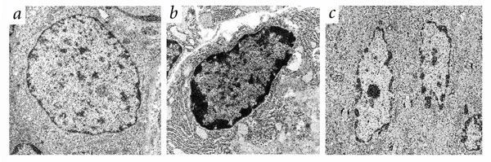
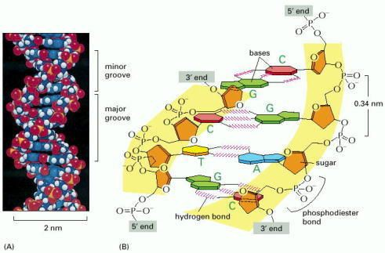
The challenge of DNA compaction
The Problem
DNA per cell is ~2m long
Nucleus diameter is 10uM
DNA is negatively charged
DNA needs to be very tightly regulated and maintained
S. Pockwinse, Nature Genetics 2002
The Solution Chromatin
Bruce Alberts, Molecular Biology of the Cell. 4th Edition, 2002

Slide 3
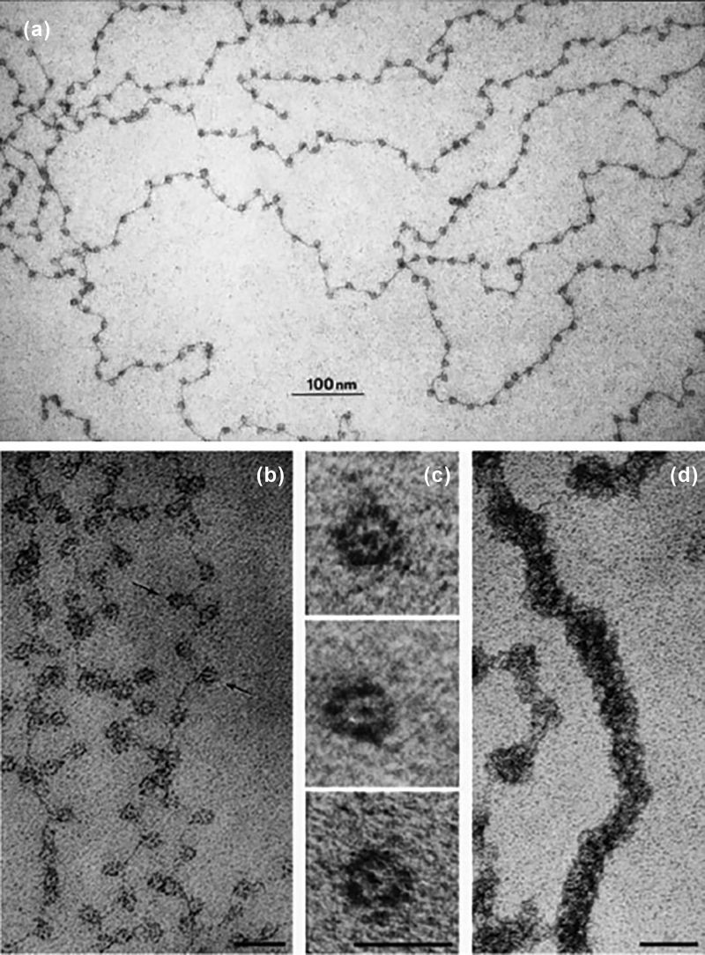
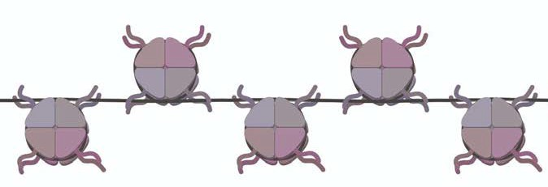
Chromatin Components
DNA
Histones (H2A, H2B, H3, H4)
Basic subunit (Nucleosome) consists of ~147bp DNA wrapped around a central histone octamer core
Ada and Don Olins Nature 1974

Slide 4
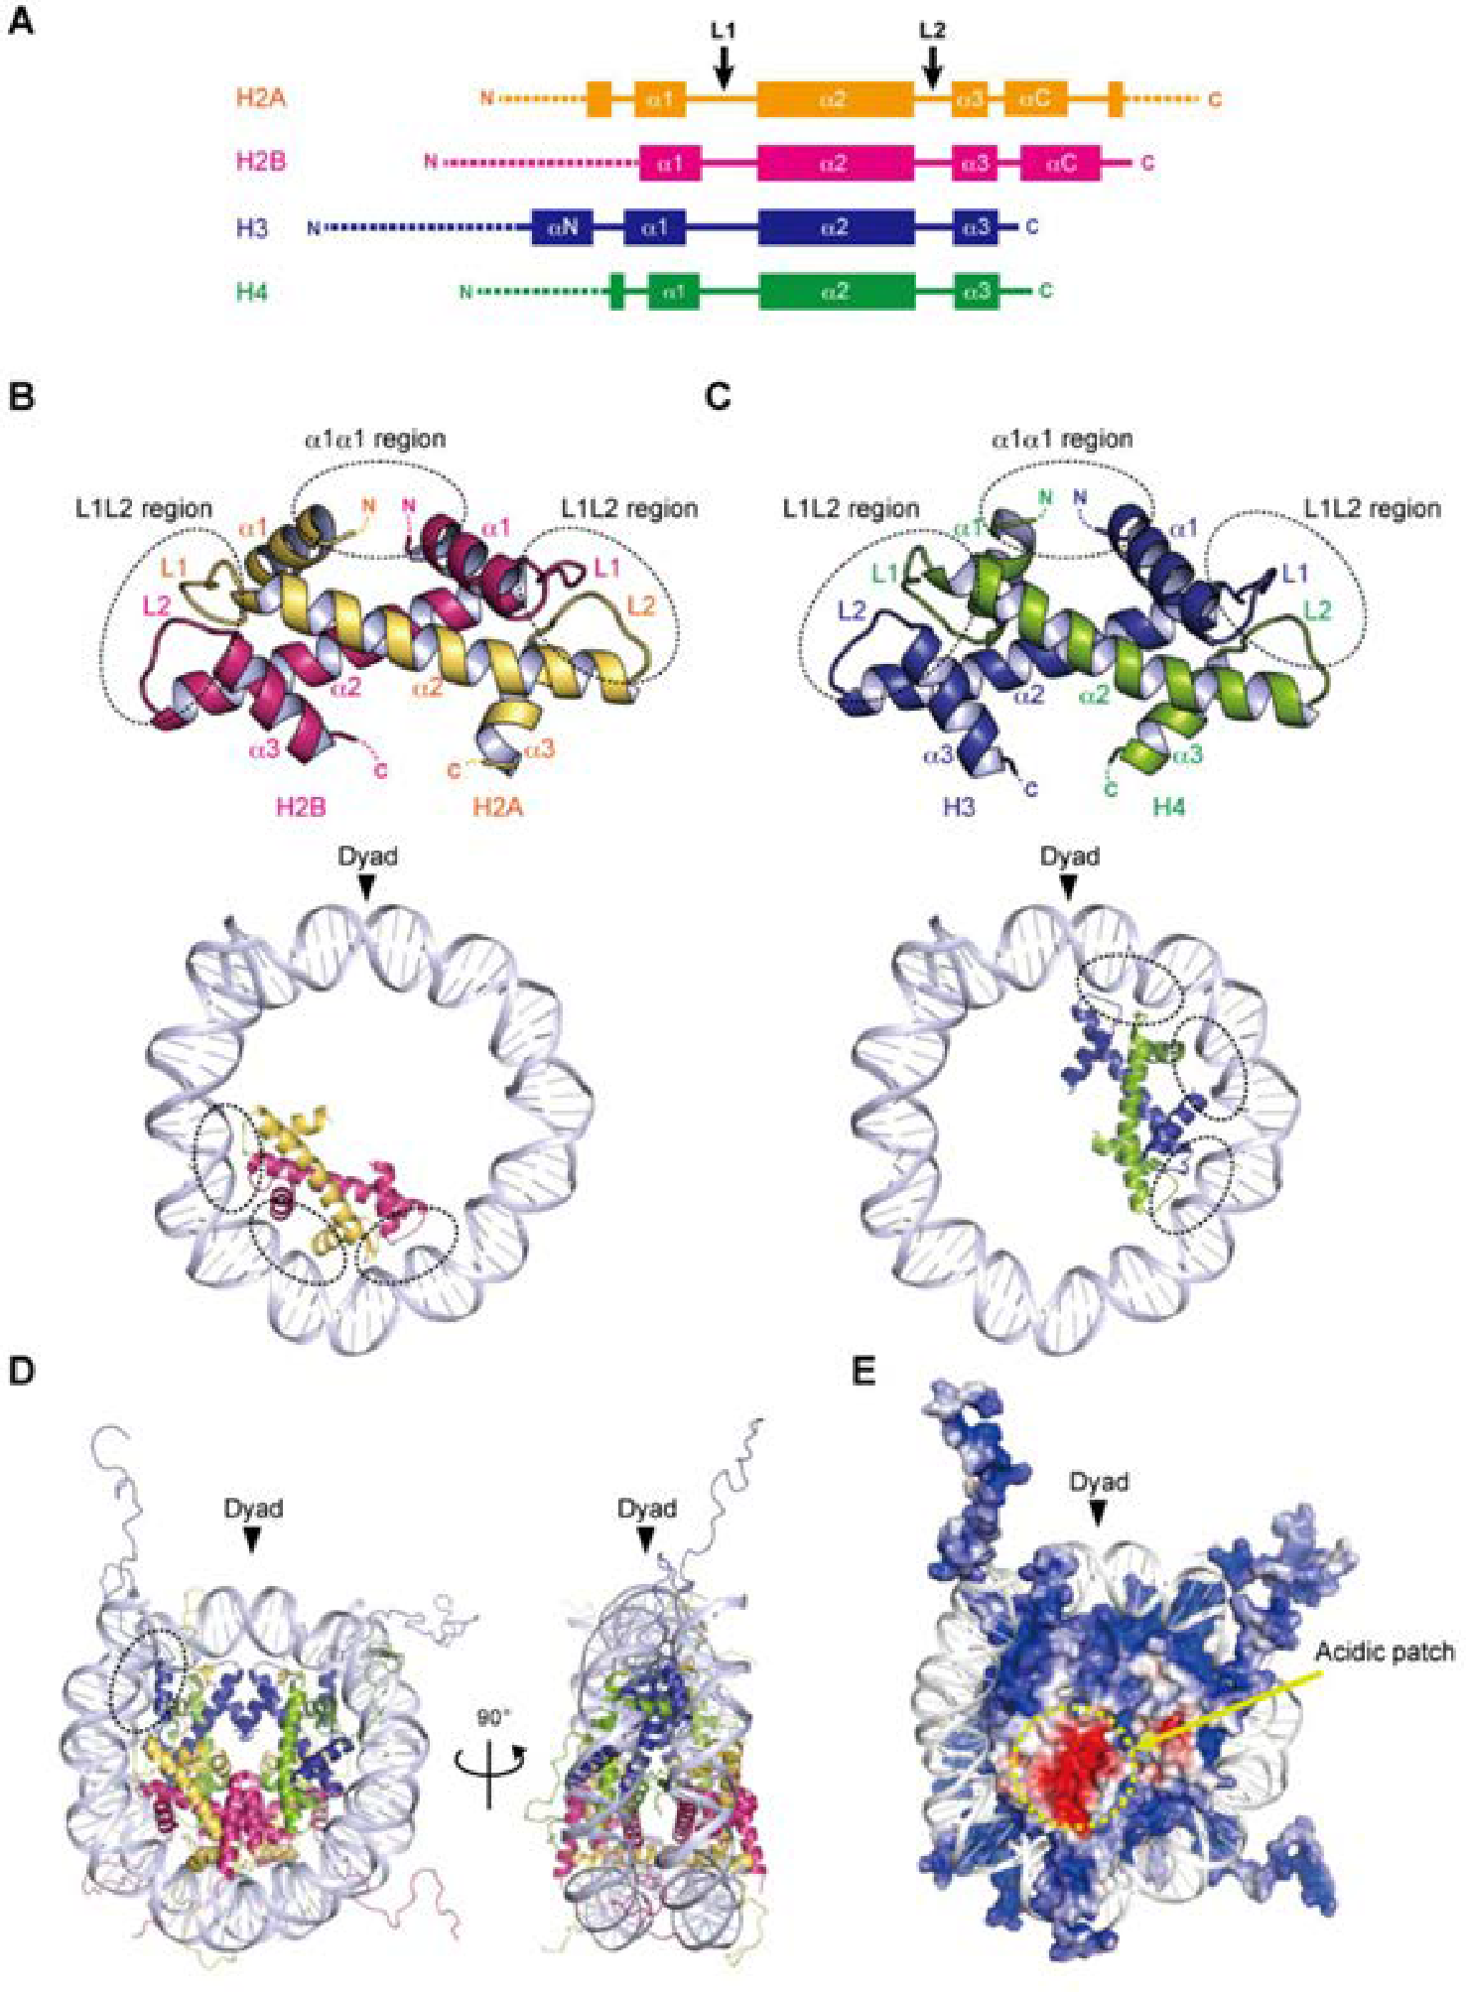
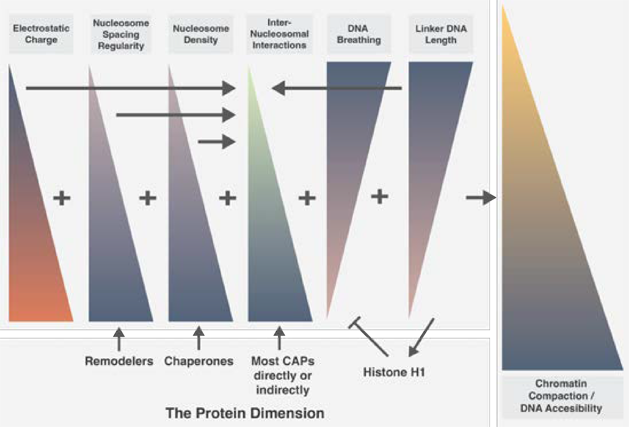
Nucleosome Highlights
Positively charged residues interact with DNA
Histone Tails
Acidic Patch
Histone H1
Variable length of Linker DNA (~10-90bp)
Sato, S.; Dacher, M.; Kurumizaka, H. Epigenomes 2022

Slide 5
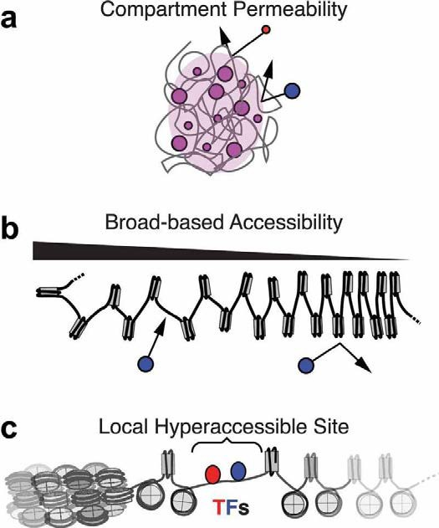
Chromatin is a dynamic polymer that modulates DNA Accessibility
Variations in chromatin structural modulators yield variable dynamic states of chromatin with different DNA accessibilities and functions
Nucleosomal DNA is inherently insulated
There is a dynamic range of DNA accessibility within chromatin at different scales dependent on chromatin structural parameters
Mansisidor AR, Risca VI Nucleus. 2022

Slide 6
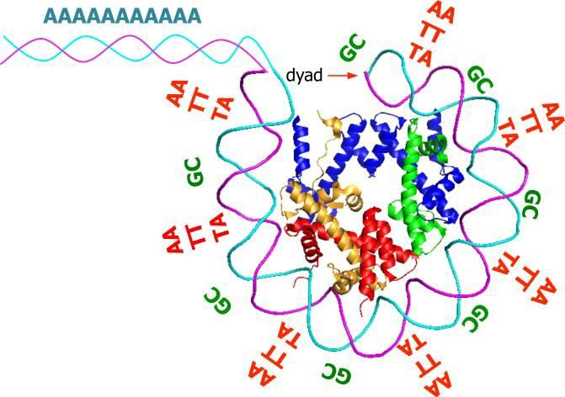
The eﬀect of DNA sequence on Nucleosome Position
DNA sequence highly influences Nucleosome positioning
Nucleosomes need to rotate the DNA ~600 degrees
More bendy = more favorable
601 sequence
Linker DNA length and DNA breathing are both highly affected by where the nucleosomes naturally position and how
Struhl K, Segal E. Mol Biol. 2013

Slide 7
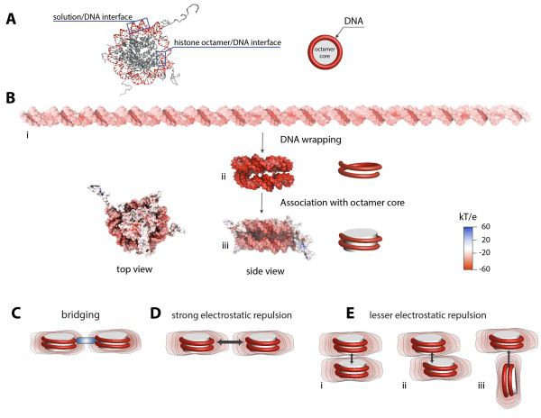
Structure Modulators - Electrostatic State
The nucleosome has a net negative charge due to the strong negative charge of DNA
The structure of the nucleosome creates a electrostatic field around the DNA limiting the potential orientations of nucleosome interactions
Gebala et al. eLife 2019

Slide 8
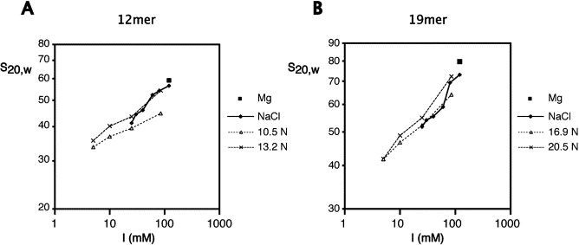
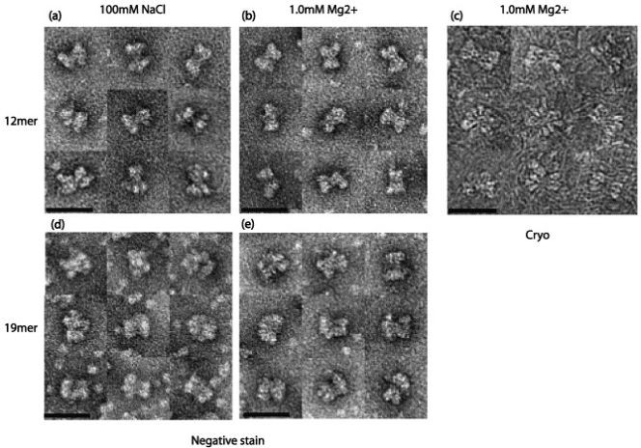
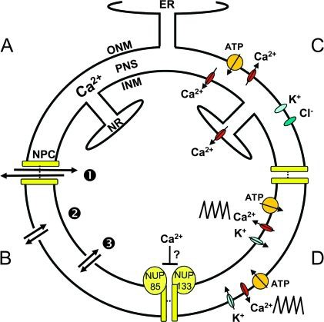
Structure Modulators - Cations Mg²⁺, Ca²⁺, Na⁺, K⁺
The relative electrostatic negative forces of the nucleosome can be neutralized by cations
Neutralization leads to greater chromatin compaction
Cations concentrations are tightly regulated in the nucleus
Van A.T. Huynh, Philip J.J., Daniela Rhodes JMB, 2005
Matzke AJ, Weiger TM, Matzke M. Mol Plant. 2010

Slide 9
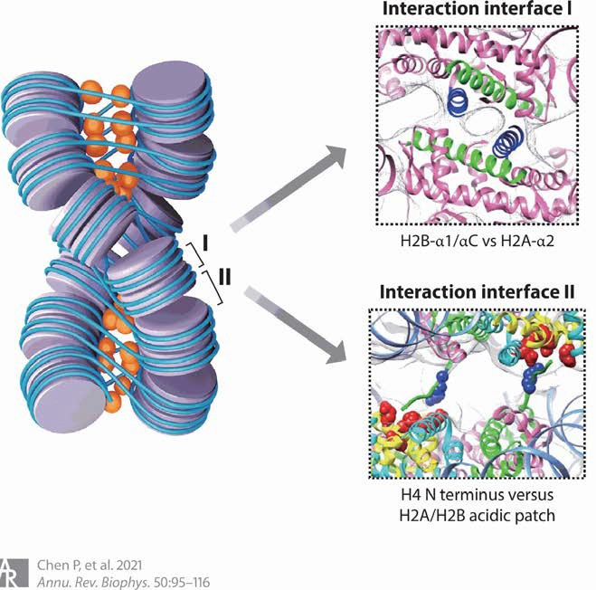
Modes of Internucleosomal Interaction
Type 1 Internucleosomal Interactions Faces of adjacent nucleosomes interact mediated by H2B-ɑ1/ɑC of nucleosome 1 with the adjacent H2A-ɑ2 of nucleosome 2
Type 2 Internucleosomal Interactions Angled interaction between two adjacent nucleosomes mediated by the H4 tail of nucleosome 1 interacting with the H2A/H2B acidic patch of nucleosome 2
These interactions can be transient and dynamic
Chromatin associated proteins can modulate the stability of these interactions

Slide 10
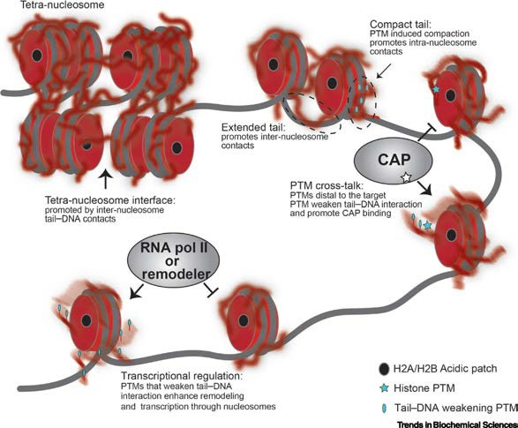
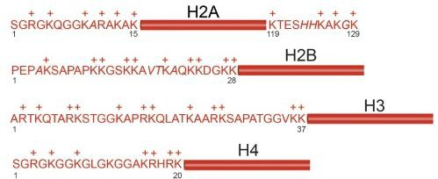
Structure Modulators - Histone Tails
Histone tails contain many positively charged residues and are intrinsically disordered (not resolved in structures)
Histone tails adopt a range of conformations and exchange between these conformations (Fuzzy complex)
Tails interact with nucleosomal DNA, linker DNA, chromatin associated proteins and nucleosomes in cis and trans
PTMs can modulate the range of these conformations and interactions regulating chromatin structure
Ghoneim, Mohamed et al. Trends in Biochemical Sciences 2021

Slide 11
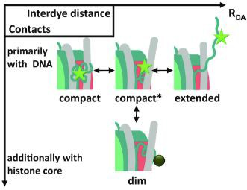
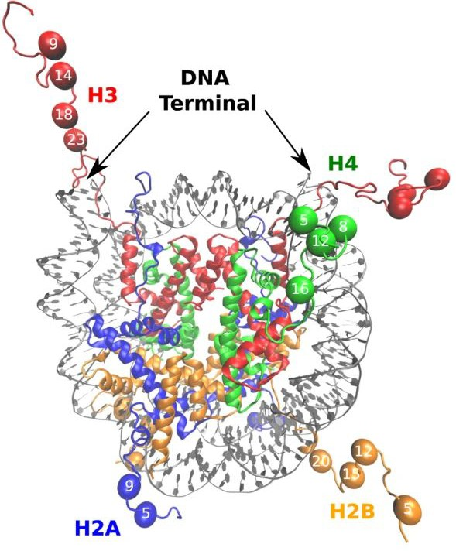
Structure Modulators - Individual Histone Tails
Lehmann K, Felekyan S, Kühnemuth R, Dimura M, Tóth K, Seidel CAM, Langowski J. Nucleic Acids Res. 2020
H3 - At entry/exit points of DNA, propensity to form helices, affects DNA breathing, proposed to have 4 main conformational states.
H4 - Extend through the face of the nucleosome. Contains two distinct dynamical regions. Interacts with nucleosomal DNA and the acidic patch in cis and trans.
H2A - Has both N and C terminal tails, N tail interacts primarily with nucleosomal DNA, C terminal tail interacts with nucleosomal and linker DNA.
H2B - Protrude from the DNA gyre on the opposite side of H3. Contains two distinct dynamical regions
Chang, L., Takada, S. Sci Rep 2016

Slide 12
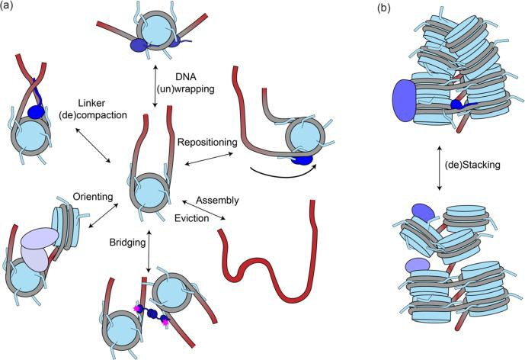
Structural Modulators - Protein interactors
Vincenzo R. Lobbia, Maria Cristina Trueba Sanchez, Hugo van Ingen JMB 2021

Slide 13
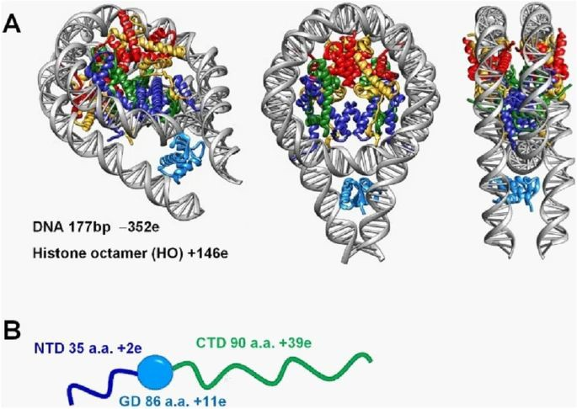
Structure Modulators - Histone H1
H1 binds to the nucleosome at the dyad interacting with linker DNA forming the chromatosome
H1 binding leads to linker compaction (less accessible)
There are 11 different subtypes in humans
They have many PTMs like core histones
Interact with other chromatin associated proteins
Wang, S., Vogirala, V.K., Soman, A. et al. Sci Rep 2021

Slide 14
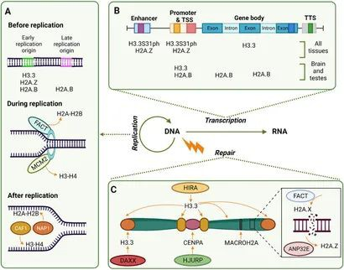
Structural Modulators - Histone Chaperones
Torres-Arciga K, Flores-León M, Ruiz-Pérez S, Trujillo-Pineda M, González-Barrios R and Herrera LA Front. Genet. 2022

Slide 15
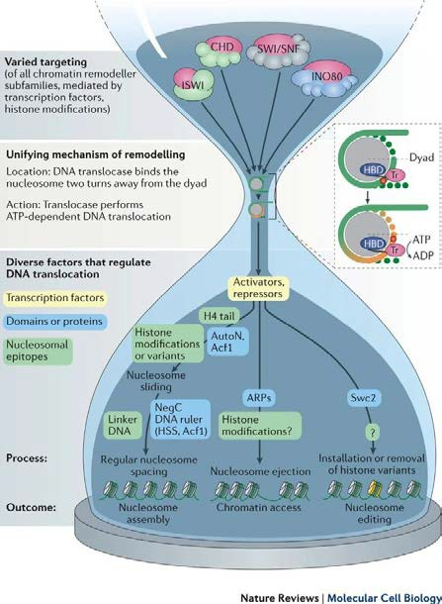
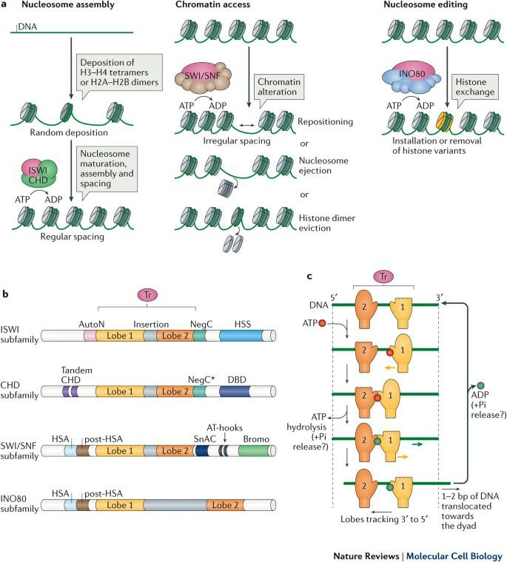
Structural Modulators - ATP dependant remodelers
Clapier, C., Iwasa, J., Cairns, B. et al. Nat Rev Mol Cell Biol 2017

Slide 16
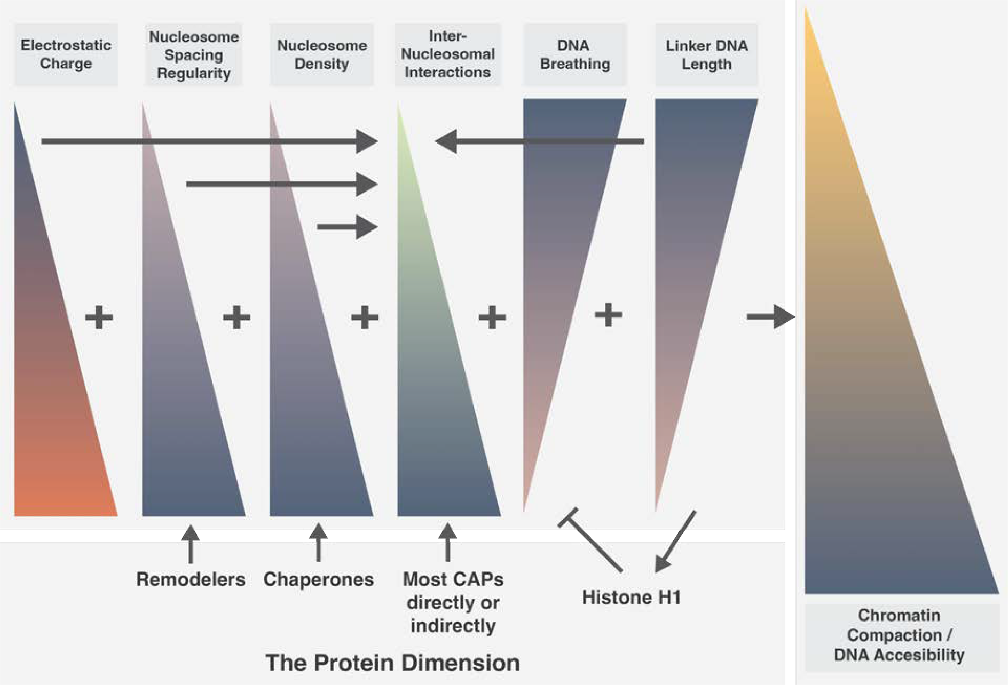
Review - What Aﬀects Chromatin Dynamics

Slide 17
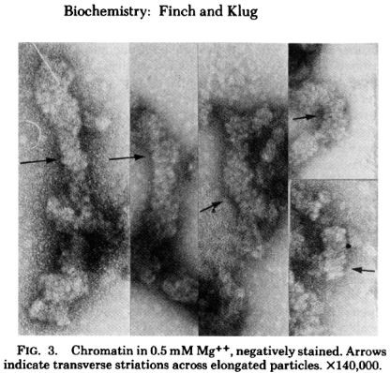
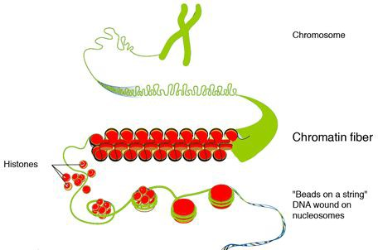
Unraveling Chromatin Structure - 30nm Fiber
Genome.gov
Finch JT, Klug A. Proc Natl Acad Sci USA. 1976

Slide 18
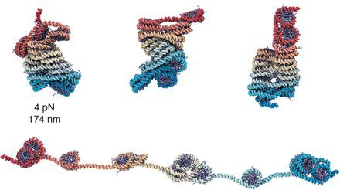
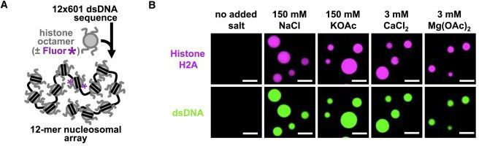
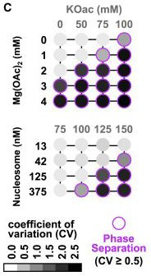
Unraveling Chromatin Structure - Liquid-Like Nucleosome Clutches
In reality the data suggests that under physiological conditions chromatin is a lot more dynamic and the properties of chromatin are “liquid-like”
Nucleosomes are often grouped in “clutches” that are highly variable in structure
Shuming Liu, Xingcheng Lin, Bin Zhang, Nucleic Acids Research 2022
- Structure/accessibility is dependant on the combination of chromatin modifiers described earlier
Gibson, Bryan A. et al. Cell 2019

Slide 19
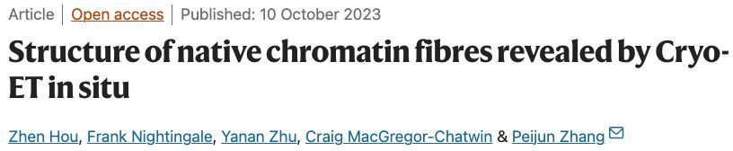
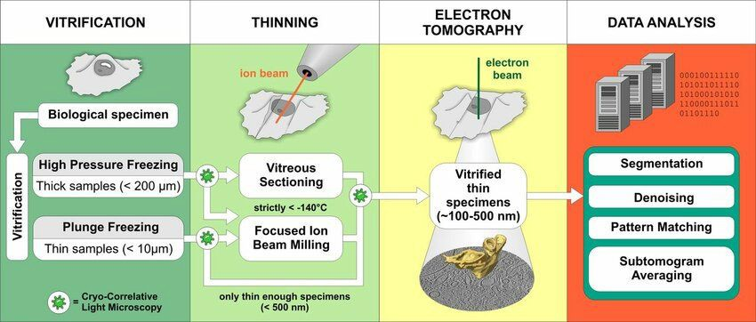
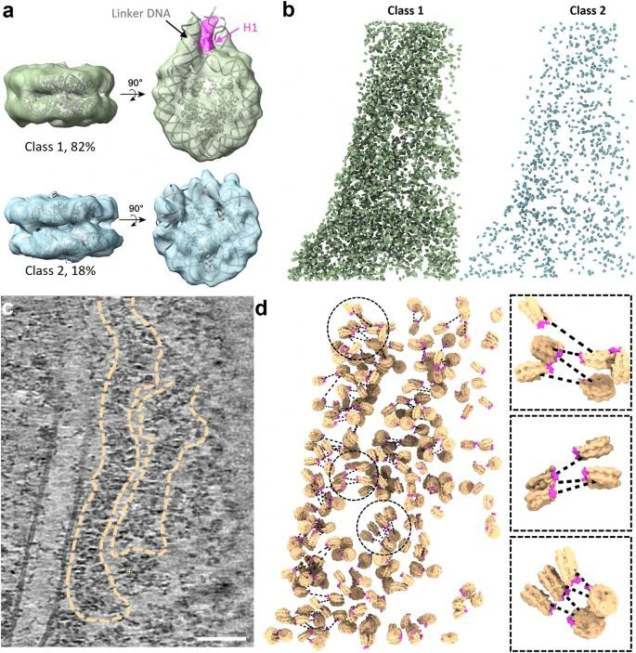
Chromatin Structure Techniques - Cryo-FIB/CryoET
Vladan Lučić, Alexander Rigort, and Wolfgang Baumeister. JCB 2013

Slide 20
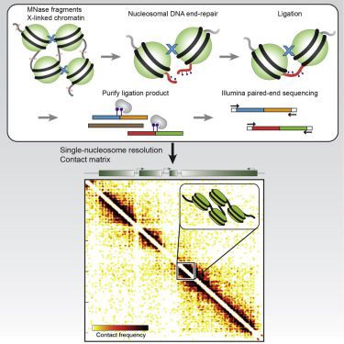
Unraveling Chromatin Structure - Micro-C
Micro-C like its predecessor Hi-C gives information on DNA contacts
Hi-C uses restriction enzymes that give
~4kb resolution with variable distances between cut sites.
Micro-C gets around this limitation by instead using MNase-digestion to get down to nucleosomal resolution
Has been combined with Capture-C to allow for greater depth at targeted genomic regions of interested
(Micro-Capture-C)
Hsieh, Tsung-Han S. et al. Cell 2015

Slide 21
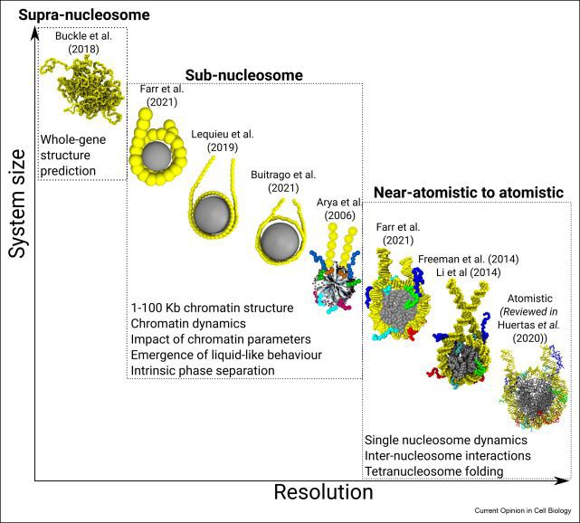
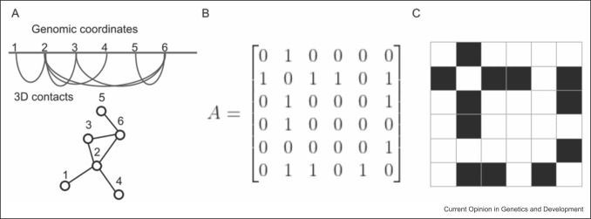
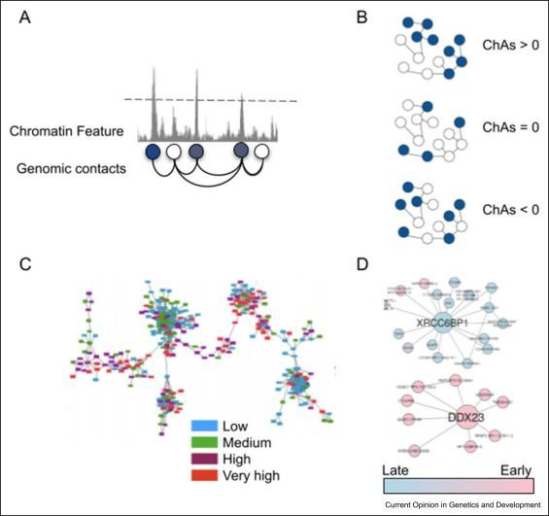
Models of Chromatin Structure - Network Modeling
Vera Pancaldi Current Opinion in Genetics & Development 2023
Jan Huertas, Esmae J. Woods, Rosana Collepardo-Guevara Current Opinion in Cell Biology 2022

Slide 22
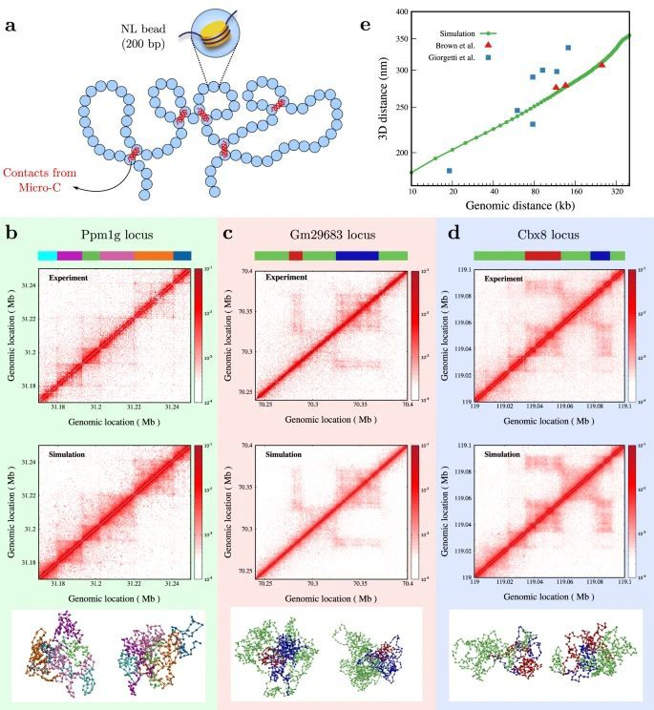
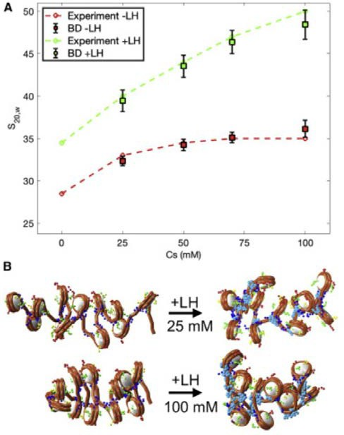
Models of Chromatin - Examples at diﬀerent scales
Kadam, S., Kumari, K., Manivannan, V. Nat Commun 2023
Zilong Li, Stephanie Portillo-Ledesma, Tamar Schlick. Biophysics Journal 2023

Slide 23
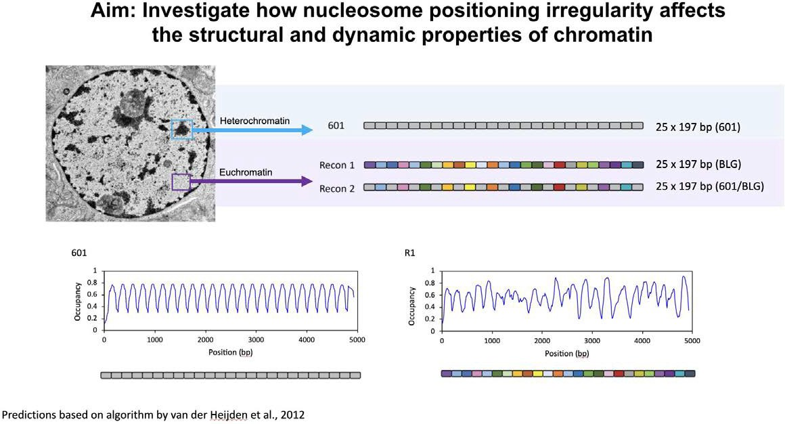
Models of Chromatin Structure - Gilbert Lab Arrays

Slide 24
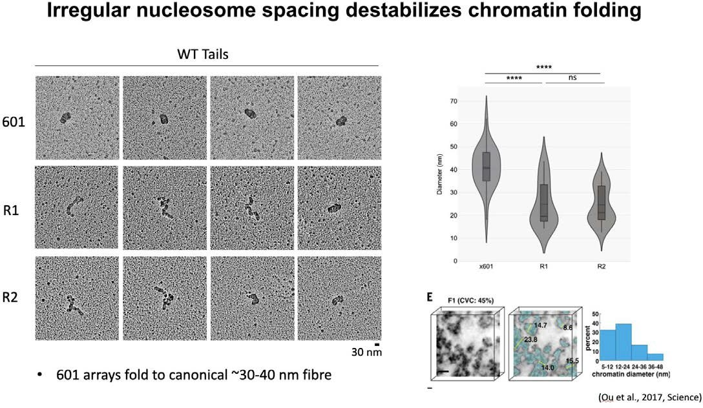
Models of Chromatin Structure - Gilbert Lab Arrays

Slide 25
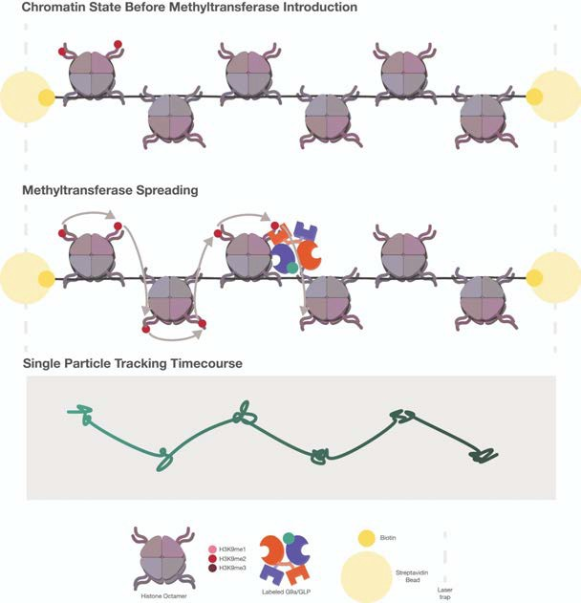
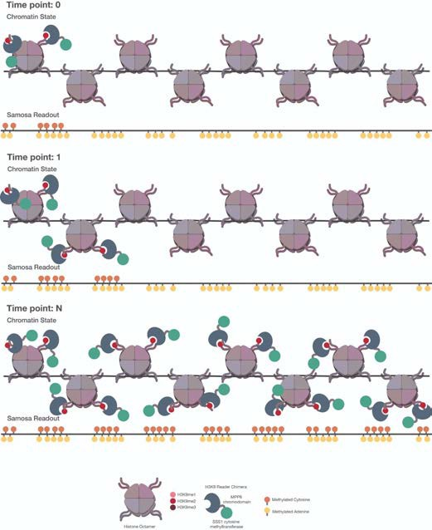
Models of Chromatin Structure - Current Outlook

Slide 26
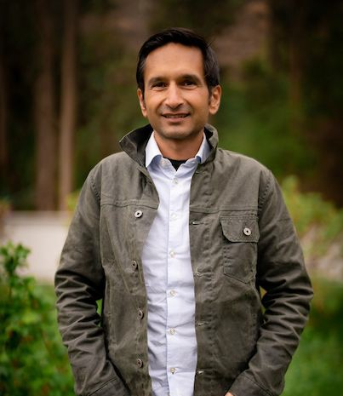

Acknowledgements

