Slide 1

The physics behind
Single Molecule Spectroscopy
Adapted from Lakowicz Principles of Fluorescence Spectroscopy
Kif Lim Workshop 3/2/23

Slide 2
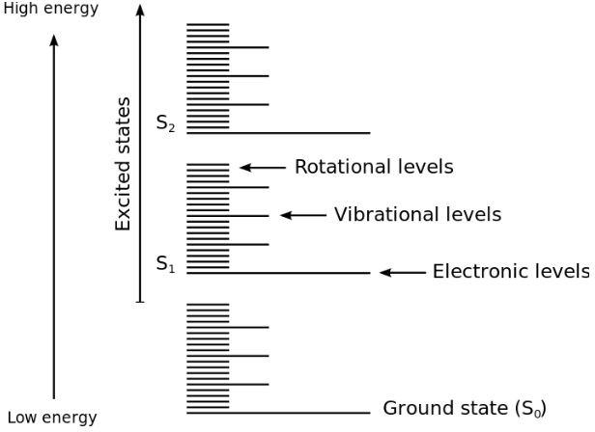
Review of Fluorescence Workshop
Divisions of energy transitions:
Electronic Transition occur when electrons move from one energy level to another.
Vibrational Transitions are due to the elastic movement of chemical bonds. These transitions occur between different vibrational levels of the same electronic state.
Rotational motions involve changes in the molecule’s angular momentum and occur within the same vibrational state.

Slide 3
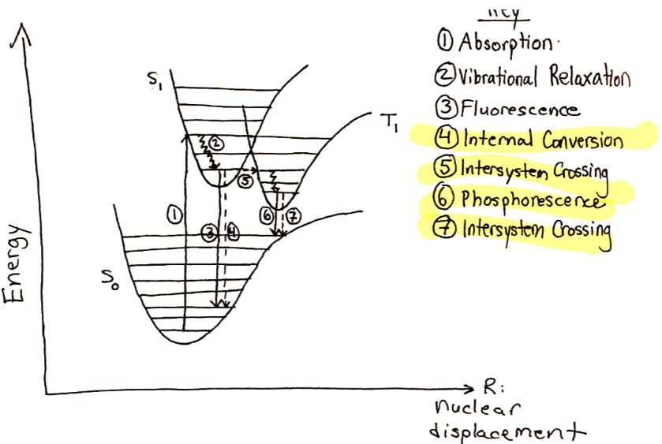
Review of Fluorescence Workshop
Absorption | Electron excited to a higher energy level | ₁₀-18 _{s}
Vibrational Relaxation | Non-radiative transition to lowest vibrational state that involves transferring kinetic energy to other molecules. | ₁₀-15 _{s}
Fluorescence | Radiative emission of light from electronically excited state to ground electronic state. | 10⁻⁹ s
Internal Conversion | Non-radiative emission from electronically excited state to ground electronic state. | 10⁻⁷ s
Intersystem Crossing | Transition from excited singlet state to triplet state requiring change in electron spin. No energy change. | 10⁻⁶ s
Phosphoresc ence | Radiative relaxation from excited triplet state to singlet ground state. | 10⁻⁵ s
The Jablonski diagram summarizes all the possible transitions that can occur after a molecule is photoexcited.

Slide 4
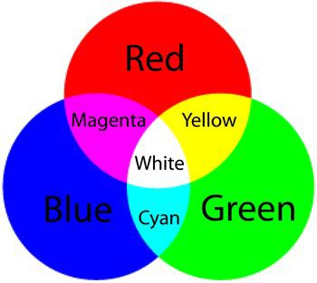
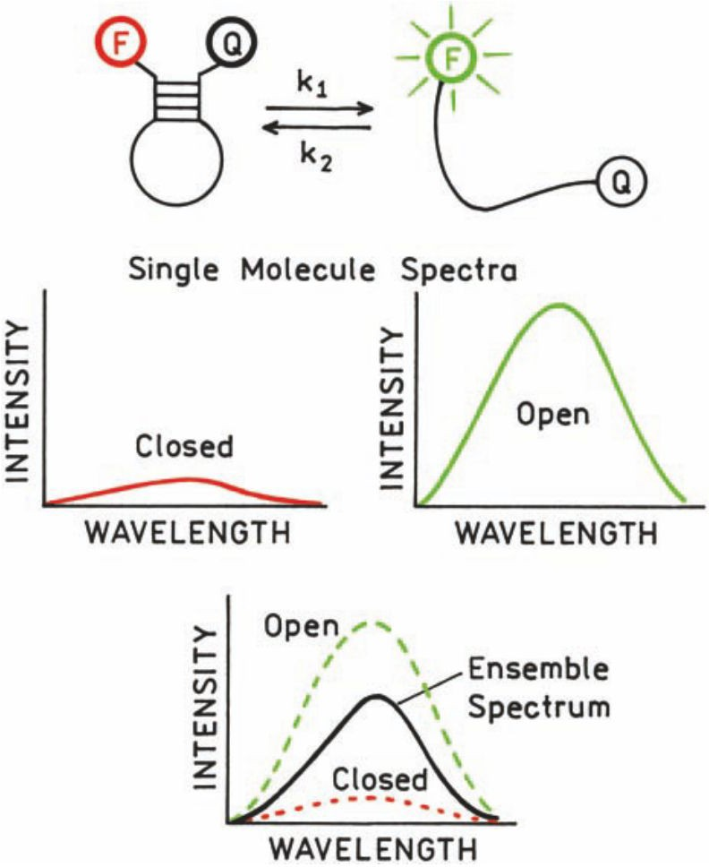
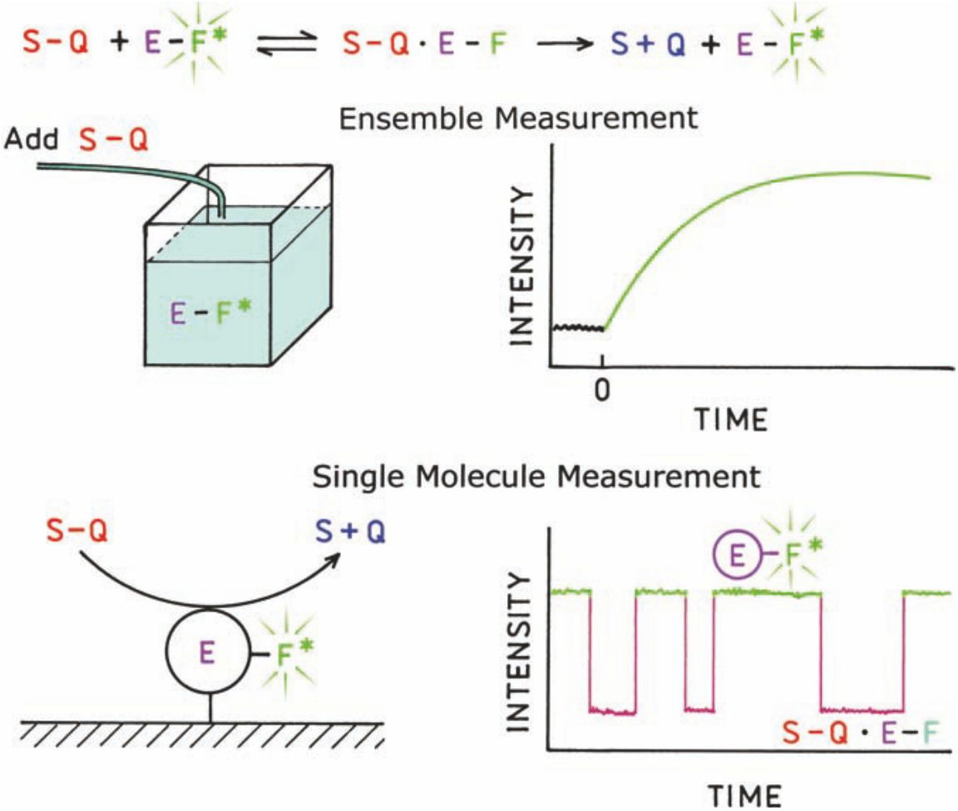
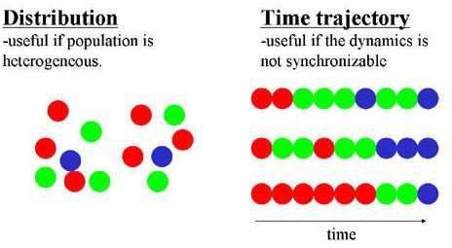
Why single-molecule?
Single-molecule imaging eliminates ensemble averaging, allow us observe heterogeneity in a population.
For instance, single-molecule measurements can capture intermediate states of a process.
Single-molecule detection is also useful to study reaction kinetics without synchronizing the reaction.

Slide 5
Challenges with imaging single-molecules
Impurities in the sample
Single-fluorophores can bleach or blink easily.
  Blinking occurs when molecules undergo intersystem crossing to the triplet state. They remain dark until they undergo phosphorescence to the ground singlet state.
Emission by optical components
Scattered light
Non-specific binding
Collective Raman Scattering of solvent molecules

Slide 6
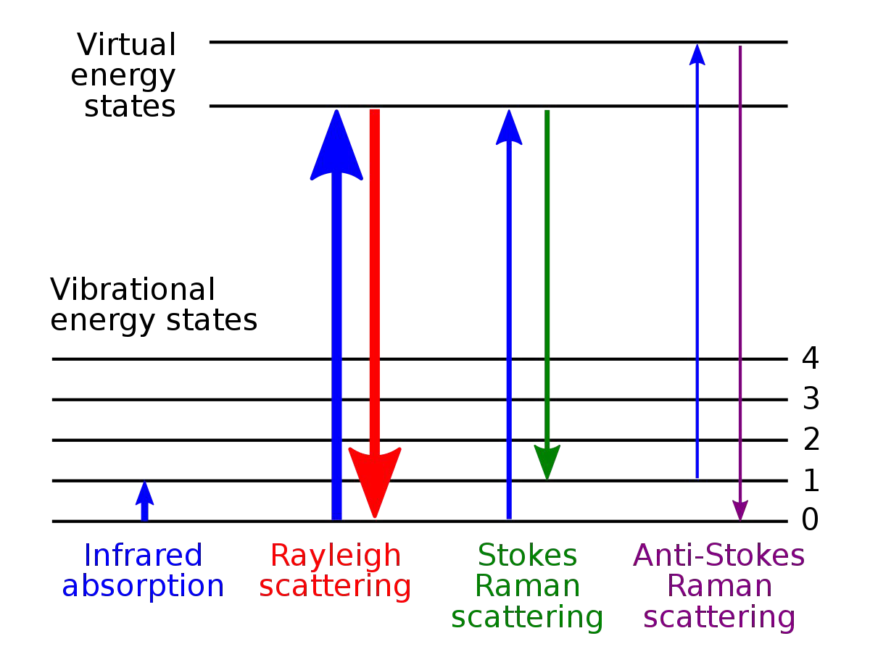
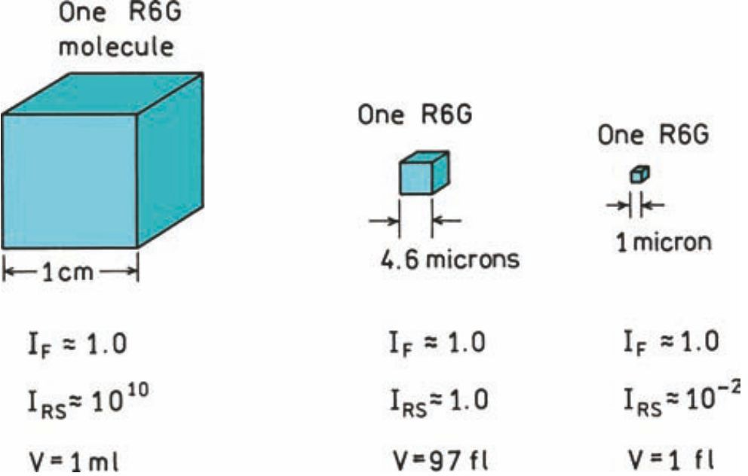
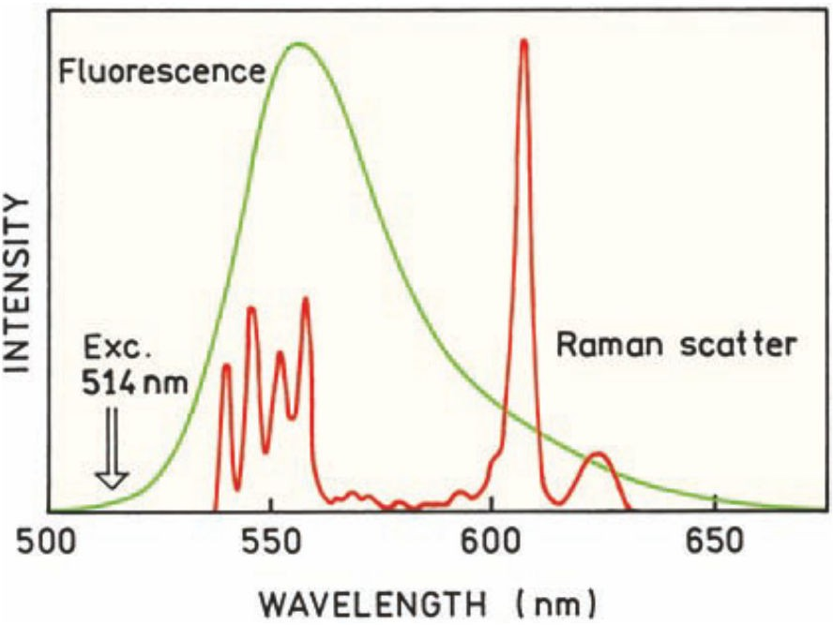
The detectability of single-molecules
The collective Raman scattering of solvent molecules can outcompete the fluorescence of a single-molecule.
This requires is to limit the observed volume when imaging fluorophores. Typical single-molecule experiments are designed so that the volume observed is less than 1 femtoliter or 1 μm³.
TIRF and confocal scopes provide a way to limit the observed volumes.

Slide 7

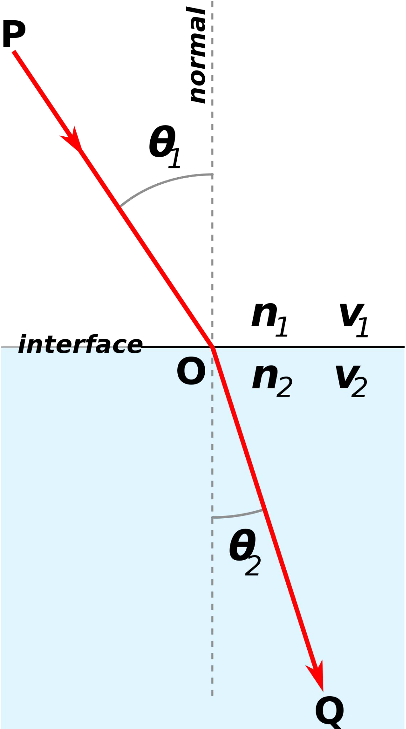


Refraction is the physical basis of TIRF
Refraction is the bending of light as it passes from one medium to another.
If n₂>n₁, then θ₂<θ₁ (the refracted angle decreases).
If n₂<n₁, then θ₂>θ₁ (the refracted angle increases).
The incident angle when θ =90º is
2
known as the critical angle.
TIR occurs when the incident angle exceeds the critical angle.

Slide 8
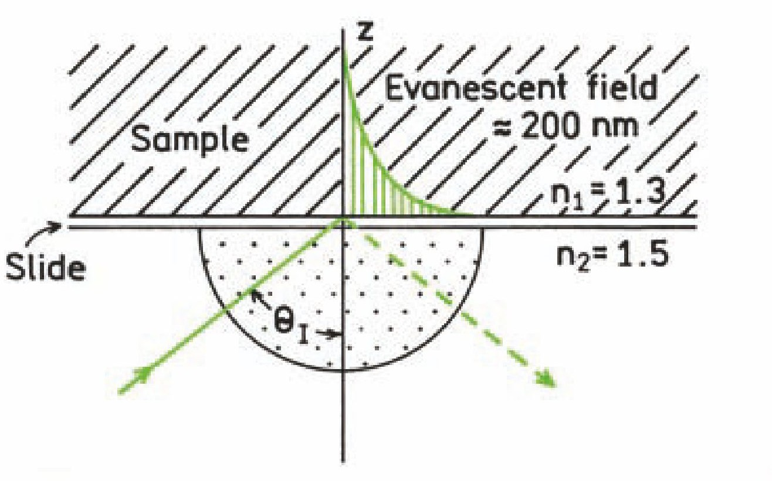
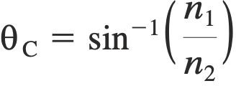
Total Internal Reflection (TIRF) Optics
Reflection occurs at the interface between the glass coverslip and the small film of aqueous medium.
While the incident light is reflected off the interface, the intensity of light can penetrate a short distance into the sample.
TIRF reduces the illuminated distance in the z-axis, thereby reducing the effective observed volume.

Slide 9
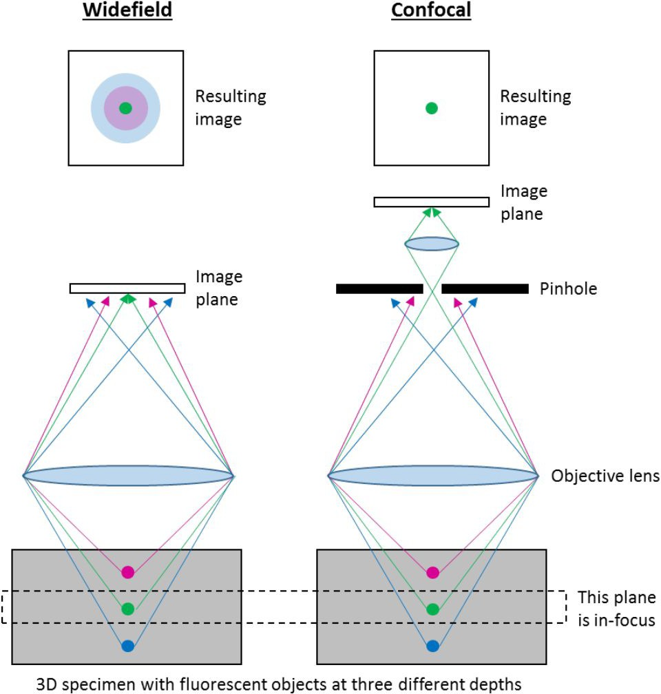
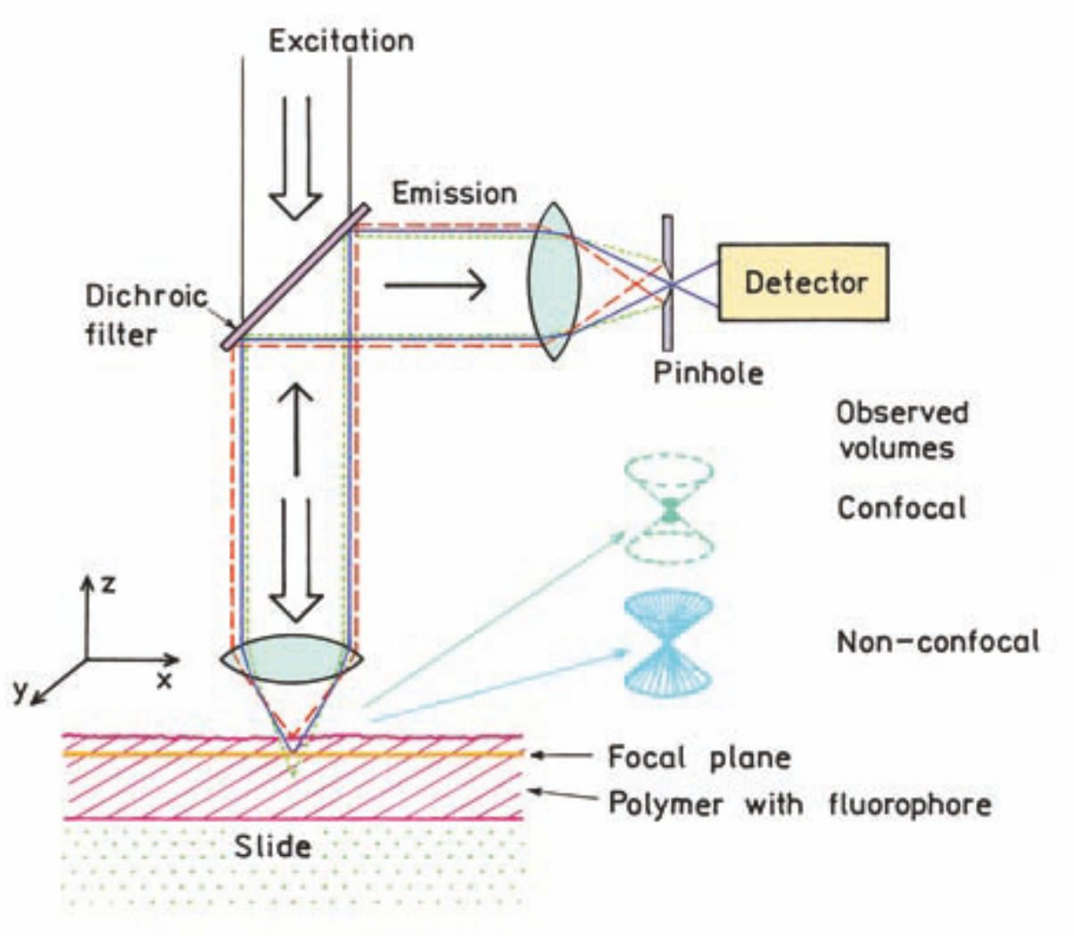
Confocal Optics
In confocal optics, a pinhole placed at the focal point of light blocks out-of-focus light. Any light above or below the focal plane is blocked because it either converges too early or too late.
Therefore, confocal optics also reduce the observed volume. The signal from a single fluorophore can be 500X the Raman scatter of solvent molecules.

Slide 10
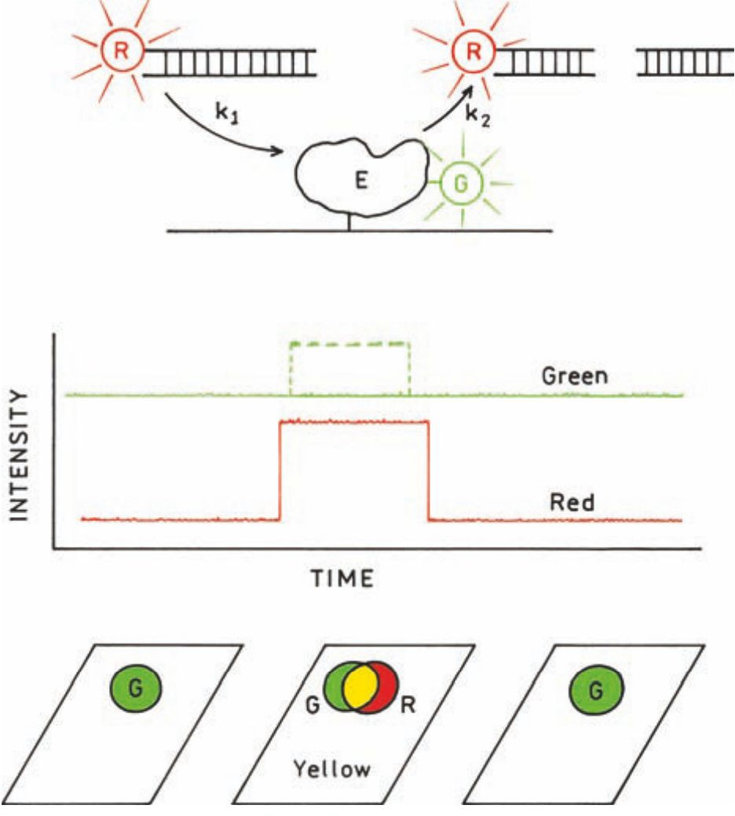
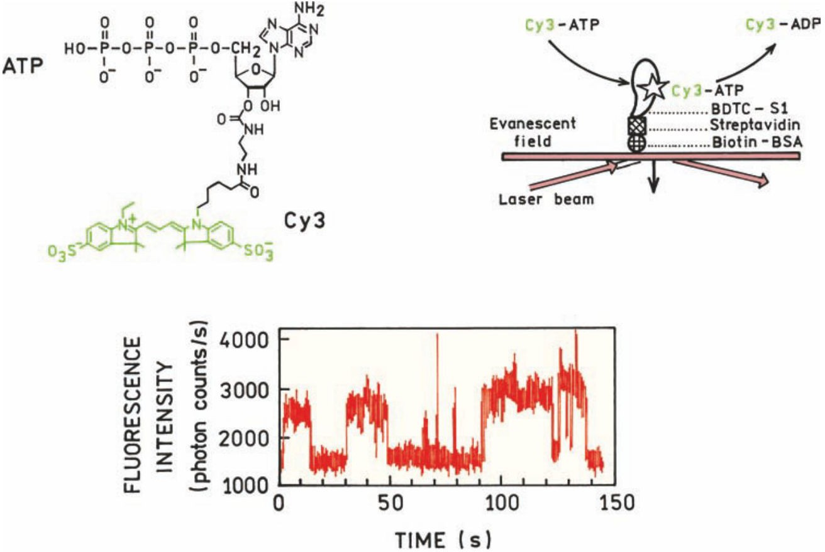
Example 1: Single-Molecule Enzyme Kinetics

Slide 11
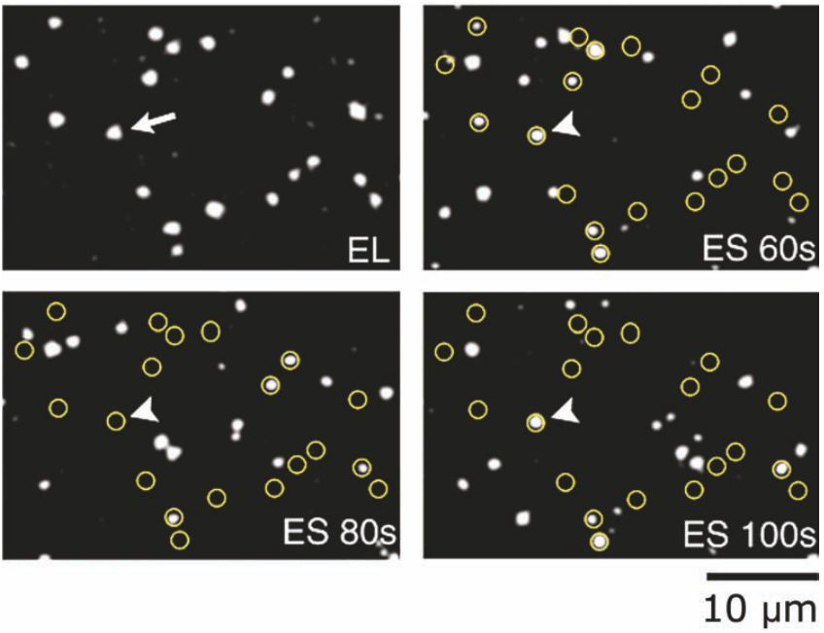
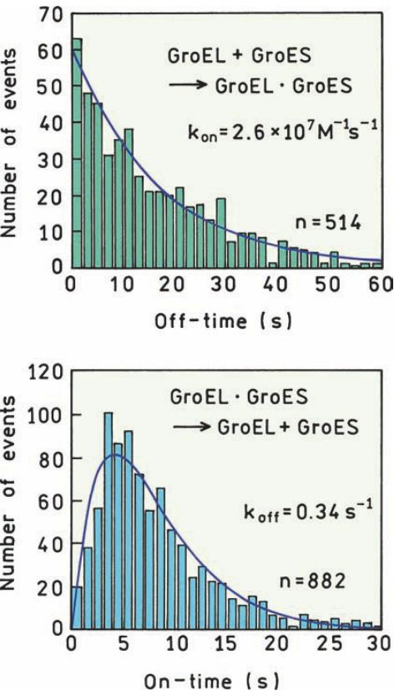
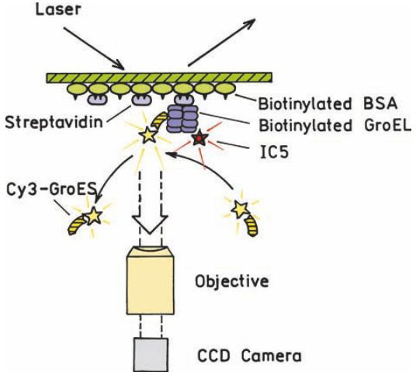
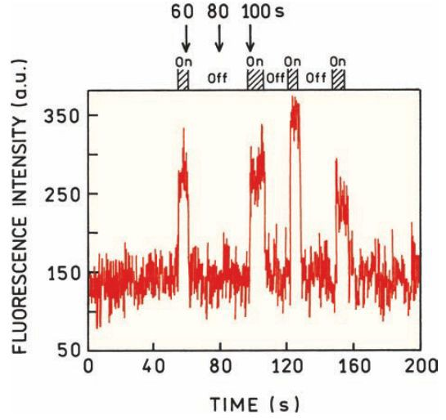
Example 2: Single-Molecule Studies of a Chaperonin Protein

Slide 12

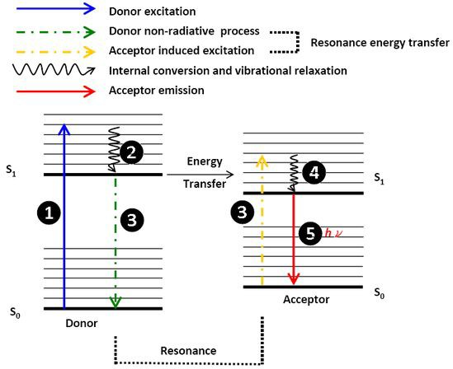
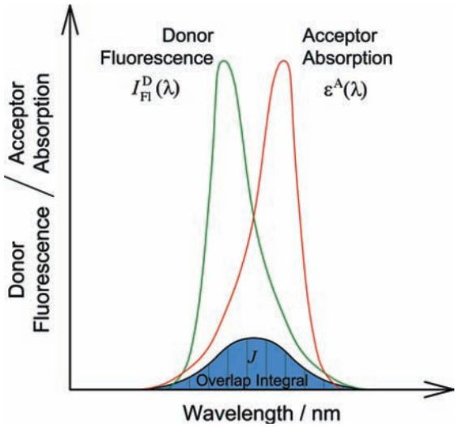
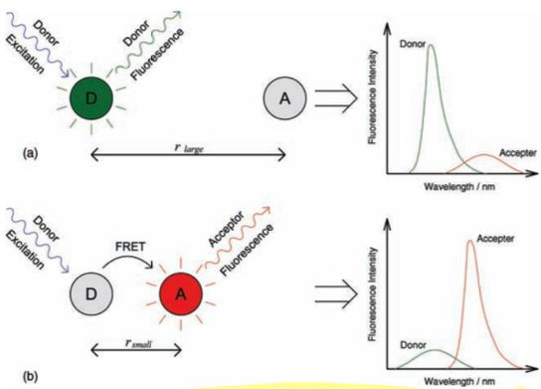
Forster Resonance Energy Transfer (FRET)
FRET involves the transfer of excitation energy from a donor to acceptor fluorophore.
FRET requires that the donor and acceptor are in close proximity (<80 Å), with a distance dependence of 1/r⁶.
The rate of energy transfer is directly proportional between the spectral overlap between donor fluorescence and acceptor absorption.

Slide 13
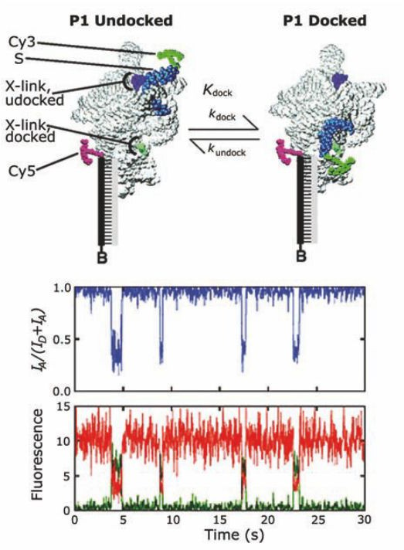
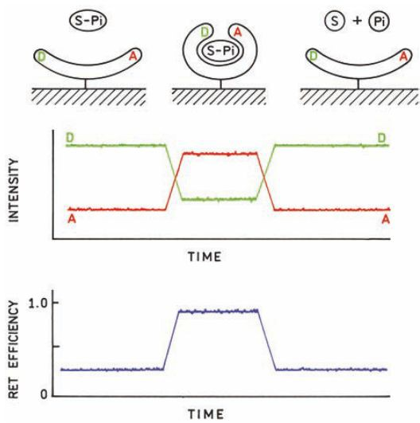
Single-Molecule FRET

Slide 14
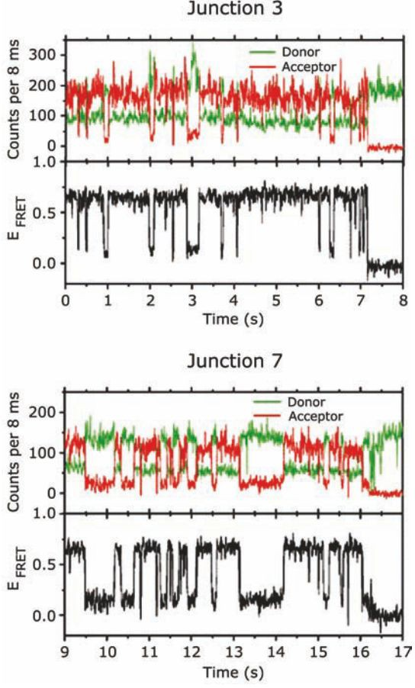
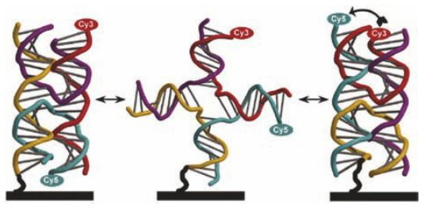
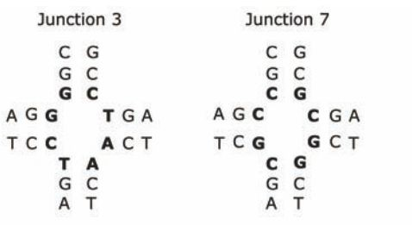
Example 3: Conformational Dynamics of a Holliday Junction

Slide 15
The single-molecule toolkit
Single-molecule imaging
Single-molecule FRET
Optical/Magnetic Tweezers
  C-traps
DNA Curtains
Single-molecule sequencing
Single-molecule polarization assay
Among many other variations… the question drives the tools used.

