Slide 1
Narlikar – Al-Sady Workshop
The Molecular Grammar of IDRs
Can Goksal – Al-Sady Lab
Keerthi Renduchintala – Narlikar Lab
August 26, 2026

Slide 2
Overview
Recap/Overview for definitions of Intrinsically Disordered Proteins/Regions
Define Condensation and Phase Separation
The Stickers and Spacers Model
Aromatics
Charge
HP1 as a test case

Slide 3
Molecular Grammar
What “grammar” means here
The systematic mapping from an amino acid sequence to how that sequence interacts with itself and with other molecules
3 parts
  Identity
    Which residues do the interacting, and how strongly
  Valence
    How many of them
  Patterning
    How they are arranged along the chain
Grammar – claim that we can extrapolate
Notes:
Keerthi
Connect exactly how its grammar
Grammar in classic viewpoint:
Direct - Grammar is the system of rules that a language uses. It tells us how to change word forms and put words in the right order to make clear sentences
Here we are saying that IDR's function in a similar way in that is not just composition but the ordering that creates function (meaning)

Slide 4
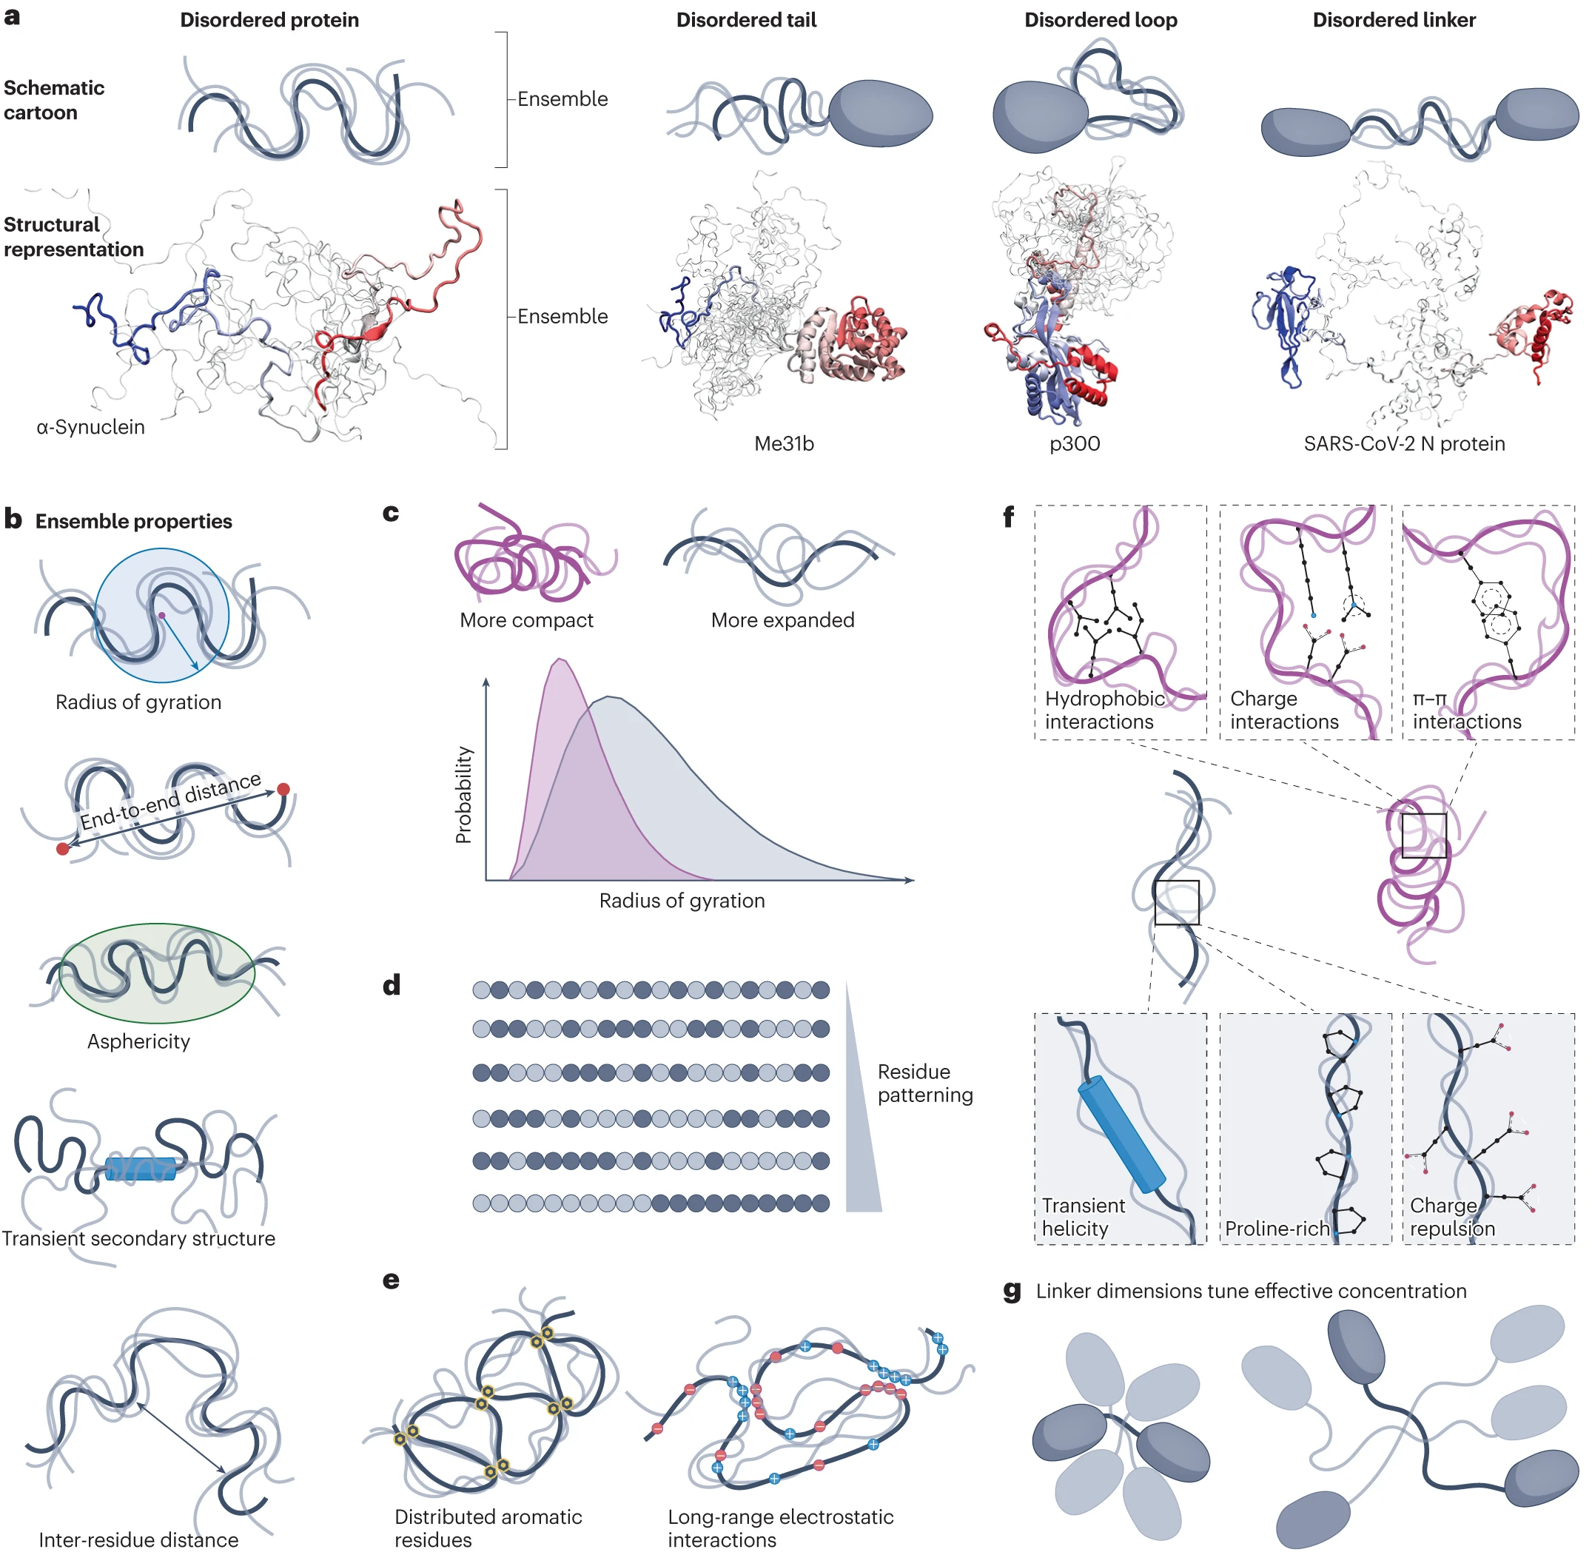
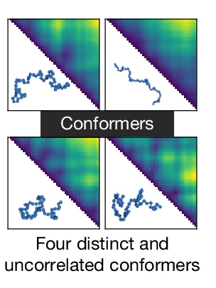
Recap/Broad Definitions of an IDR/P
Intrinsically Disordered Regions/Proteins:
Proteins or Domains with no stably persisting secondary or tertiary structures
No single structure - exist as an ensemble
Composition-biased:
  ⬇ ⬇ bulky hydrophobic aa: V, L, I, M, F, W, Y
  ⬆ ⬆ polar/charged aa: S,P,Q,E,K,R
Ensembles measured by parameters
  Radius of gyration
  Inter-residue distances
  End-to-end distances
  Asphericity

Slide 5
INTRAMOLECULAR
INTERMOLECULAR
How does this chain fold back on itself?
Do chains crosslink into a network?
Radius of gyration
Compaction vs. expansion
Answered by: STARLING, Mpipi single-chain sims
Attractive or repulsive?
Saturation concentration: the concentration where a network forms
Answered by: droplet assays, phase diagrams
Notes:
Keerthi

Slide 6
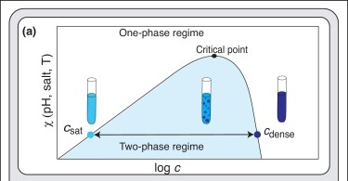
Condensation and Phase Separation
Above a threshold concentration, a homogeneous solution demixes into a dense phase and a dilute phase
That threshold is the saturation concentration, Csat
  Below Csat: one phase
  Above Csat: two phases, and adding more protein grows the dense phase rather than raising the dilute concentration
Csat moves with salt, temperature, pH, partners, and PTMs
Lower Csat = stronger driving force for condensation.
  For IDRs, can this be predicted from grammar?
Molecular Grammar of IDRs
Borcherds et al. Curr. Opinion in Structural Biology, 2021
Notes:
Keerthi
We are predicting for a given salt, temp, etc.
When interactions between macromolecules are weaker than those between macromolecules and water (so‑called good solvent conditions), the macromolecules remain miscible in solution at all concentrations. However, when the macromolecule–macromolecule interactions are sufficiently stronger than macromolecule–water interactions (poor solvent conditions), the macromolecule has limited solubility and gains the propensity to phase separate117. In such systems, phase separation occurs at the concentration at which the favourable energetics of macromolecule–macromolecule interactions begin to overcome the entropic tendency of the solution to remain homogeneously mixed.

Slide 7
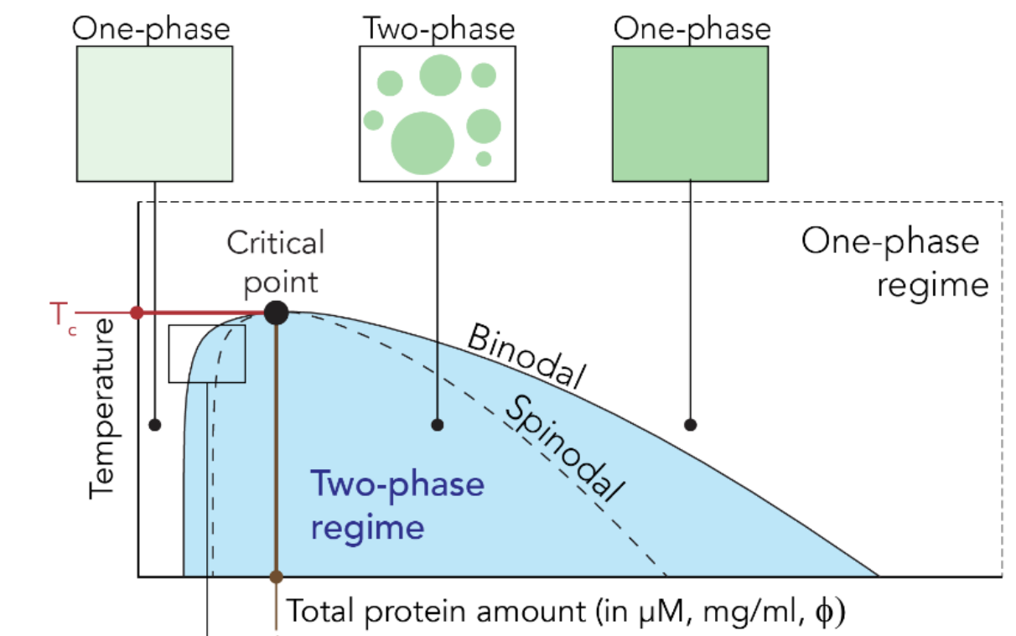

How to read a phase Diagram
How to Build:
Titrate a concentration series at fixed T
Score droplets +/-
Boundary is Csat
Repeat across temperatures
Notes:
Keerthi
Find a phase diagram that is simple and a better segway between previous slide.
First talk about how these values are experimentally determined
T_c is a single point on the curve. The apex of the dome - the temperature above which no amount of concentration will demix. One number per sequence (at fixed buffer). The critical point is where the binodal's two arms merge, so at T_c the dilute and dense concentrations become equal.

Slide 8
How to read a phase Diagram
Pick a Temperature
  Draw a horizontal line across the plot
How to Build:
Titrate a concentration series at fixed T
Score droplets +/-
Boundary is Csat
Repeat across temperature
Notes:
Keerthi
Find a phase diagram that is simple and a better segway between previous slide.
First talk about how these values are experimentally determined
T_c is a single point on the curve. The apex of the dome - the temperature above which no amount of concentration will demix. One number per sequence (at fixed buffer). The critical point is where the binodal's two arms merge, so at T_c the dilute and dense concentrations become equal.

Slide 9
How to read a phase Diagram
Pick a Temperature
  Draw a horizontal line across the plot
Find where it crosses the left arm
    That concentration is Csat – the dilute phase. Below it, one phase; never see droplets.
How to Build:
Titrate a concentration series at fixed T
Score droplets +/-
Boundary is Csat
Repeat across temperature
Notes:
Keerthi
Find a phase diagram that is simple and a better segway between previous slide.
First talk about how these values are experimentally determined
T_c is a single point on the curve. The apex of the dome - the temperature above which no amount of concentration will demix. One number per sequence (at fixed buffer). The critical point is where the binodal's two arms merge, so at T_c the dilute and dense concentrations become equal.

Slide 10
How to read a phase Diagram
Pick a Temperature
  Draw a horizontal line across the plot
Find where it crosses the left arm
    That concentration is Csat – the dilute phase. Below it, one phase; never see droplets.
Find where it crosses the right arm
    That is the dense-phase concentration
How to Build:
Titrate a concentration series at fixed T
Score droplets +/-
Boundary is Csat
Repeat across temperature
Notes:
Keerthi
Find a phase diagram that is simple and a better segway between previous slide.
First talk about how these values are experimentally determined
T_c is a single point on the curve. The apex of the dome - the temperature above which no amount of concentration will demix. One number per sequence (at fixed buffer). The critical point is where the binodal's two arms merge, so at T_c the dilute and dense concentrations become equal.

Slide 11

How to read a phase Diagram
Pick a Temperature
  Draw a horizontal line across the plot
Find where it crosses the left arm
    That concentration is Csat – the dilute phase. Below it, one phase; never see droplets.
Find where it crosses the right arm
    That is the dense-phase concentration
Anything between the two is inside the dome
    Add protein here and dilute concentration holds steady while the dense phase grows
How to Build:
Titrate a concentration series at fixed T
Score droplets +/-
Boundary is Csat
Repeat across temperature
Notes:
Keerthi
Find a phase diagram that is simple and a better segue between previous slide.
First talk about how these values are experimentally determined
T_c is a single point on the curve. The apex of the dome - the temperature above which no amount of concentration will demix. One number per sequence (at fixed buffer). The critical point is where the binodal's two arms merge, so at T_c the dilute and dense concentrations become equal.

Slide 12
How to know it's a Condensate
Observation:
What it establishes:
Round droplets
Surface tension causes round droplets
Notes:
Keerthi

Slide 13
How to know it's a Condensate
Observation:
What it establishes:
Round droplets
Surface tension causes round droplets
Droplets fuse
Material can flow and rearrange
Notes:
Keerthi

Slide 14
How to know it's a Condensate
Observation:
What it establishes:
Round droplets
Surface tension causes round droplets
Droplets fuse
Material can flow and rearrange
FRAP recovery
Molecules exchange between assembly and surroundings
Notes:
Keerthi

Slide 15
How to know it's a Condensate
Observation:
What it establishes:
Round droplets
Surface tension causes round droplets
Droplets fuse
Material can flow and rearrange
FRAP recovery
Molecules exchange between assembly and surroundings
Reversible
Assembly is at thermodynamic equilibrium
Notes:
Keerthi

Slide 16
How to know it's a Condensate
Observation:
What it establishes:
Round droplets
Surface tension causes round droplets
Droplets fuse
Material can flow and rearrange
FRAP recovery
Molecules exchange between assembly and surroundings
Reversible
Assembly is at thermodynamic equilibrium
Concentration buffered
Two phases coexist
Notes:
Keerthi

Slide 17
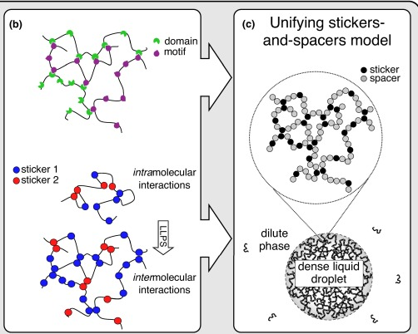
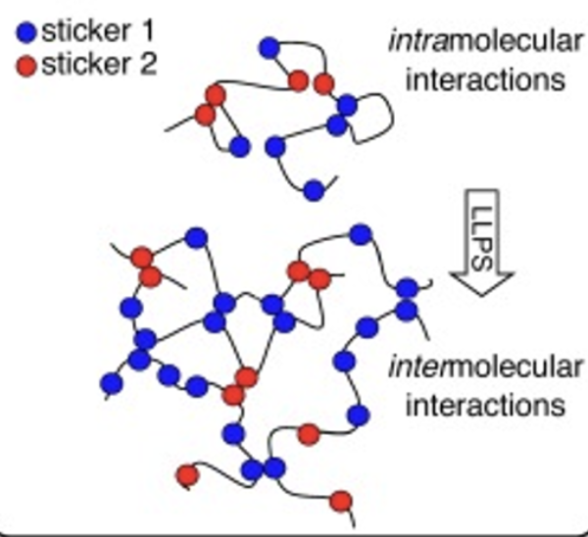
Sticker-and-Spacers Framework
Definitions
Stickers
  Adhesive elements that contribute the main interaction potential
Spacers
  Connect stickers and influence ability to interact with each other
Notes:
Bring and expand to domains-domain interactions

Slide 18
Framework covers systems that look nothing alike
Both domain-motif systems and IDR systems
Domain-motif, heterotypic
Stickers = domains and motifs themselves
Spacers = linkers between repeats
IDR systems
Stickers = individual residues or short motifs
Spacers = polar residues in between

Slide 19
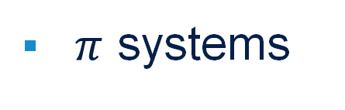
What makes a sticker
Stickers-and-Spacers Framework
$π$ systems
Aromatic rings stack with each other
*Note - Sticker assignment depends on binding partner, changing the partner can change which residues are stickers
Notes:
Add a category that is cation-pi and example structures that are purely pi and purely electrostatics

Slide 20
What makes a sticker
Stickers-and-Spacers Framework
$π$ systems
Aromatic rings stack with each other
Electrostatics
Complementary blocks of opposite charge
Sticker assignment depends on binding partner, changing the partner can change which residues are stickers
Notes:
Add a category that is cation-pi and example structures that are purely pi and purely electrostatics

Slide 21
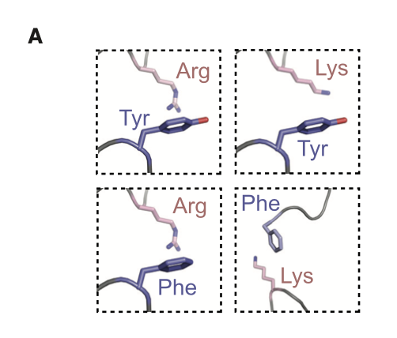

What makes a sticker
Stickers-and-Spacers Framework
$π$ systems
Aromatic rings stack with each other
Electrostatics
Complementary blocks of opposite charge
Cation - π / Anion - π
Heterotypic interaction where aromatic ring interacts with charged residue
Sticker assignment depends on binding partner, changing the partner can change which residues are stickers
Notes:
Add a category that is cation-pi and example structures that are purely pi and purely electrostatics

Slide 22
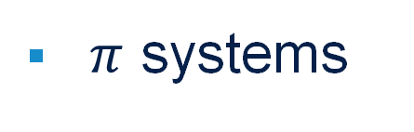
What makes a sticker
Stickers-and-Spacers Framework
$π$ systems
Aromatic rings stack with each other
Electrostatics
Complementary blocks of opposite charge
Cation - π / Anion - π
Heterotypic interaction where aromatic ring interacts with charged residue
Hydrogen bonding
Hydrophobic contact
Sticker assignment depends on binding partner, changing the partner can change which residues are stickers
Notes:
Add a category that is cation-pi and example structures that are purely pi and purely electrostatics

Slide 23
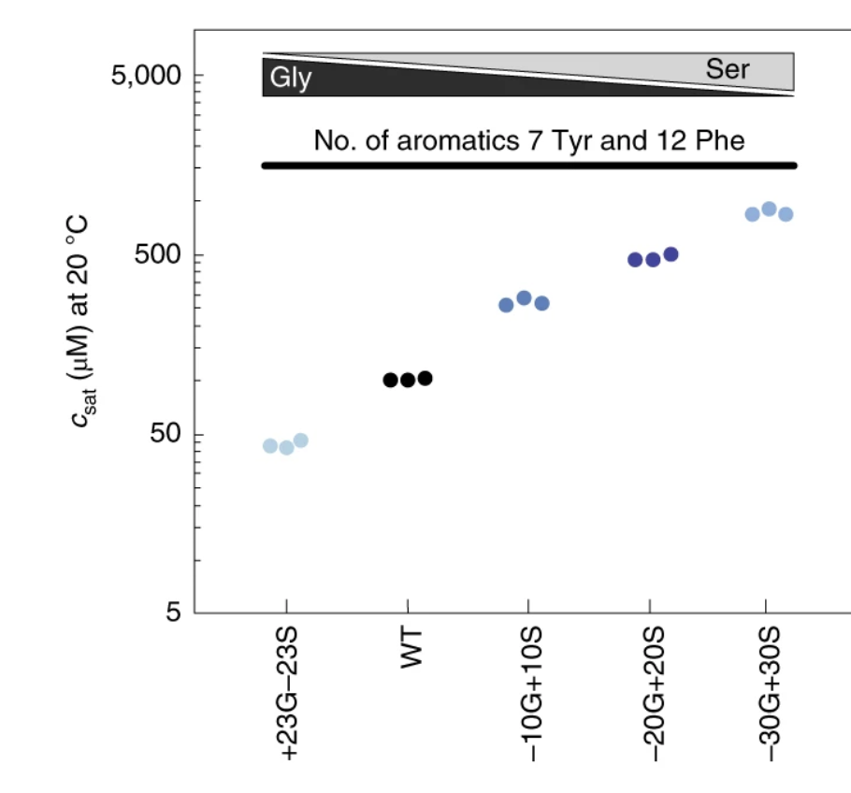
Spacers are not passive elements
Spacer chemistry sets the effective solvation volume - whether the chain would rather be surrounded by water or by itself
  Good-solvent spacers (charged, proline-rich) oppose condensation and can keep an otherwise sticky sequence soluble
Glycine and serine are not interchangeable spacers
  Their relative content is a measurable modulator of Csat
  But system-dependent
Notes:
Talk to siyuan

Slide 24
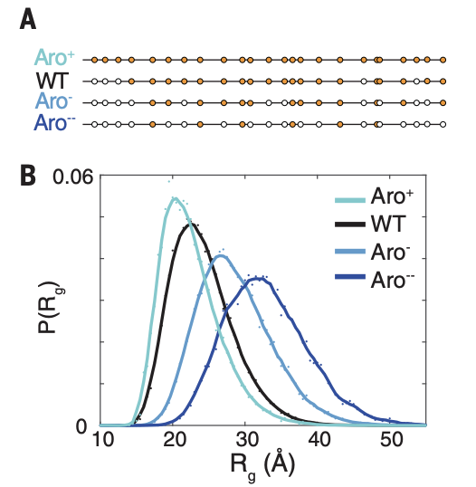
Aromatics - Valence: how many stickers
The system
  Low complexity domain of hnRNPA1
  4 sequences of same length, differing in aromatic count
All-atom simulation
  Fewer aromatics -> the chain expands
  WT Rg = 26.1 Angstroms
Notes:
Keerthi
Martin et al Science 2020

Slide 25
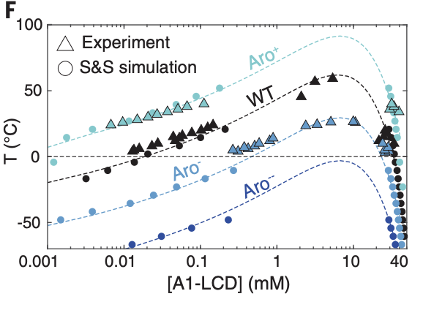
Aromatics - Valence: how many stickers
  Small change in chain dimensions correspond to large changes in Csat
All-atom simulation
  Fewer aromatics -> the chain expands
  WT Rg = 26.1 Angstroms
  More aromatics -> phase separation at lower concentration over wider range
Notes:
Keerthi
Martin et al Science 2020

Slide 26
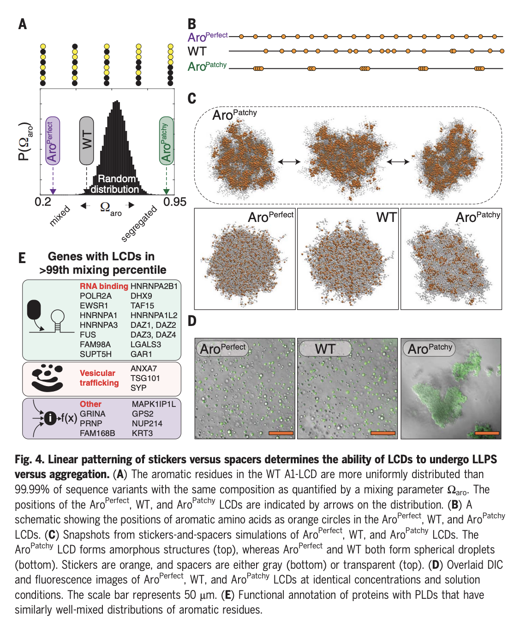
Aromatics – Patterning: Where stickers sit
Same residues, different arrangement, different outcome
Same composition, different arrangements
Aro^{perfect} has spherical droplets
Aro^{patchy} has amorphous aggregates
WT hnRNPA1 LCD more uniformly spaced than 99.99% of randomly generated sequences
Notes:
Keerthi

Slide 27

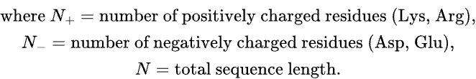
Describing a charged IDR
Das & Pappu, 2013
FCR – Fraction of charged residues
NCPR – Net charge per residue
κ – charge patterning parameter
Notes:
Das and Pappu 2013

Slide 28

Describing a charged IDR
Das & Pappu, 2013
FCR – Fraction of charged residues
NCPR – Net charge per residue
  Low NCPR – Polyampholyte, low net charge
  High NCPR – Polyelectrolyte, high net charge
κ – charge patterning parameter
Notes:
Das and Pappu 2013

Slide 29
Describing a charged IDR
Das & Pappu, 2013
FCR – Fraction of charged residues
NCPR – Net charge per residue
  Low NCPR – Polyampholyte, low net charge
  High NCPR – Polyelectrolyte, high net charge
κ – charge patterning parameter
How do FCR and NCPR change IDR ​behavior?
Notes:
Das and Pappu 2013

Slide 30
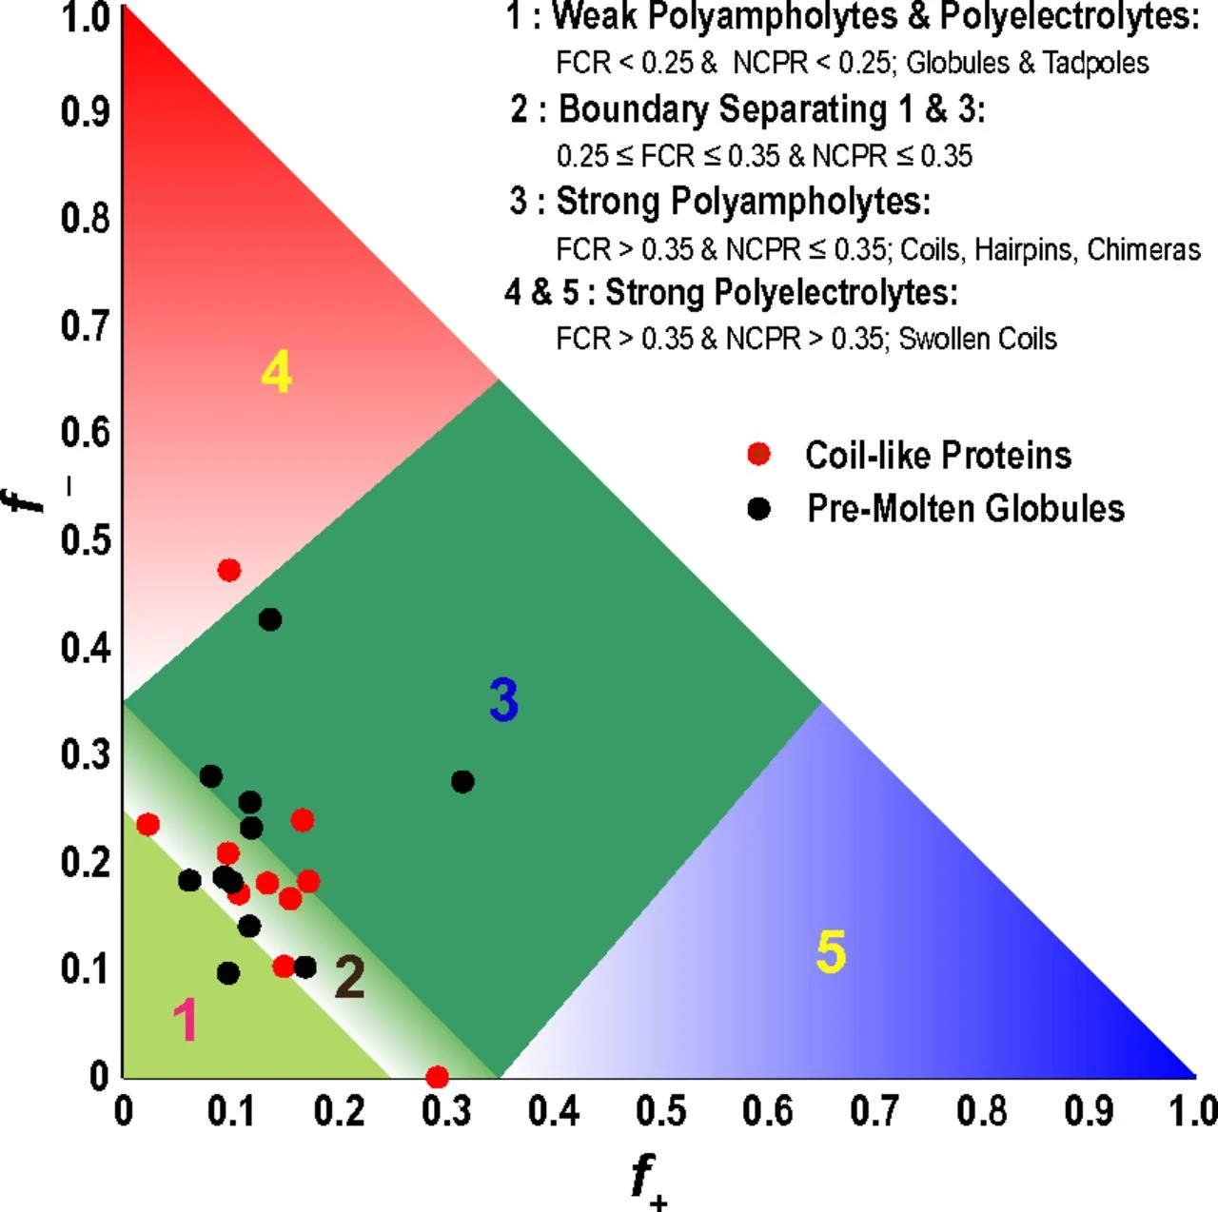


Describing a charged IDR
Das & Pappu, 2013
High FCR, High NCPR = strong polyelectrolyte
  Tends toward extended conformations due to one charge dominating (self-repulsion)
High FCR, low NCPR = strong polyampholytes
Low FCR = weak polyampholyte & polyelectrolyte
Notes:
Das and Pappu 2013

Slide 31

Describing a charged IDR
Das & Pappu, 2013
High FCR, High NCPR = strong polyelectrolyte
High FCR, low NCPR = strong polyampholytes
  Conformation dependent on patterning (κ)
Low FCR = weak polyampholyte & polyelectrolyte
Notes:
Das and Pappu 2013

Slide 32
Describing a charged IDR
Das & Pappu, 2013
High FCR, High NCPR = strong polyelectrolyte
High FCR, low NCPR = strong polyampholytes
Low FCR = weak polyampholyte & polyelectrolyte
  Tend towards more compact, globular conformations
Notes:
Das and Pappu 2013

Slide 33
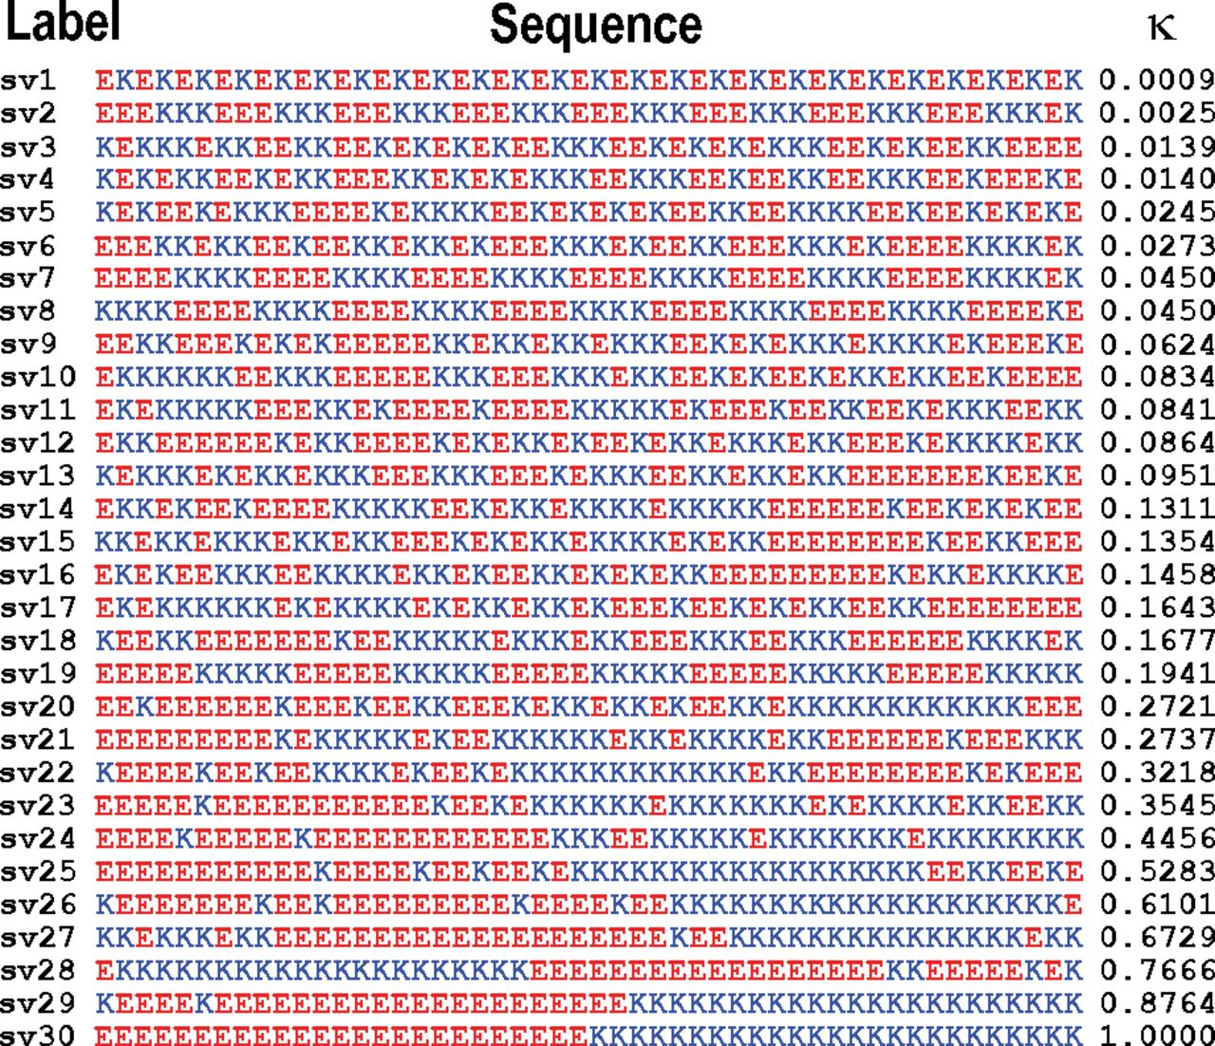
Describing a charged IDR
Das & Pappu, 2013
FCR – Fraction of charged residues
NCPR – Net charge per residue
κ – charge patterning parameter
  Value between 0 (charges well-mixed) and 1 (charges segregated) that describes charge distribution across polypeptide
Notes:
Das and Pappu 2013

Slide 34
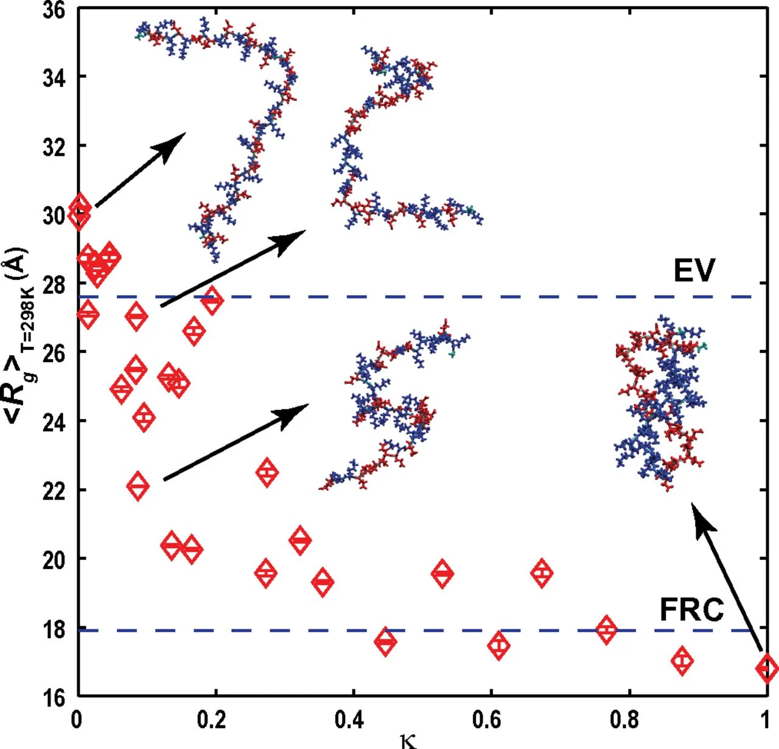
Describing a charged IDR
Das & Pappu, 2013
FCR – Fraction of charged residues
NCPR – Net charge per residue
κ – charge patterning parameter
  Value between 0 (charges well-mixed) and 1 (charges segregated) that describes charge distribution across polypeptide
κ determines differences in radius of gyration and shape when FCR/NCPR are similar between two IDRs
Notes:
Das and Pappu 2013

Slide 35
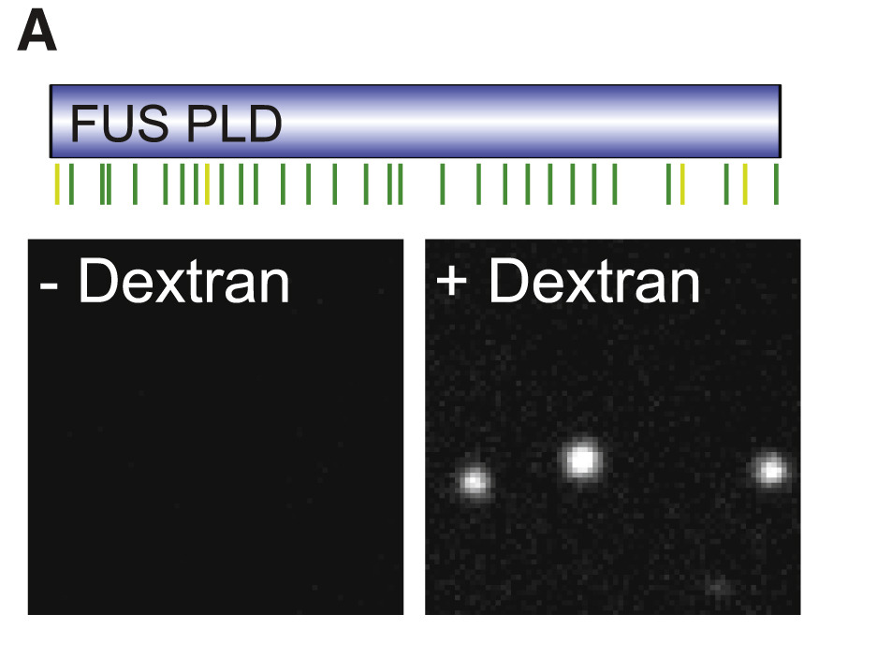
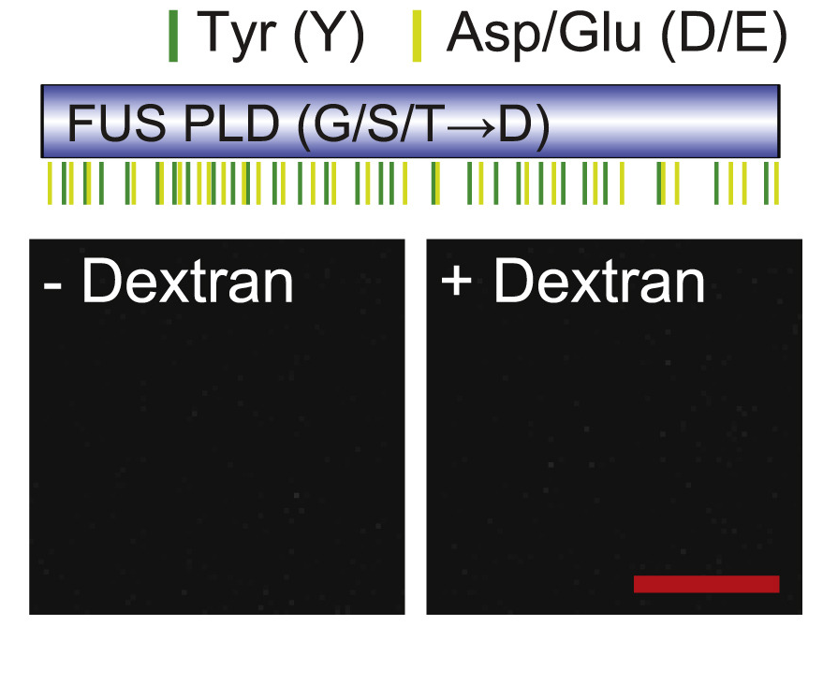
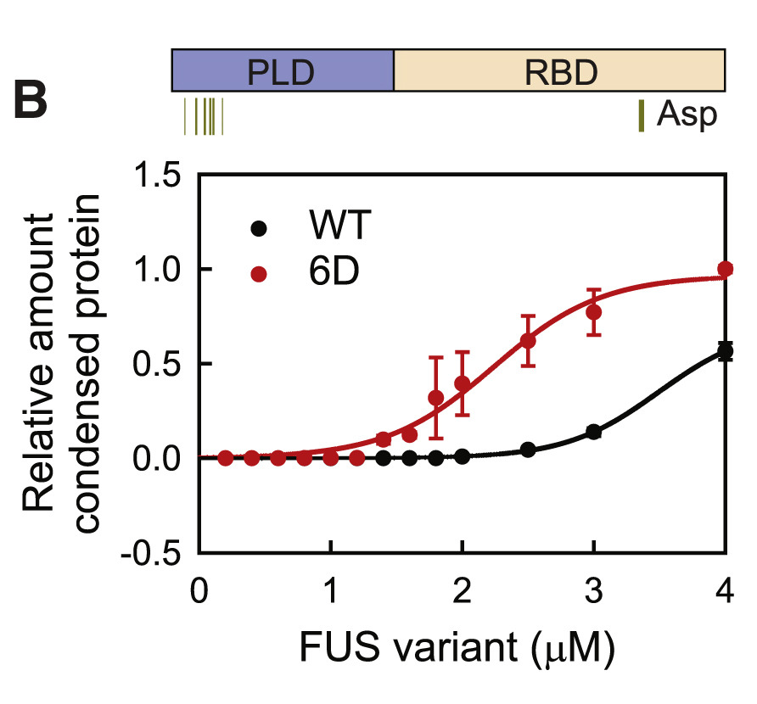
How do charged residues change IDR behavior?
Wang et al, 2018
With FUS proteins:
6D = 6 aspartic acid added into FUS PLD
Notes:
Das and Pappu 2013

Slide 36
How do charged residues change IDR behavior?
Wang et al, 2018
With FUS proteins:
Electrostatics tunes, not drives, phase separation
6D = 6 aspartic acid added into FUS PLD
Notes:
Das and Pappu 2013

Slide 37
How do charged residues change IDR behavior?
Wang et al, 2018
With FUS proteins:
Electrostatics tunes, not drives, phase separation
Introduction of too many negative charge breaks down phase separation
6D = 6 aspartic acid added into FUS PLD
Notes:
Das and Pappu 2013

Slide 38
How do charged residues change IDR behavior?
Wang et al, 2018
With FUS proteins:
Electrostatics tunes, not drives, phase separation
Introduction of too many negative charge breaks down phase separation
Some negative charge addition can, however, decrease saturation concentration
6D = 6 aspartic acid added into FUS PLD
Notes:
Das and Pappu 2013

Slide 39
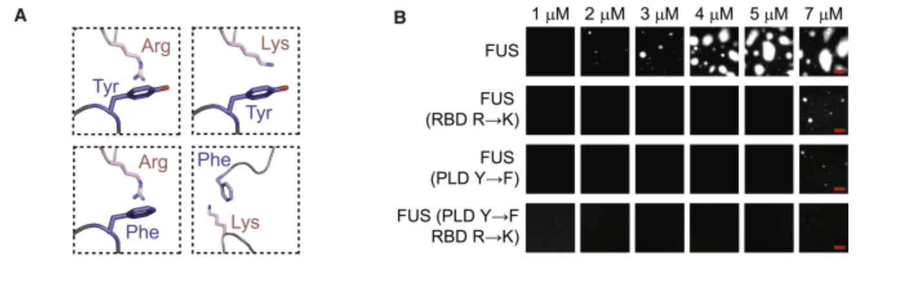
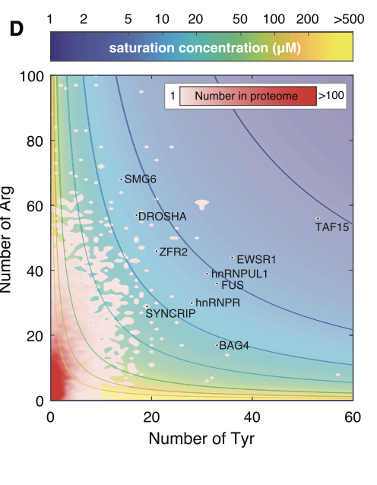
When Aromatics and Charged Residues exist at the same time
Arginine to Lysine in RBD or Tyrosine to Phenylalanine in PLD cause FUS to stop condensing
Wang et al, Cell. 2018.
Notes:
Green is wild-type FUS — an arginine against a tyrosine ring. Droplets by about 2 µM.
Purple changes the arginine. Red changes the tyrosine. Either one alone, nothing until 7 µM. Both, nothing at all.
The arginine is in the RBD and the tyrosine is in the PLD.
Why these mutations? Conservative swaps. R→K keeps the positive charge but lysine can't lie flat against the ring; Y→F keeps the aromatic but loses the hydroxyl that makes the ring electron-rich. Each removes one property and holds the rest fixed

Slide 40
Why HP1 as a model system
Objection: HP1 has folded domains, needs a PTM, and binds DNA. Isn’t its phase behavior driven by attributes not associated with IDR molecular grammar
Supply valence, not interaction chemistry. Dimerization makes each HP1 a bivalent scaffold. The contacts that promote demixing are IDR-IDR
Folded Domains
Phosphorylation makes the NTE more acidic. Changing charge and where charge sits is a grammar variable
Requires a PTM.
Gap is DNA/chromatin substrate

Slide 41
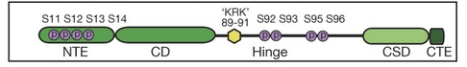
Human CBX5/Drosophila HP1a
Domain architecture
NTE
Disordered. Phosphorylation of S11-S14 makes charge negative
Hinge
Disordered. K/R rich, positively charged and binds DNA
CTE
Disordered.
CD/CSD
Folded globular domains. CD reads H3K9me; CSD dimerizes. Both contribute valence and neither is an IDR
Notes:
Compare 4 glutamates and additional 4 glutamates

Slide 42
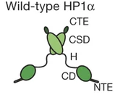
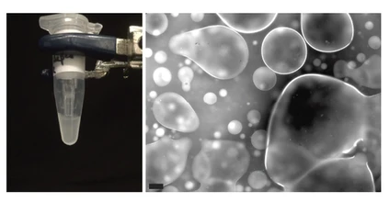
Orthologs
Two orthologs. Similar architecture, but different phase behavior
Human HP1a
  Does not phase separate by itself
  When phosphorylated phase separates
  Also phase separates with DNA/chromatin

Slide 43
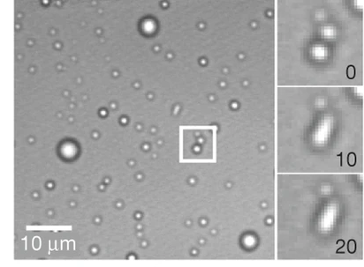
Orthologs
Two orthologs. Similar architecture, but different phase behavior
Drosophila HP1a
  Phase separates by itself (unmodified)
  Also phase separates with DNA/chromatin

Slide 44
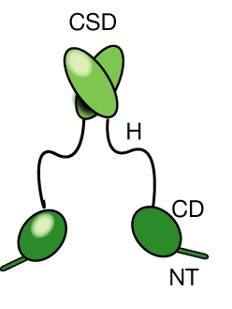
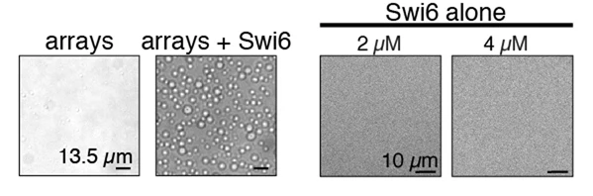
Orthologs
Three orthologs. Similar architecture, but different phase behavior
S. pombe Swi6
  Phase separates only with DNA/chromatin

Slide 45
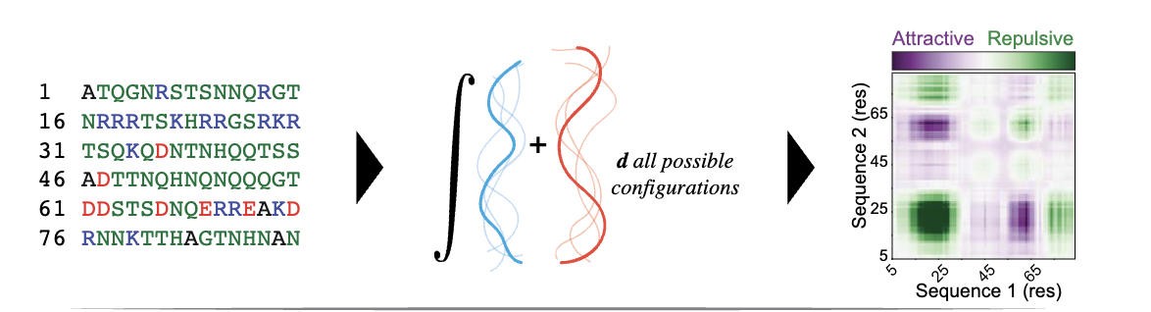
FINCHES predicts IDR phase diagrams
First-principle Interactions via CHEmical Specificity
Sequence -> per-residue interaction values
  For every residue in A against every residue in B, how attractive or repulsive
  Two ways to read values
    Intermaps -> resolved along sequence, showing which regions engage which
    Average into one number ε
      Attractive = (-)
      Repulsive = (+)
Notes:
Keerthi
Mean-field model

Slide 46
FINCHES predicts IDR phase diagrams
First-principle Interactions via CHEmical Specificity
Sequence -> per-residue interaction values
  For every residue in A against every residue in B, how attractive or repulsive
  Two ways to read values
    Intermaps -> resolved along sequence, showing which regions engage which
    Average into one number ε
      Attractive = (-)
      Repulsive = (+)
ε -> Flory χ
  Divide by sequence length, converts whole-molecule value into per-unit one
Notes:
Keerthi
Mean-field model

Slide 47
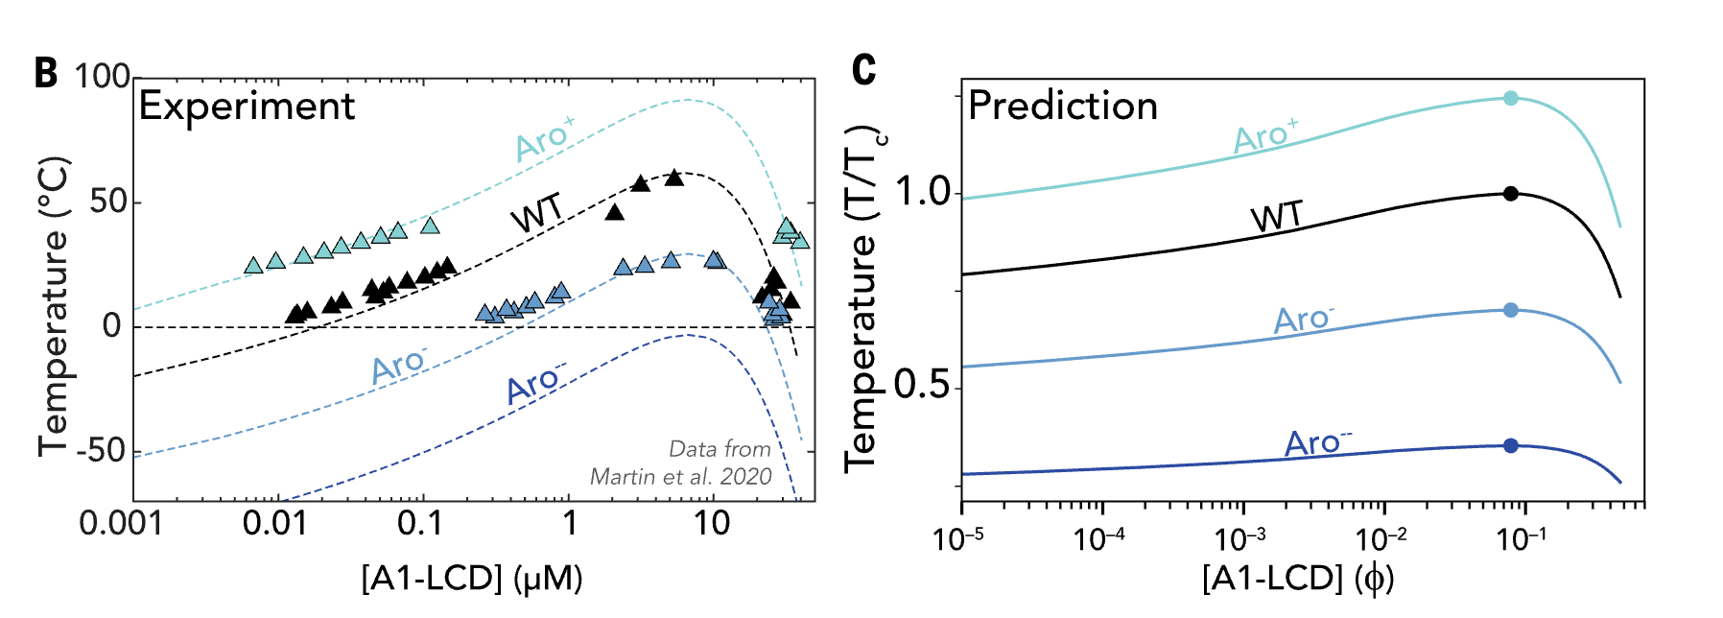
FINCHES predicts IDR phase diagrams
First-principle Interactions via CHEmical Specificity
Sequence -> per-residue interaction values
  For every residue in A against every residue in B, how attractive or repulsive
  Two ways to read values
    Intermaps -> resolved along sequence, showing which regions engage which
    Average into one number ε
      Attractive = (-)
      Repulsive = (+)
ε -> Flory χ
  Divide by sequence length, converts whole-molecule value into per-unit one
Flory χ -> full phase diagrams
  Solved analytically.
The goal is to predict which direction a phase diagram moves when you change the sequence
Notes:
Keerthi
Mean-field model

Slide 48
FINCHES Assumptions
Central Assumption: attraction between two IDRs is mediated solely by complementary chemistry, not through any precise structured interaction between subregions
Every residue in A is allowed to see every residue in B. Model does not know residues tethered in a chain
Every contact is possible
Matrix collapses to one number
Pairwise values average into a single value
Simplest theory of whether a polymer solution stays mixed: One parameter balancing mixing entropy against contact energy.
Flory-Huggins for phase diagrams
Notes:
Keerthi

Slide 49
FINCHES Limitations
No structured interfaces
  Folded domains are invisible
  Chemical specificity only
No mutually exclusive binding modes
  Can't know that engaging one region rules out the other
No competition with itself
  Model does not weigh that a chain can satisfy contacts through intramolecular interactions
Notes:
Keerthi

Slide 50
Predicting contact map of HP1s using FINCHES https://www.finches-online.com/intermaps

Slide 51
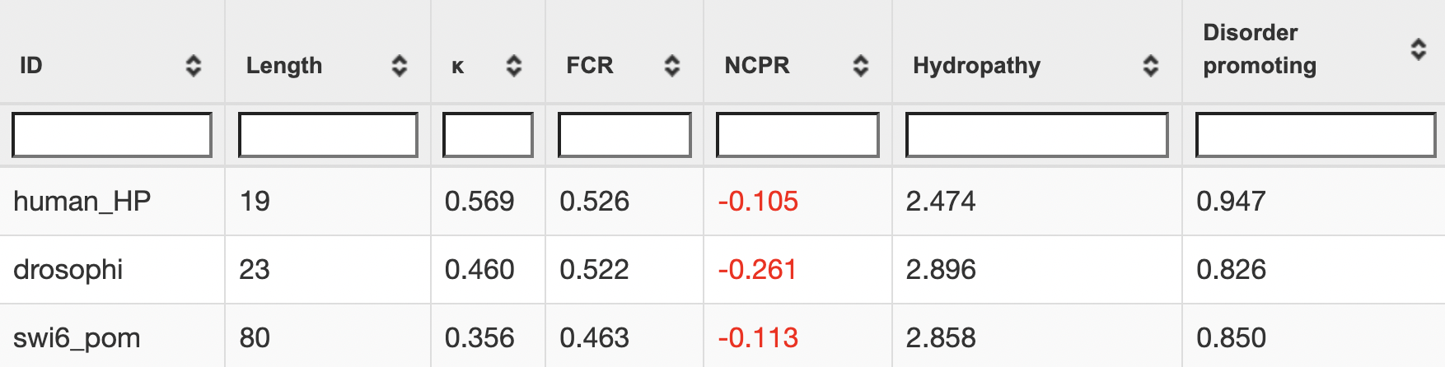
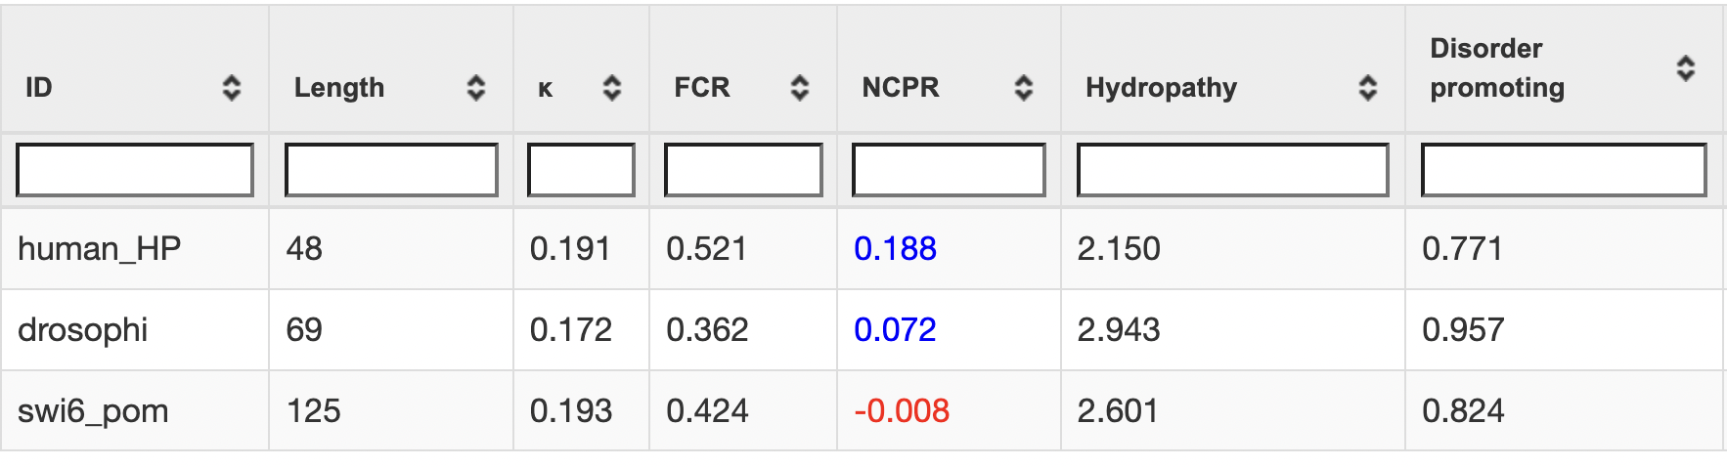
Charge parameters for HP1 IDRs
NTE
Hinge

Slide 52
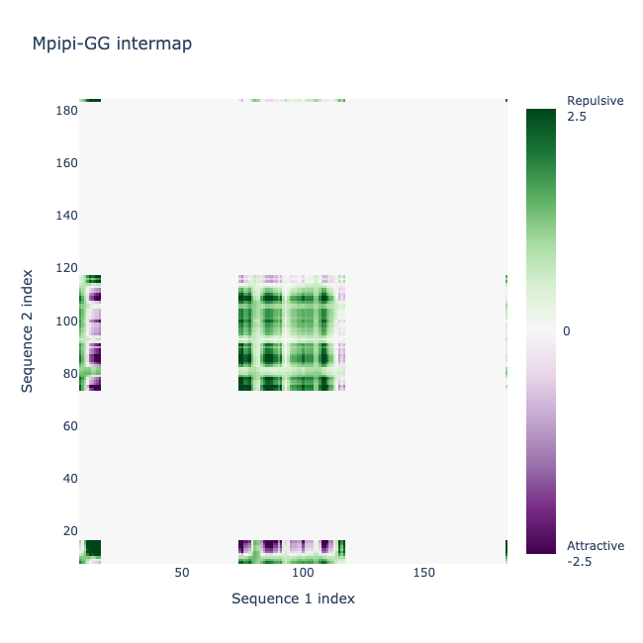
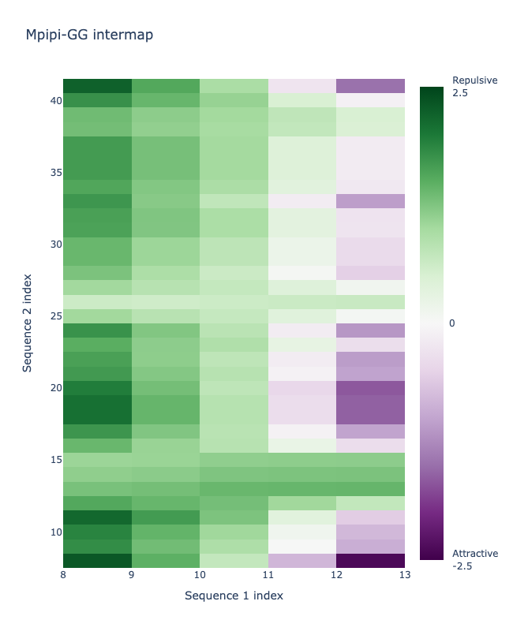
Human HP1a (CBX5)
NTE + hinge contact map
HP1 sequence #2
Hinge sequence
HP1 sequence #1
NTE sequence
Notes:
These are contact maps. One sequence along the bottom, another up the side, and each square is how those two residues interact. Green is repulsive, purple is attractive, white is neutral.
On the left, full-length HP1 against full-length HP1. The big white field is the folded domains: the CD and CSD are masked out, because this model only handles disordered regions. What's left is the disordered parts talking to each other. The green block in the middle is the hinge against itself, which makes sense, it's lysine and arginine rich, so two hinges repel.
On the right is the zoom we care about: the NTE along the bottom, the hinge up the side. It's mostly green. Unmodified, these two regions don't want to interact.
Which fits — unphosphorylated HP1α doesn't phase separate on its own

Slide 53
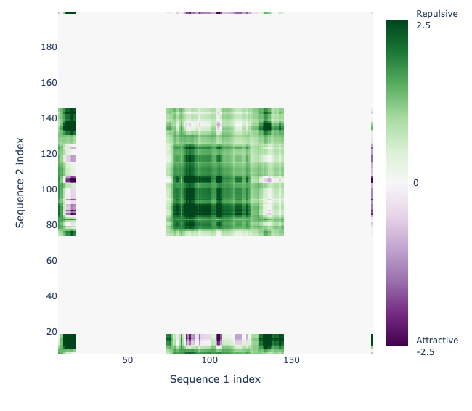
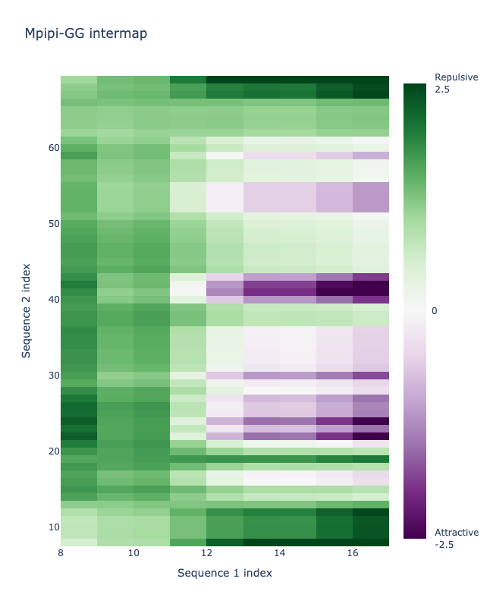
Drosophila HP1a
NTE + hinge contact map
HP1 sequence #2
Hinge sequence
HP1 sequence #1
NTE sequence

Slide 54
Try introducing phosphorylation to see how it changes IDR properties

Slide 55
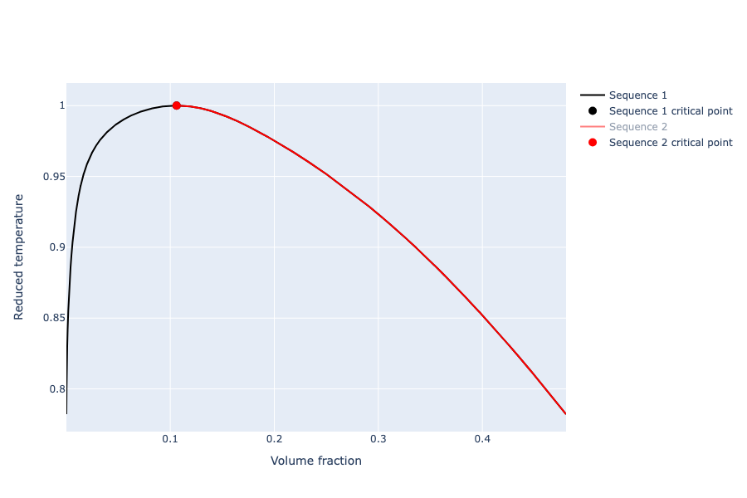
FINCHES Phase diagrams can't predict phosphorylation mediated phase separation
Human HP1a
Human HP1a (4x S→D)
Notes:
Because 4 positive charges averaged out while calculating E does not cause enough of a change to find a difference in phase diagrams

Slide 56
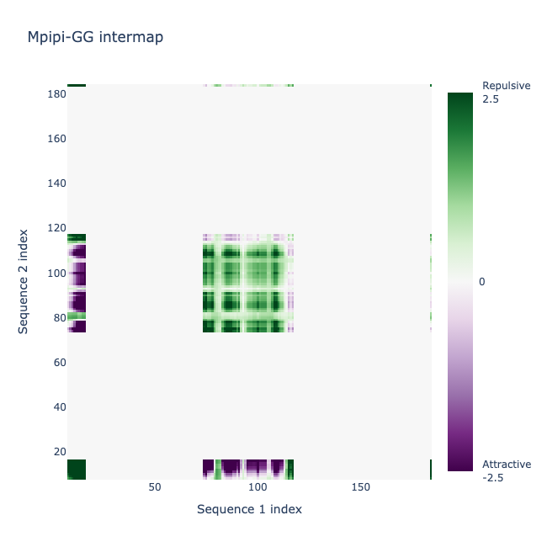
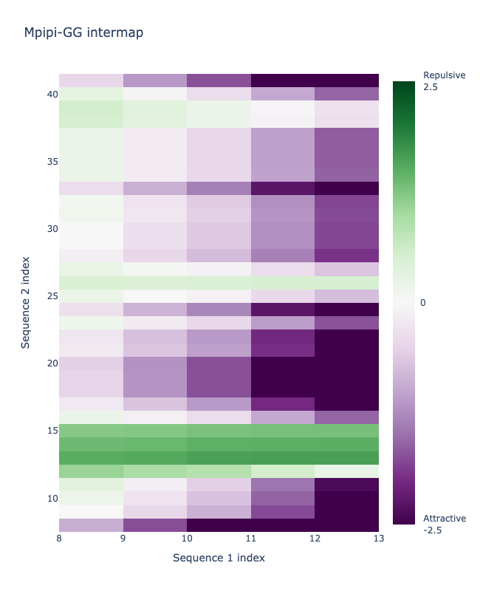
Contact maps display changes with phosphorylation
Human HP1a - 4x phosphorylated (4x S→D) NTE + hinge contact map
HP1 sequence #2
Hinge sequence
HP1 sequence #1
NTE sequence
Notes:
Same protein, four serines in the NTE swapped to aspartate to mimic phosphorylation.
Left panel, full length: the hinge–hinge block is still green, unchanged. But look along the bottom edge and the left edge - the NTE rows have gone purple.
Right panel, the NTE against the hinge: this was green a minute ago. Now it's almost entirely purple."

Slide 57
Contact maps display changes with phosphorylation
Human HP1a NTE + hinge
Human HP1a NTE (4x S→D) + hinge
Hinge sequence
Hinge sequence
NTE sequence
NTE sequence
Notes:
Same two maps, side by side. Left is unmodified, right is the phospho-mimic. Nothing changed except four residues in the NTE.
the NTE and hinge go from repelling each other to strongly attracting.
And it makes sense chemically: the NTE was serine-rich and near neutral. Adding four aspartates makes it acidic, and the hinge is lysine and arginine rich. Opposite charges.
Takeaway
This matches what's known biologically: the phosphorylated NTE of one HP1 dimer contacts the hinge of another. FINCHES found that from sequence alone.

Slide 58
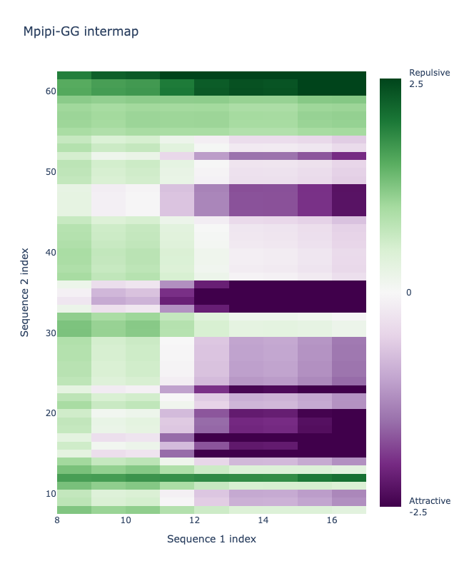
Contact maps display changes with phosphorylation
Drosophila HP1a NTE + hinge
Drosophila HP1a NTE (3x S→D) + hinge
Hinge sequence
Hinge sequence
NTE sequence
NTE sequence
Notes:
Same two maps, side by side. Left is unmodified, right is the phospho-mimic. Nothing changed except four residues in the NTE.
the NTE and hinge go from repelling each other to strongly attracting.
And it makes sense chemically: the NTE was serine-rich and near neutral. Adding four aspartates makes it acidic, and the hinge is lysine and arginine rich. Opposite charges.
Takeaway
This matches what's known biologically: the phosphorylated NTE of one HP1 dimer contacts the hinge of another. FINCHES found that from sequence alone.

Slide 59
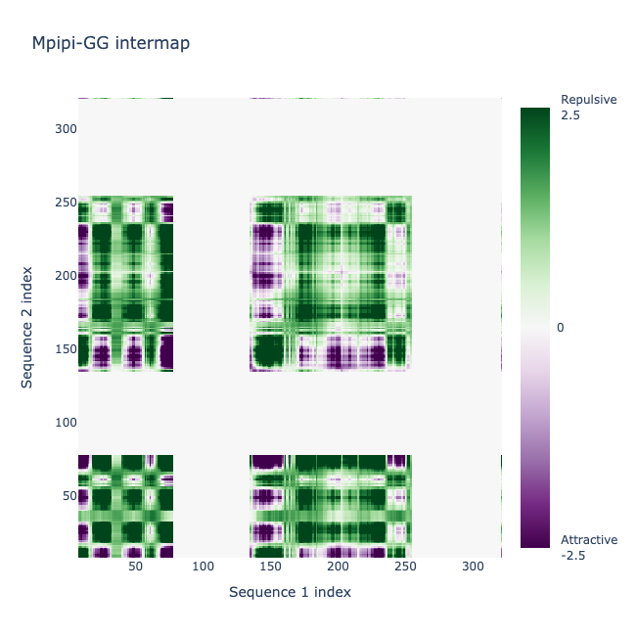
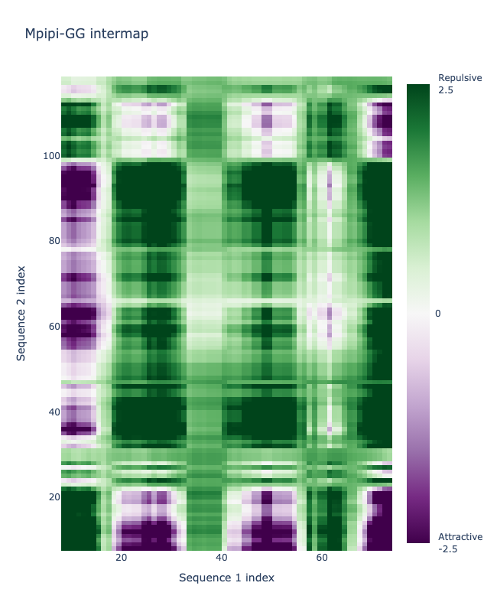
Pombe Swi6
NTE + hinge contact map

Slide 60
Pombe Swi6
NTE + hinge contact map
Hinge
NTE

Slide 61
Takeaways
Properties of condensates
What drives (aromatics) and tunes (electrostatics) condensate formation
Parameters to describe charged IDRs (FCR, NCPR, k)
HP1 orthologs display differential phase separation behavior
Tools to identify and predict IDR behavior (FINCHES contact maps & phase diagrams)
Molecular Grammar of IDRs​
Notes:
Keerthi

