Slide 1
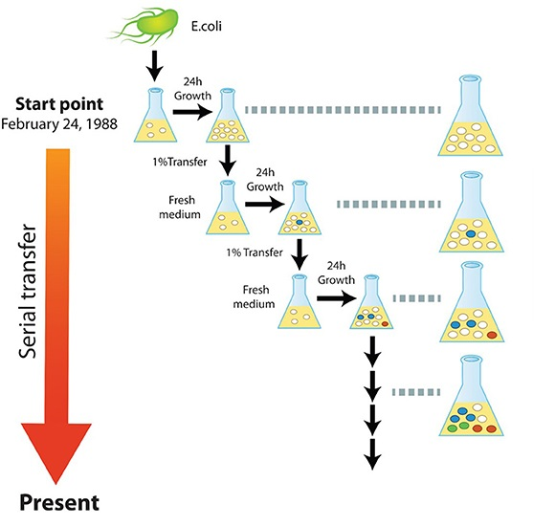
Experimental Evolution
05/01/ 2023

Slide 2
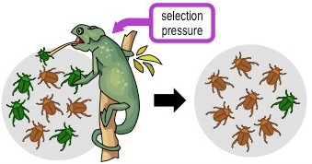
Major Evolutionary Forces
Evolution: changes in allele frequencies over time
Natural selection
Whenever there is a benefit

Slide 3
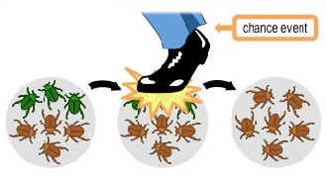
Major Evolutionary Forces
Genetic drift
Random process
Small population size
Not clear boundaries
Meiotic drive
Alleles/ haplotypes/chromosomes subvert mechanisms of fair segregation and
obtain greater than Mendelian transmission

Slide 4
To test whether the change is random/due to acting process:
Fit / deviation from Hardy-Weinberg equation
p² + 2pq + q² = 1
p² = Major homozygous frequency (AA)
2pq = heterozygous frequency (Aa)
q² = Minor homozygous frequency (aa)
Hardy-Weinberg assumptions: (restrictions to be met for randomness)
Mating is random
Random union of gametes
Large population size
Migration is negligible
Low mutation rate
The locus has two alleles
Diploid organism that reproduce sexually

Slide 5
Experimental Evolution
Evolutionary dynamics : how the past shape present and affect future ?
No way to replicate evolutionary history
Limited inferences from fossils

Slide 6
Experimental evolution
Directly observe evolution in real time
Infer causality in evolutionary processes
Includes:
Grow cells in culture
Replicate lines in controlled conditions
Freezable: “fossil record”
Notes:
Heat Shock Factor 1 (HSF1) exists as an inactive monomer in a complex with Hsp70, Hsp40 and Hsp90 in the cytoplasm. Stress conditions lead to protein unfolding and misfolding in the cytoplasm which results in dissociation of the chaperone complex from HSF1. HSF1 then trimerizes and translocates to the nucleus where it undergoes post-translational modifications including acetylation, sumoylation that render it transcriptionally active. Activated HSF1 trimer induces the transcription of hsp genes, resulting in the translation of HSPs, including Hsp70 and Hsp90. The increased cellular concentration of these chaperones binds to HSF1 and attenuates its activity by negative feedback mechanism

Slide 7
Types of Evolution Experiments
Barrick, J., Lenski., 2013
Notes:
Heat Shock Factor 1 (HSF1) exists as an inactive monomer in a complex with Hsp70, Hsp40 and Hsp90 in the cytoplasm. Stress conditions lead to protein unfolding and misfolding in the cytoplasm which results in dissociation of the chaperone complex from HSF1. HSF1 then trimerizes and translocates to the nucleus where it undergoes post-translational modifications including acetylation, sumoylation that render it transcriptionally active. Activated HSF1 trimer induces the transcription of hsp genes, resulting in the translation of HSPs, including Hsp70 and Hsp90. The increased cellular concentration of these chaperones binds to HSF1 and attenuates its activity by negative feedback mechanism

Slide 8
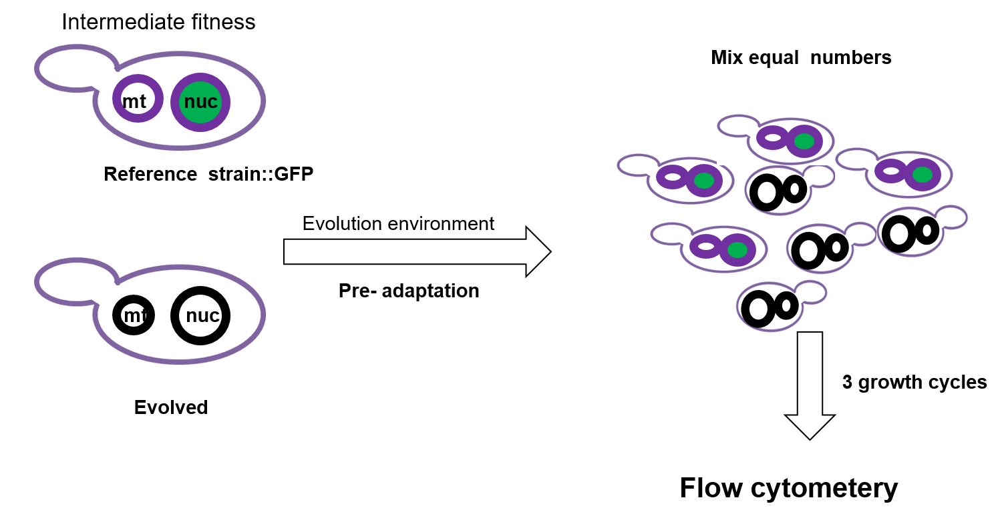
Relative fitness detection
Measure fitness changes over time :

Slide 9
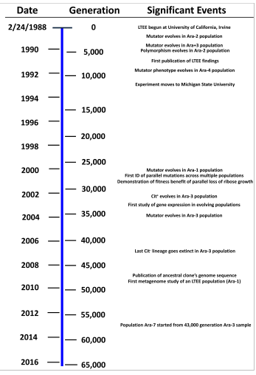
Long- Term Evolution Experiment (LTEE)
Lenski lab

Slide 10
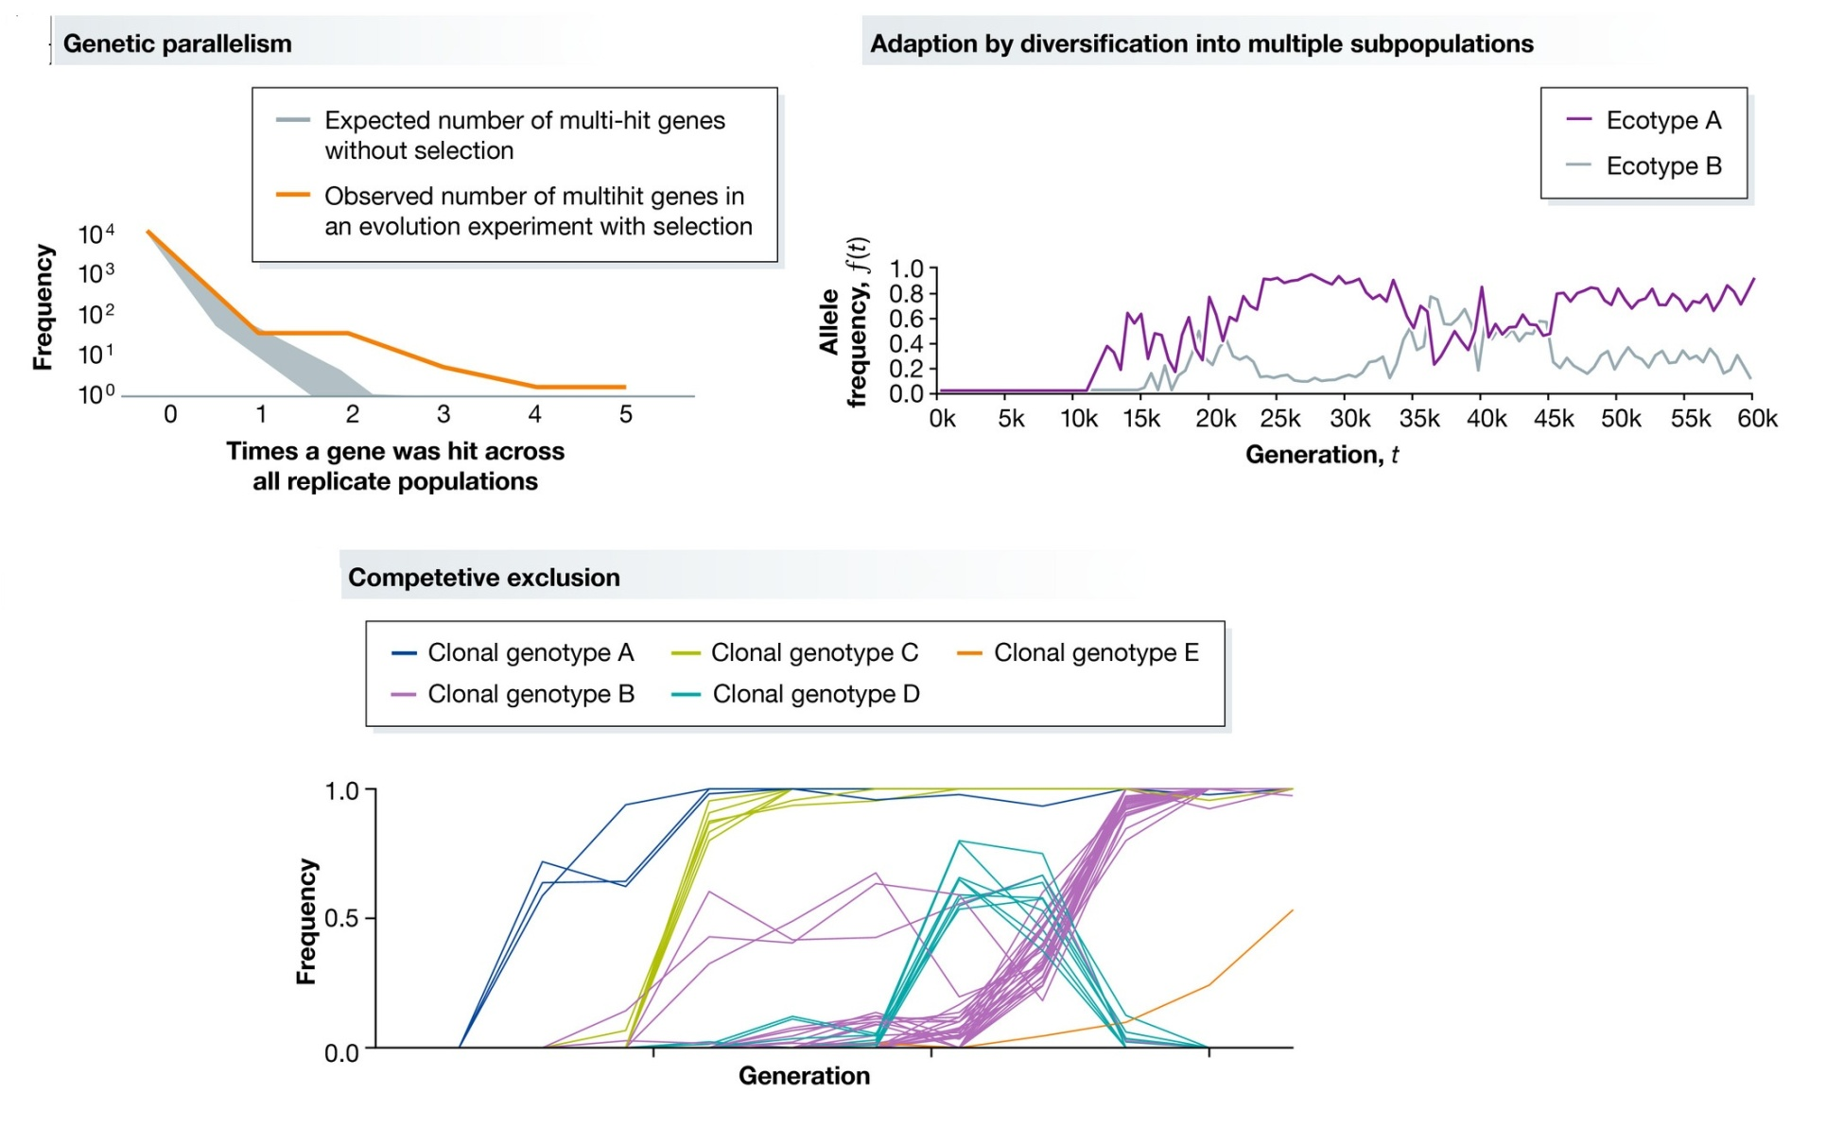
Some aspects revealed by LTEE
McDonald etal., 2019

Slide 11
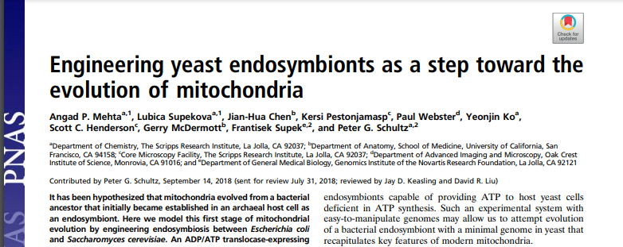
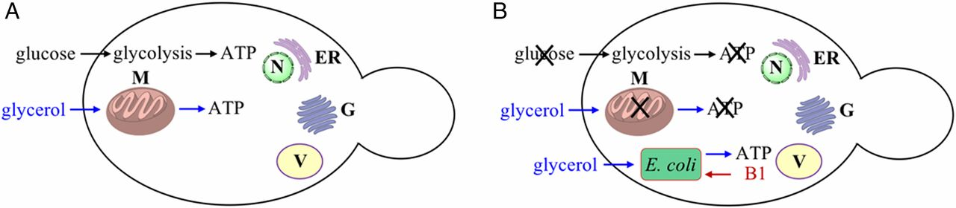
Experimental Evolution as a study tool
How organelles evolved ?
Mitochondria : endosymbiosis
B1: thiamin diphosphate (vitamin B1)

Slide 12

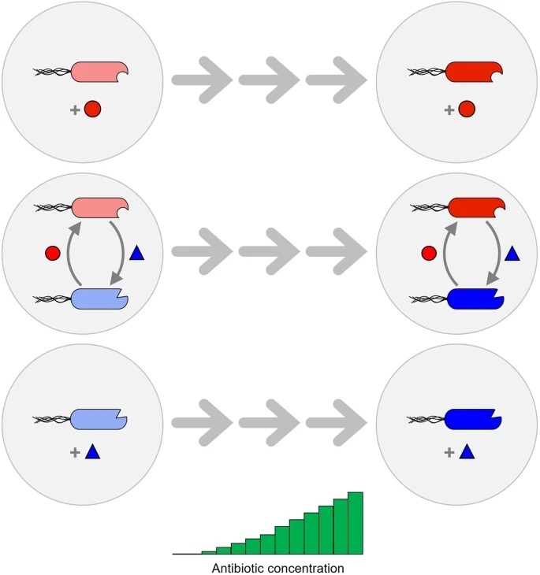
Experimental Evolution as a study tool
Process : Mutualism and how it affect adaptability
Δ trpB
Δ tyrA
Ampicillin
Kanamycin
Chloramphenicol
Tetracycline
100 µM tryptophan
100 µM tyrosine

Slide 13
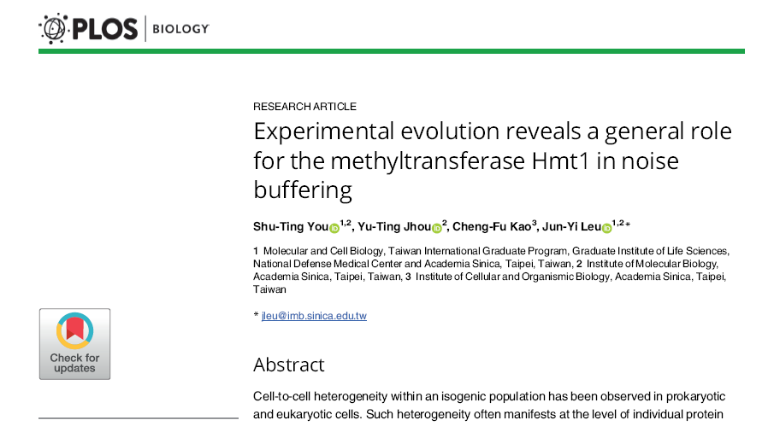
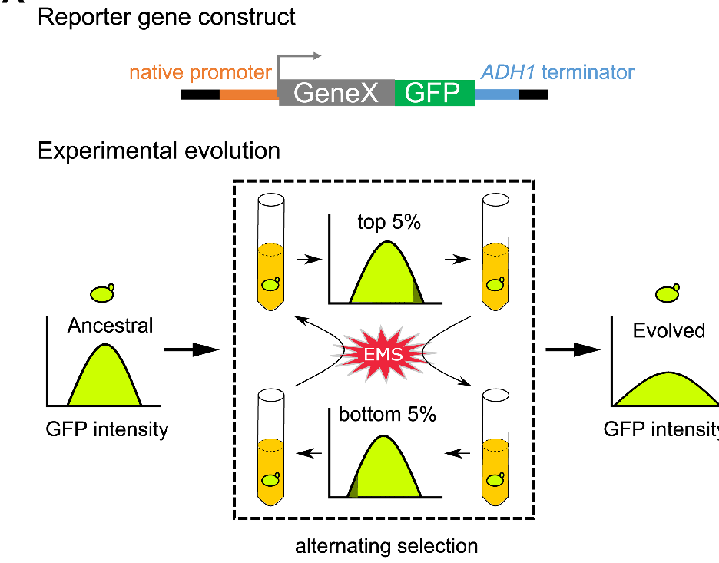
Experimental Evolution as a study tool
Process: Noise regulation

Slide 14

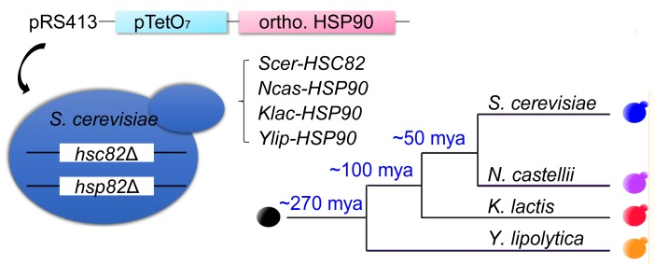
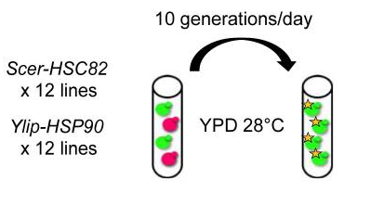
Experimental Evolution as a study tool
Gene swap
Understand functional conservation
Evolvibility

Slide 15
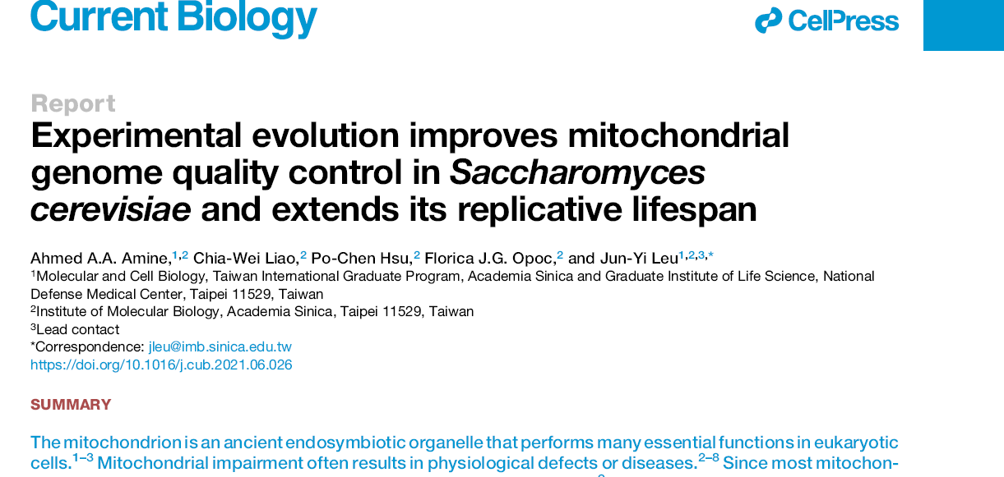
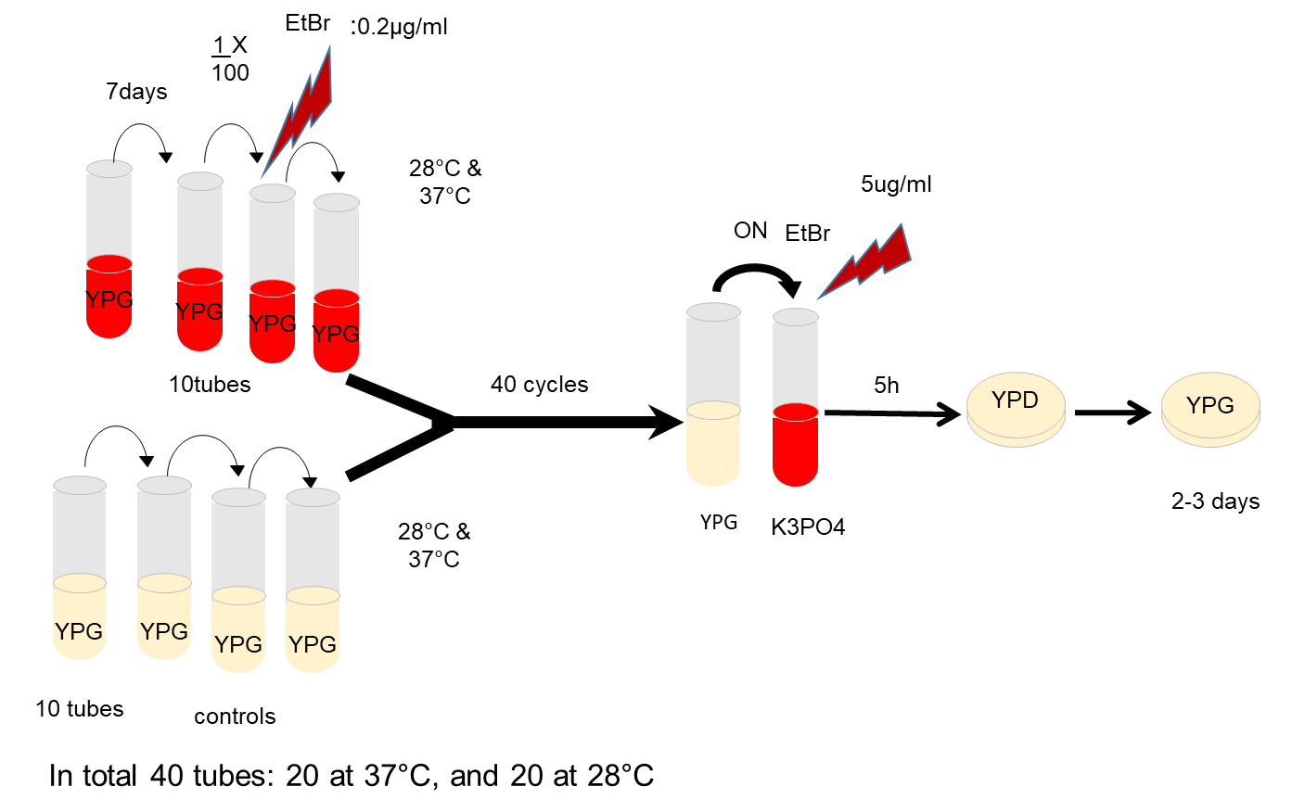
Experimental Evolution as a study tool
Evolutionary repair
Alternative solutions
Time scale required

